Slide 1
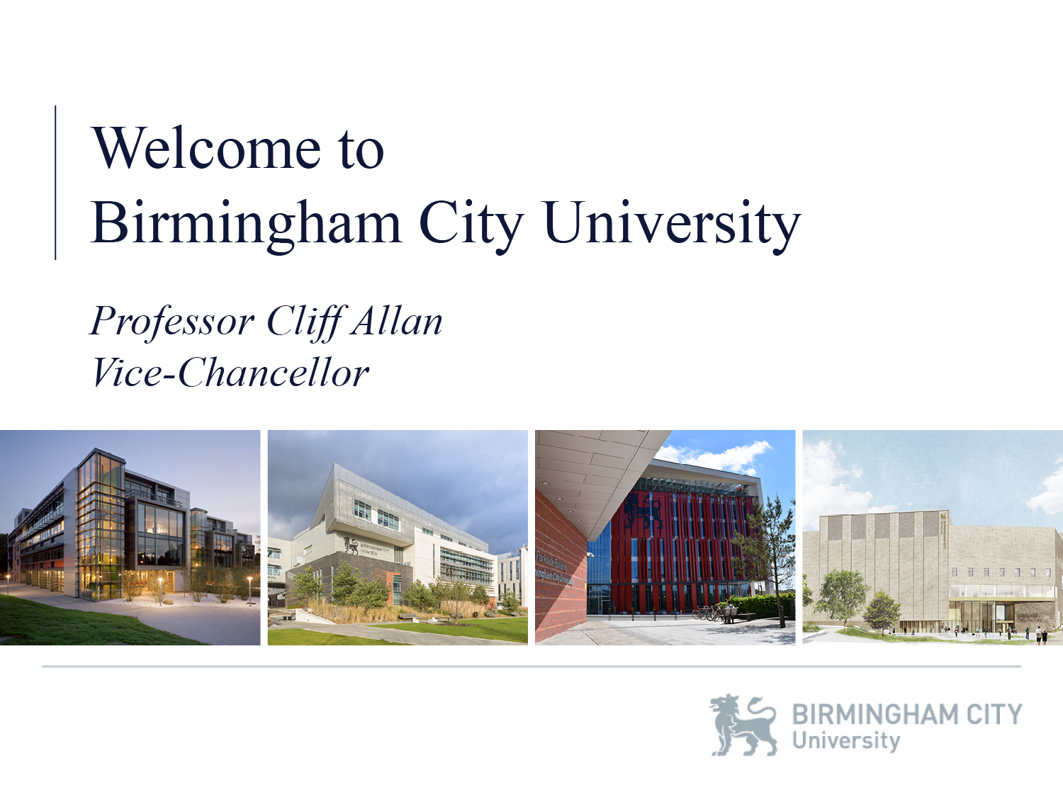
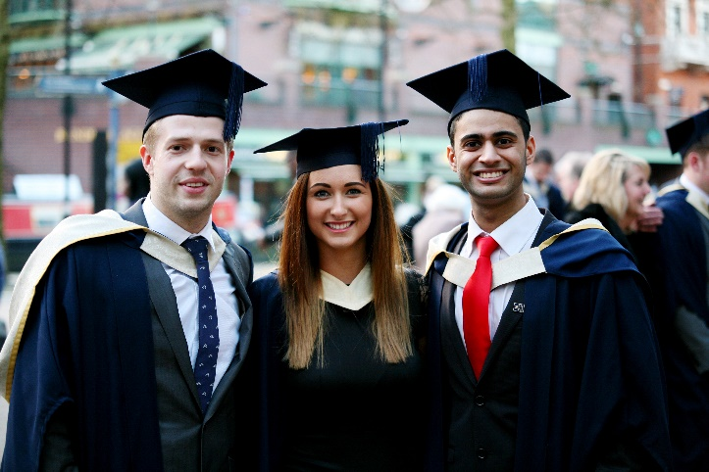
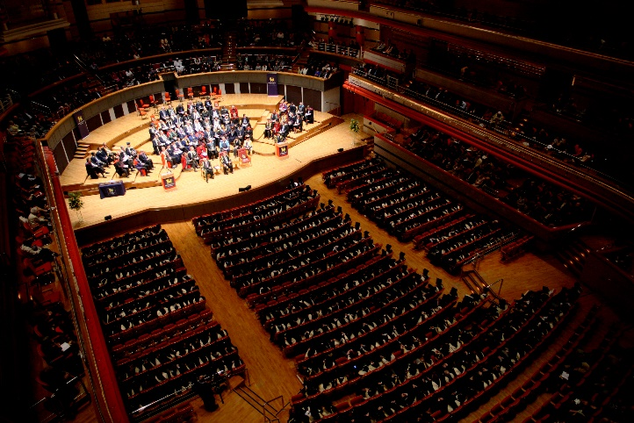
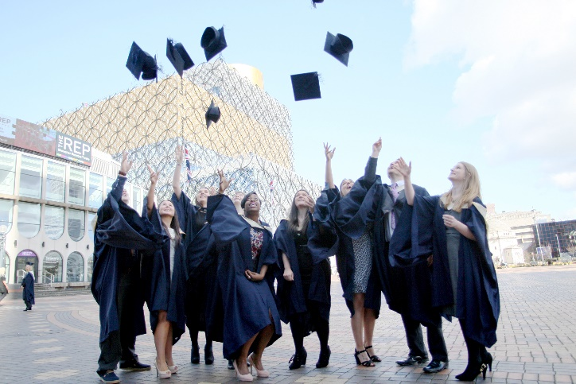
Antony Bounds
Deputy Director, Recruitment and Admissions
Notes:
Welcome
Welcome to Birmingham City University. My name is Antony Bounds, I am Deputy Director of Recruitment and Admissions and the schools and colleges liaison service, which you all deal with, forms part of my remit. I am pleased to be giving this welcome talk to so many of you today.
Your role
You all have an extremely important role. Your students look to you for advice and guidance as they try to make their choice of university. By the end of the day we want to make sure that you feel that you have enough knowledge of BCU to go back to your schools and colleges and tell your students about how studying here can have a positive impact on their lives.

Slide 2
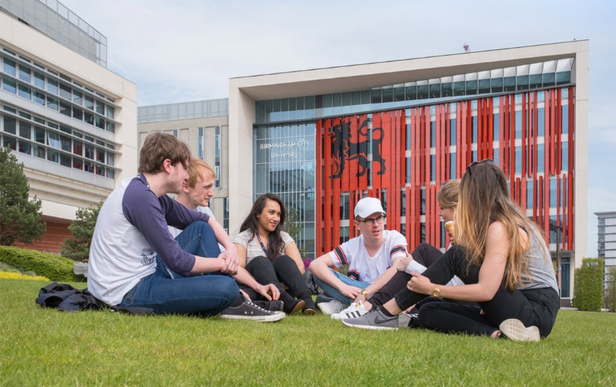
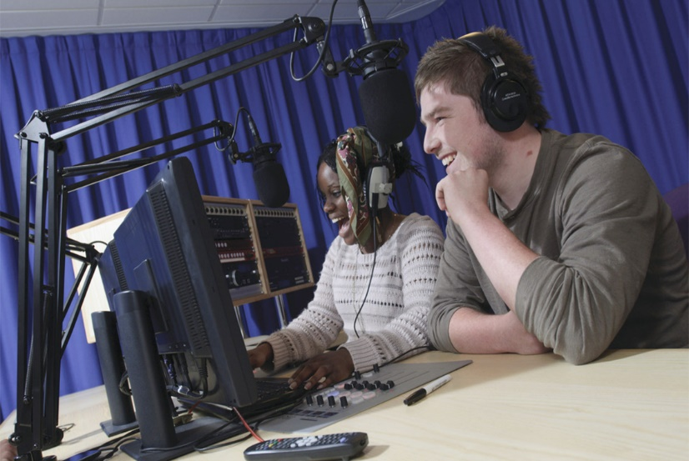
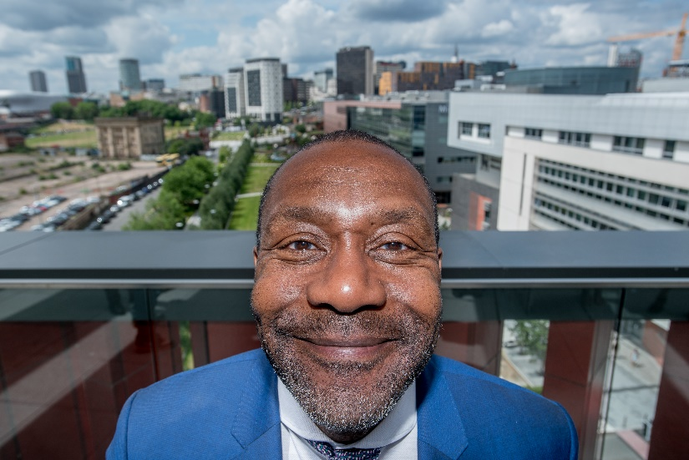
Our University:
A unique experience
CHANGE PIC
CHANGE PIC
CHANGE PIC
Notes:
About BCU
Here at BCU we have 24,000 students, from over 80 countries … a 1,700-strong team of teaching staff to give our students the very best possible experience while studying with us
We have a huge emphasis on applied learning –we don’t just teach our students the theory but we also give them the opportunities to practise what they learn – working with businesses and ensuring all our programmes use real world examples so our graduates are as ready as they can be for the world of work from the day they graduate.
It’s why we do so well when it comes to the impact of our research – 90% considered to have outstanding or very considerable impact socially and economically
It’s also one of the big reasons why 94% of our graduates are in full time work or further study six months after graduating
Our determination to ensure our graduates are ready not just for a job, but for the career of their own choosing, is why we have recently completely overhauled our curriculum to ensure we embed fundamental principles into every course we provide. Our work to transform the curriculum means we now have workplace learning and international opportunities built in to all our courses and at the heart of everything we do.

Slide 3
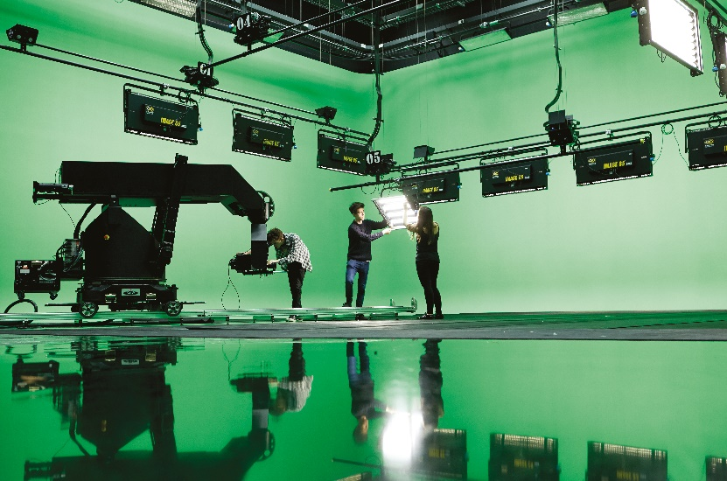
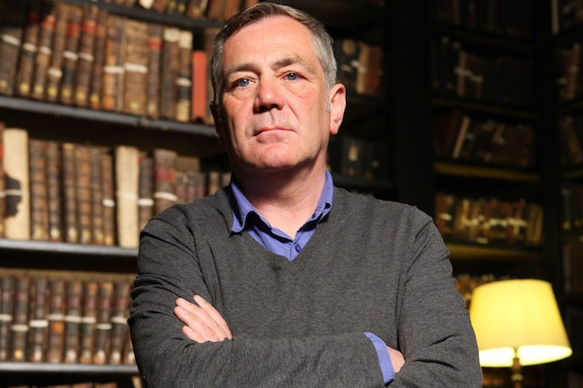
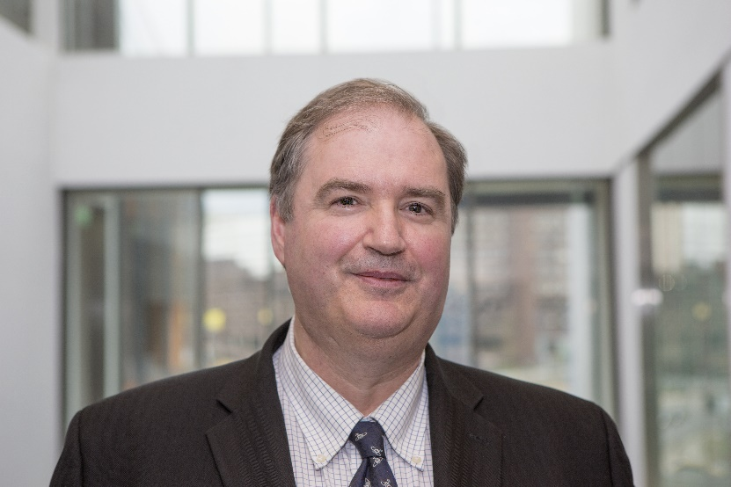
Our University:
A special place
Notes:
What’s so special?
PEOPLE:
Our students are taught by people who live their research. We have Julian Lloyd Webber, head of the Conservatoire, or, as you can see there, Professor David Wilson, one of our criminologists, who featured prominently in TV programmes such as ITV’s Bring Back Borstal.
They aren’t just significant figures in their own fields though, but also a huge part of the teaching experience that our students have here.
We are also about to enter a new phase of development under the leadership – from September – of Professor Philip Plowden, who will join us as our Vice Chancellor. He is currently Deputy Vice Chancellor at the University of Derby where Professor Plowden has delivered a step-change in academic quality, with the institution’s league table rising from 91st to 48th. You may also be aware that Professor Bashir Makhoul, our Deputy Vice Chancellor Academic has taken up the role of Vice Chancellor at the University of the Creative Arts and left the institution recently.
FACILITIES:
The facilities we provide are of a quality that makes learning a real pleasure – such as our Green Screen in the Parkside Building next door – one of the largest in the UK, and our computer networking facilities which are among the best in all of Europe. Our lawyers too, are taught in a replica courtroom – constantly practising their craft in a real world setting.
ALUMNI:
And then there is the success of the people who come and study here and then go and make their mark on the world
A dotcom billionaire in California, a lawyer who helped free an innocent women from a death sentence in Sudan and Lily Pebbles, whose fashion vlogs are seen by a million YouTube viewers every week.
Employers know what our graduates offer too, and have an idea of what ‘the BCU Graduate’ can give them. There are no shortage of examples – Jaguar Land Rover, Sky News, Birmingham Women’s Hospital … they’re among countless employers who know that a BCU graduate delivers what they need.

Slide 4
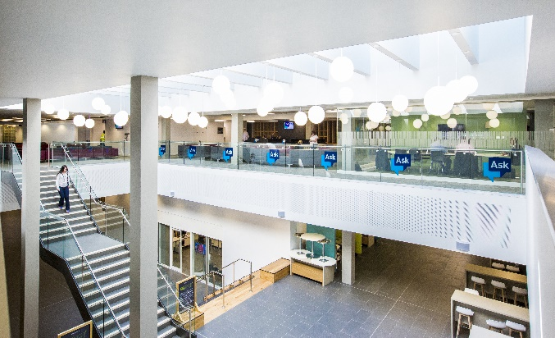
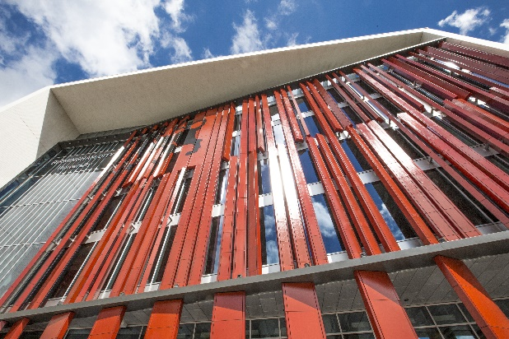
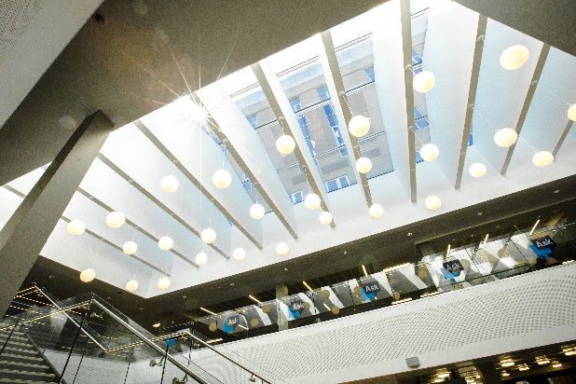
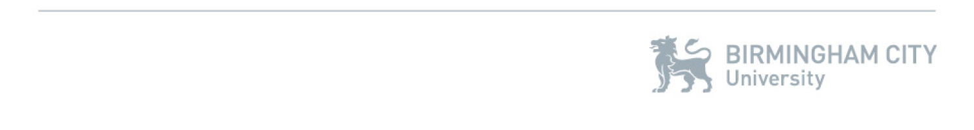
Our University:
Transforming Birmingham
Notes:
BCU’s impact on the city
I talked about our facilities but I also want to say something about our remarkable new campus here at the heart of Birmingham. Just as Birmingham as a city is changing before our eyes, so our University is a massive part of that transformation …
We have literally picked up this unloved and uninspiring quarter of Birmingham’s City Centre, known as Eastside, and made it what you can see today – go and stand in the City Park outside and look around you, or go to the top floor of the Curzon Building and look out across the city …

Slide 5
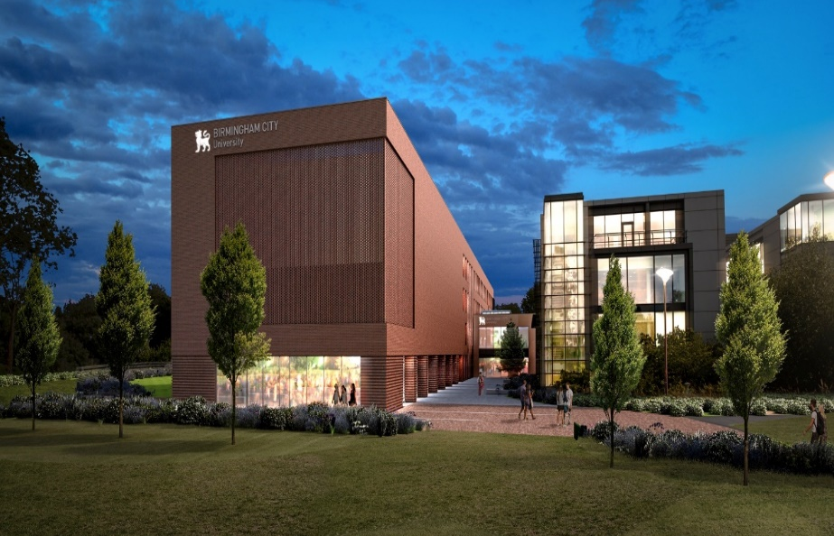
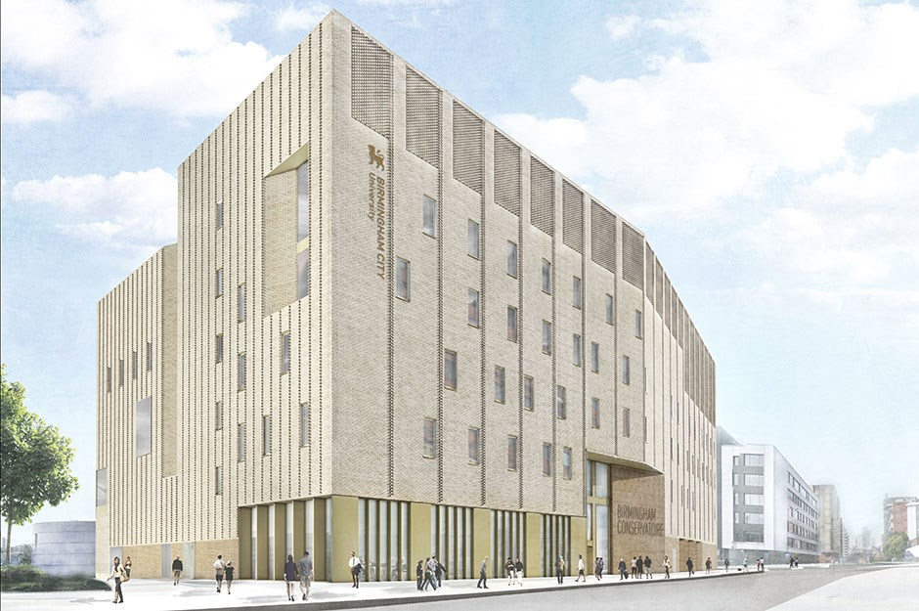
Our University
New homes for our talent
Notes:
City South & Conservatoire
And it isn’t just here at Eastside that we’re making changes to our estate that will give our students the very best environment in which to study … we’re also investing massively in our other major campus, in Edgbaston, called City South.
On the left you can see our new building at City South, which we aim to open next year – this will give us a new home for our School of Education and to our completely new School of Health Sciences … creating the professionals of tomorrow who will support the health and wellbeing of our region in the years to come
On the right is our genuinely state of the art new Conservatoire – here on this campus, where from next September we will be teaching our talented music students everything they need to take their place in the contemporary creative arts economy.
It’s all part of a £260m spending programme

Slide 6
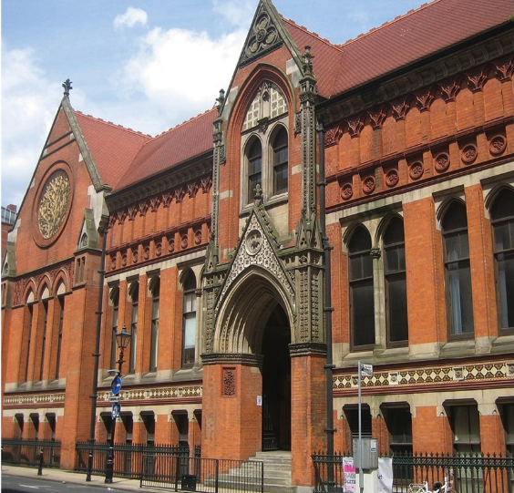
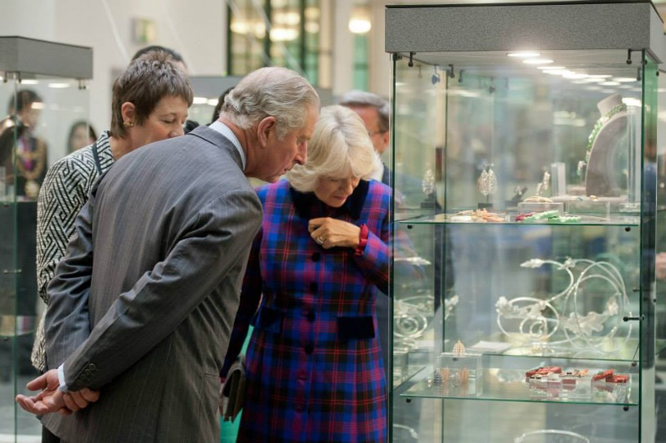
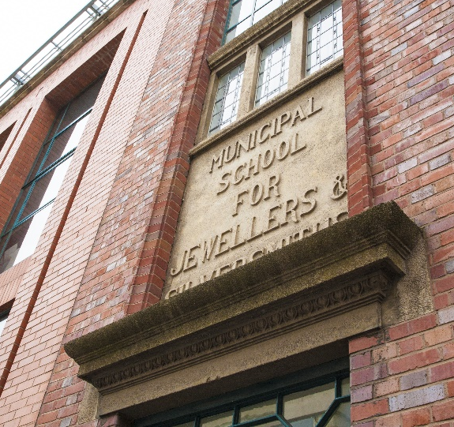

Our University
21st century meets industrial heritage
Notes:
Embedded in City’s history
But just as we’re promoting and leading change at the heart of this great city, we are also marrying change with a wonderful history.
So just as Birmingham has its gleaming new buildings, exciting 21st century architecture like the new Library, so too it has its wonderful Victorian history.
And it is the same for us.
Just as we have this wonderful new campus, so too we can trace our roots back as far as 1843, with the founding of the Birmingham Government School of Design.
And only last year our School of Jewellery celebrated its 125th anniversary … showing how, like the city around us, BCU is a marriage of the timeless strength of our industrial heritage and the modernity of a fast paced 21st century city that is changing by the day

Slide 7
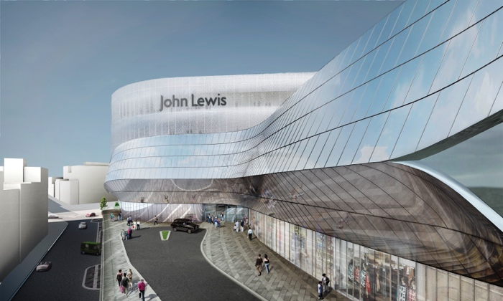
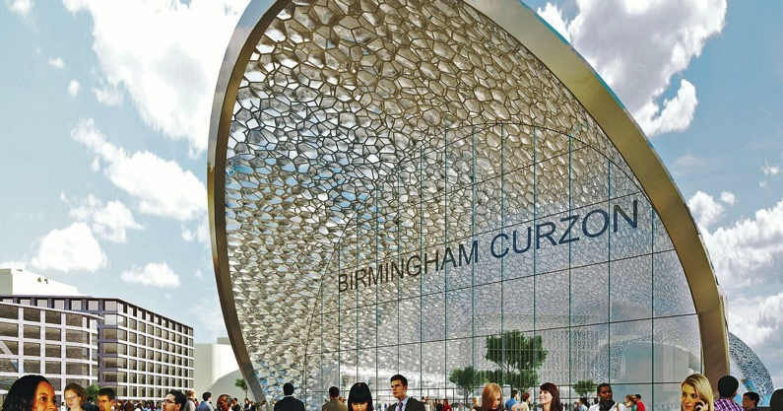
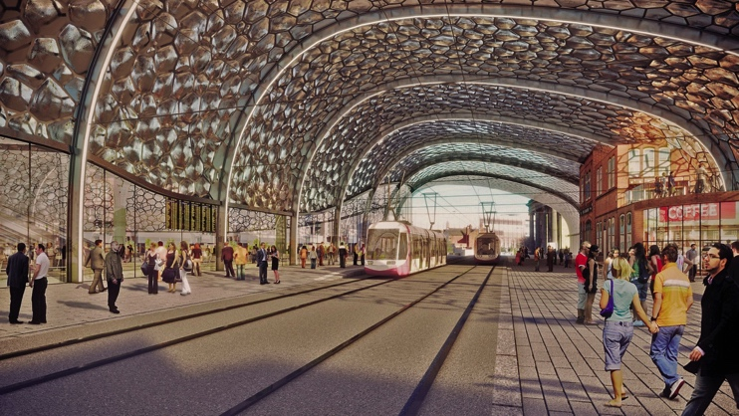

Birmingham –
a city of constant reinvention
Notes:
The changing face of Birmingham
I have mentioned the change taking place in Birmingham more broadly and just want to come back to that for a brief moment
Some of you may be from Birmingham or the wider region. Whatever the case, you may know or have heard that this is a very different place to the one it used to be.
Just take a look at some of the images above…Grand Central, and the amazing new station planned for HS2 just outside this building. Major employers are flocking here too – HSBC, Deutsche Bank, accountancy firm Mazars, HS2.
Walk around Birmingham today and the economic and cultural renaissance is palpable. This city is changing before our eyes, the skyline is transforming and attitudes – of those of us who live here and those visiting – are developing in sync.

Slide 8
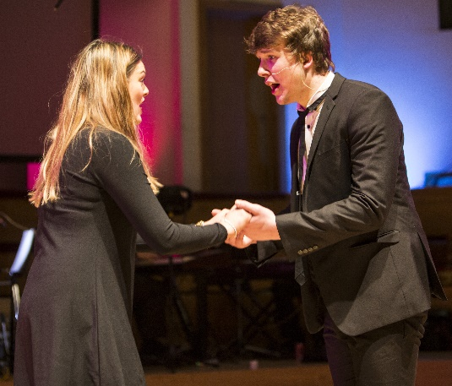
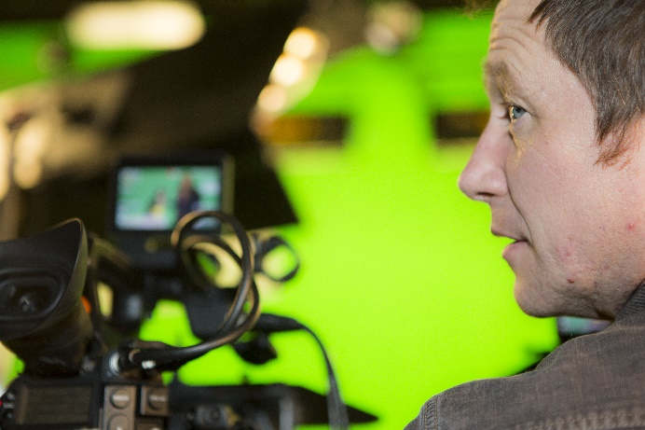
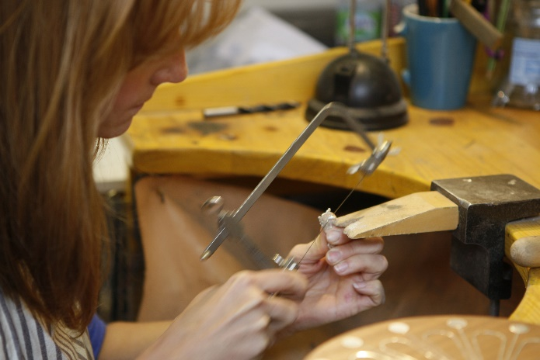
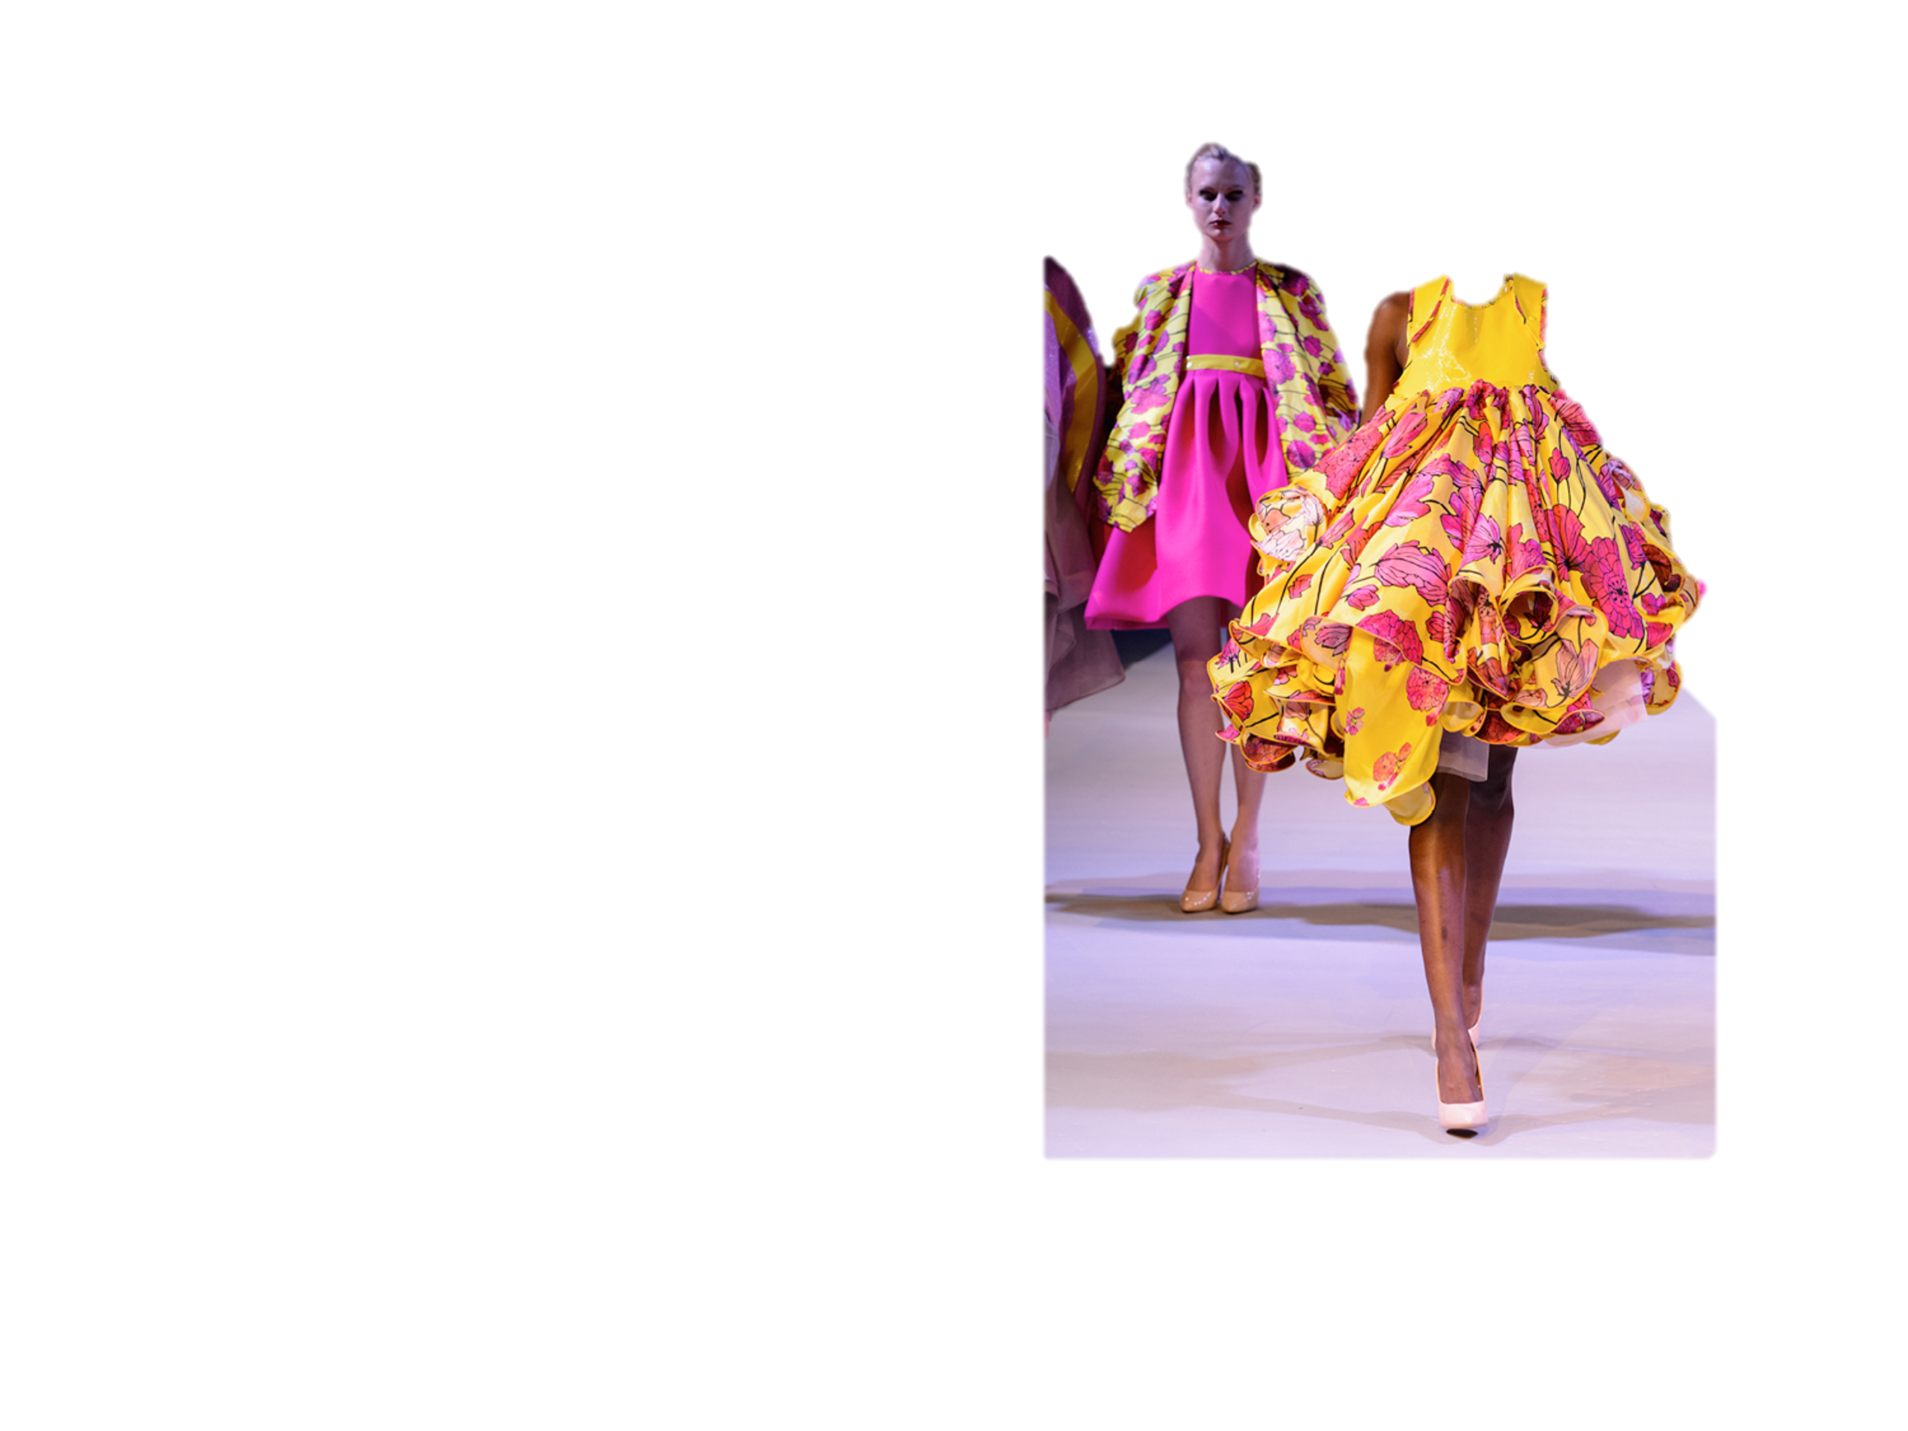
Your future
career
Graduate+ and ‘OpportUNIty’ for all
Notes:
I have told you about how we embed real world practice into our curriculum but I also want to mention two other powerful initiatives here at BCU that help make students ready to make a mark on the world when they graduate …
Graduate +
GRADUATE + is our undergraduate continuing professional development programme for all students
It starts with an online personal development test, which produces an individualised report for each student to show strength and development gaps in terms of their employability
Through special workshops and a points based model leading to a Graduate + award, the University will then help each student to develop to the point where they are as employable as it is possible to be on graduating.
OpportUNIty
And as if that isn’t enough, we also give our students actual jobs, real work through our OpportUNIty programme – a scheme through which they work for the University while they are studying here – something well over 1,200 of our current students have been able to do, gaining real world experience and some useful income too.

Slide 9
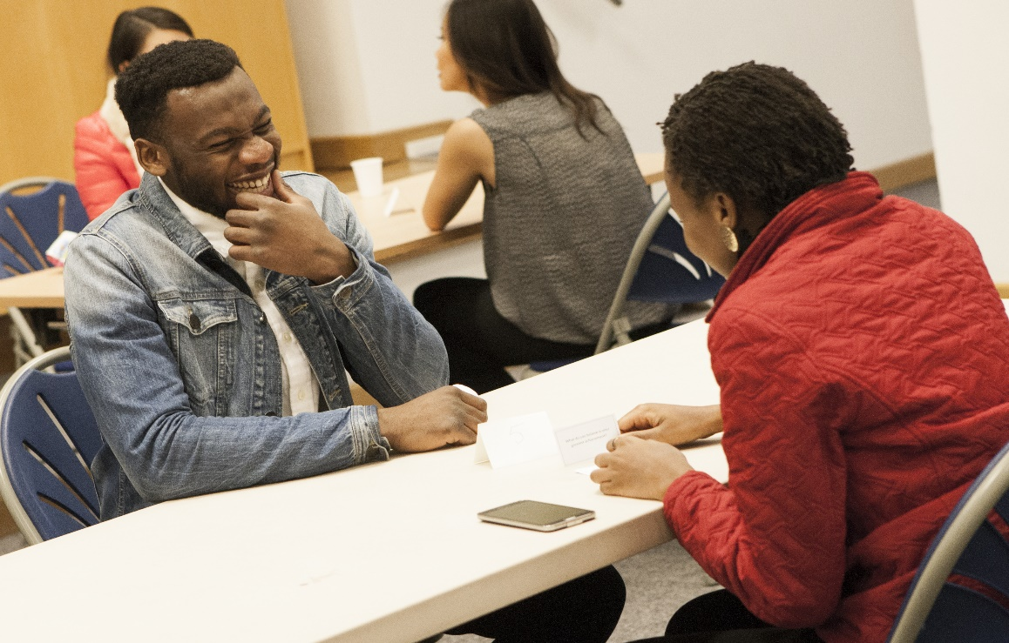
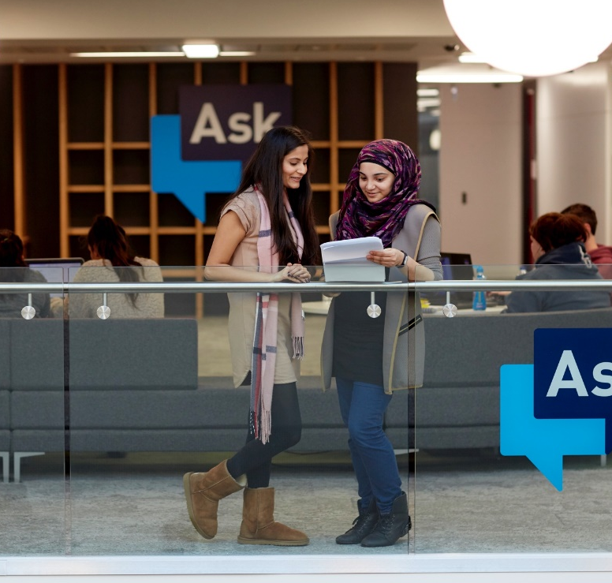
The University
Care and support
Notes:
BCU is an exciting place to study and we are right in the heart of an incredibly exciting and vibrant city. Many of our students grab every opportunity with both hands and enjoy every aspect of their time with us.
But we know there are times when people need a bit of support, with either their studies or general wellbeing, and so I would also like to just touch on some of the care and support we offer to all our students…
We have a super Student Affairs Team on hand for any and every concern our learners might have – there aren’t many issues or problems that they haven’t come across before and know how to deal with.
Personal tutor
Our students’ academic needs are fully supported too, as each student has a personal tutor allocated to them to help with whatever course problems, or wider concerns they might have.
ASK
And then we have our state of the art student enquiry service, ASK, responsible for managing whatever queries or concerns a student might have. This service is available to students all across the University, and online too, with the ambitious strapline of ASK Us Anything.

Slide 10

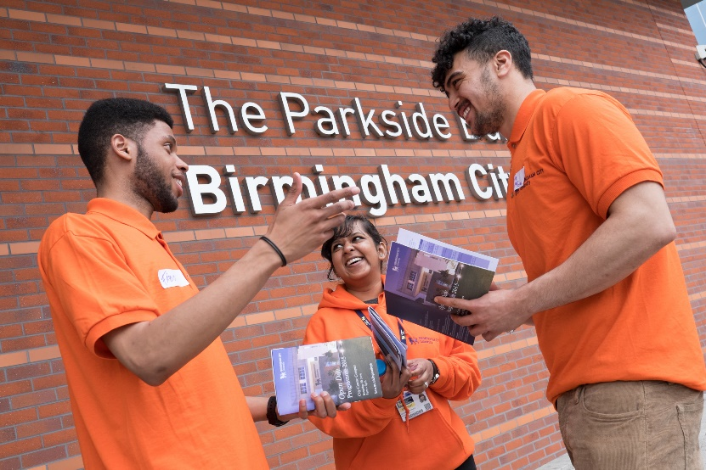
The University:
Working with you
Notes:
Our offer to Schools and Colleges
As you will know by the fact you’re with us today, we offer a wide range of opportunities to attend events or have us come and speak at your own institutions.
We are always keen to work more closely with you and we offer:
Talks and workshops on a wide range of subjects – delivered by staff and student ambassadors.
We provide resources for students (Think Higher, revision guides and workbooks)
We attend at careers fairs and information events
We deliver on-campus Taster Days and Masterclasses
And of course, you’ll find us at UCAS events – such as Birmingham UCAS at the NEC on 12 & 13 June 2017

Slide 11




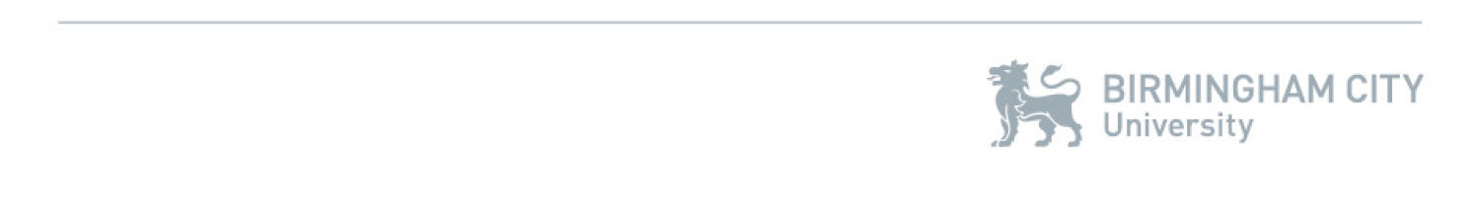
Find out more…
www.bcu.ac.uk
Course Enquiries Team 0121 331 5595
/birminghamcityuniversity
/MyBCU
Have a great day!
Notes:
Today you will be hearing from faculty leads in more detail about what we have to offer your students.
I hope that my presentation has set out how BCU has transformed into a dynamic, modern institution at the heart of a growing city.
I know that we have a packed and exciting programme today, so if anyone has any questions I’m around for most of the day and happy to catch up with you in person.
Please enjoy the rest of your day with us at Birmingham City University.
Thank you.
Final screen as people leave …

