Slide 1
A Career in Real Estate: Where Can it Lead You
Professor David M. Higgins
of 20
Notes:
Thank you for the invite to speak
Coverage in 3 areas
What is Real Estate - 6 slides
Real Estate Career Opportunities - 6 slides
BC Real Estate Undergraduate program - 6 slides
Information on David Higgins
- Orginally from the UK
- Spent the last 25 years in New Zealand and Australia industry and academica

Slide 2
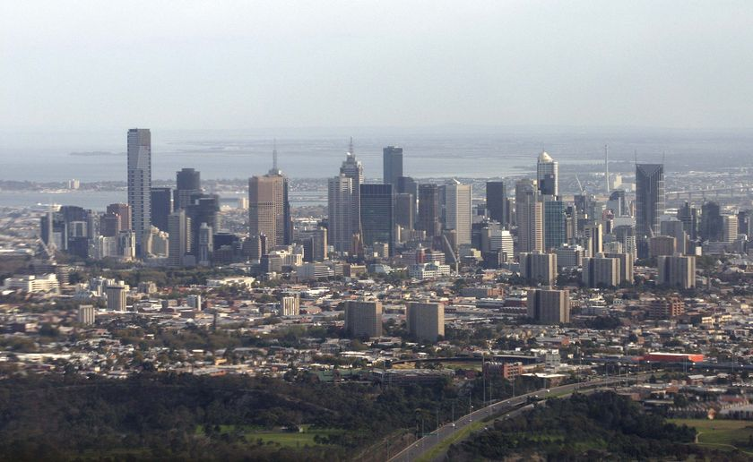
Real Estate – What is it?
Housing: family home, high rise apartments
Commercial buildings: offices, shopping centres, warehouses
Community facilities: hospitals, prisons, retirement villages, childcare centres
Entertainment facilities: amusement parks, marinas
Sport facilities: golf courses, sport stadiums, swimming pools
Rural: cattle and arable farms, wineries, tree plantations
Infrastructure: airports, port, rail, universities, schools
of 20
Notes:
Property – What is it
– There are many different property types
Residential Property
Housing: family home, High rise apartments
Core Property
Commercial buildings: offices, shopping centres, warehouses

Slide 3
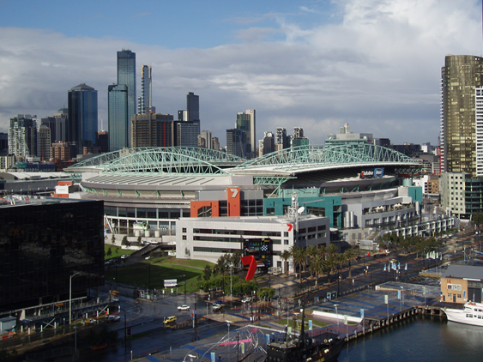
Real Estate – What is it?
Housing: family home, high rise apartments
Commercial buildings: offices, shopping centres, warehouses
Community facilities: hospitals, prisons, retirement villages, childcare centres
Entertainment facilities: amusement parks, marinas
Sport facilities: golf courses, sport stadiums, swimming pools
Rural: cattle and arable farms, wineries, tree plantations
Infrastructure: airports, port, rail, universities, schools
of 20
Notes:
Property – What is it
– There are many different property types
Non Core Property
- Community facilities: hospitals, prisons, retirement villages, childcare centres
- Entertainment facilities: amusement parks, marinas,
Sport facilities: golf courses, sport stadiums , MCG, Etihad stadium
Rural: cattle and arable farms, wineries, tree plantations
Infrastructure: Airports, Port, Rail, Universities, schools
Talk about actively managed the asset – Physical, Occupier and Financial

Slide 4

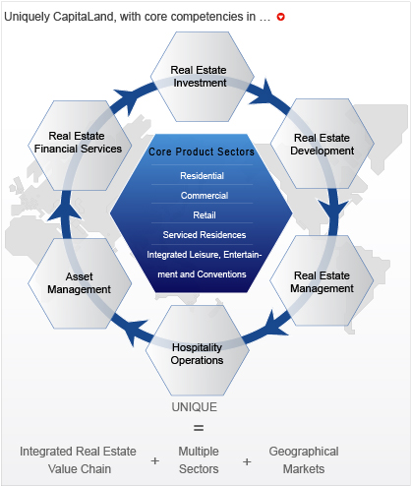
Real Estate – What is it?
Example:
Leading Global Real Estate Company
CapitaLand Group (Singapore)
Properties held in different investment structures
Investors:
- Large Pension Funds
- Sovereign Wealth Funds
- Institutions
- Retail Investors (you and I)
Source: CapitaLand 2014
of 20
Notes:
Large Asian Property Company (Headquarters in Singapore)
Major property assets across Asia
Offices and Reatial in Australia - Cornerstone investor
China – Capitaland Retail Trust – Shopping Centre ie a fund quoted on the Singapore stock markets that has properties in China
Note slide
Locations across Asia
Specialize types
Residential
Commercials – offices
Retail – shopping Centres
Service apartments – hotels
Note services offered
Start at Real estate development
Recently floated property fund in Malaysia
Focus now on developing countries – ie China, and Brazil selling down mature property markets - Australia

Slide 5

Real Estate Career Opportunities
Real Estate Asset Management
Real Estate Funds Management
Real Estate Valuation
Real Estate Development
Real Estate Transactions
- Sales and Leasing
Real Estate Research Analyst
Real Estate Consultancy
of 20
Notes:
Wide coverage of opportunities
Historically 3 main areas
Owning real estate
Real Estate Asset Management
Real Estate Funds Management
Developing real estate
Real Estate Development
Real Estate consultancy
Real Estate Valuation
Real Estate Transactions - Sales and Leasing
Real Estate Research Analyst
New Area Corporate Real estate
acting for the occupier

Slide 6
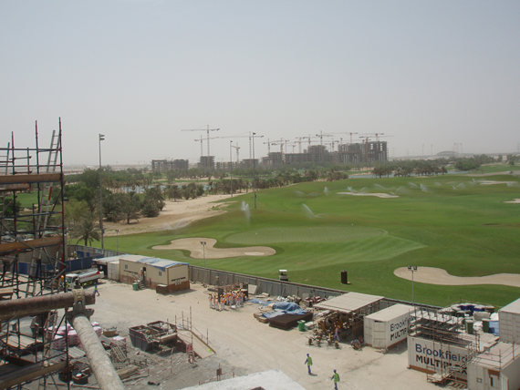
Property Developer
Real Estate Development
  - Site selection / location analysis
  - Feasibility / Finance
  - Planning approval process
  - Construction
  - Tendering through to completion
  - Marketing/Disposal
  - Sustainable development
of 20
Notes:
Property Development
3 Knowledge Areas
Feasibility
Coverage these aspects
- Site selection / location analysis
- Feasibility / Finance
Planning approval process
Construction
- Construction
Tendering through to completion
Disposal
- Marketing/Disposal
Important area is
Sustainable development
(What is good design, building products selection)

Slide 7
Property Valuer
Valuations
What is the asset worth in £ ($) terms
Unlike other asset classes there is no central trading place, so very difficult to place a value on a property asset.
Required for
  - Acquisition (buying) and disposal (selling) of existing property
  - Land development – How much should I pay for the block of land
  - Upgrade of property – should I do it? Is it financially worthwhile?
  - Statutory requirement – taxes, insurance etc
of 20
Notes:
Valuation
Unlike other asset classes there is no central trading place, so very difficult to place a value on a property asset.
Need a valuation for several reasons - purchaser and bank
Talk about different valuation approaches – normally for a commercial building Valuer required to provide 3 approaches in a valuation report
- Comparable evidence
- DCF Discounted cash flow – future performance
- Replacement value

Slide 8
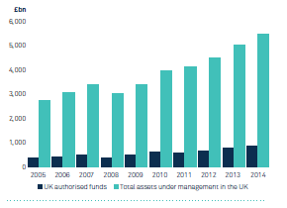
UK Fund Management
Real Estate Fund Manager
Source: Investment Association 2016
of 20
Notes:
UK Fund Management
Light blue - all UK funds under management.
Dark blue – retail funds which retail (mum and dads investors) can invest in
Growth in large pension funds – public, industry and company pension funds
Now approx. £6 trillion under management
UK £6 trillion Globally £52 trillion - 2020 £88 trillion PWC

Slide 9
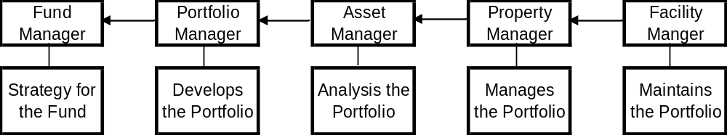
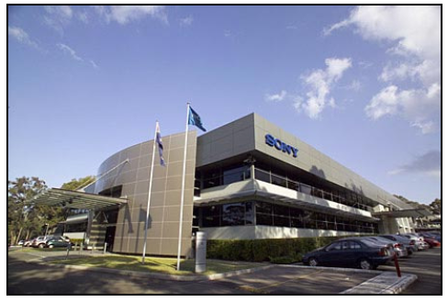
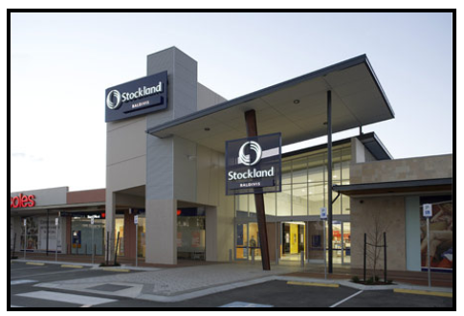
Real Estate Fund Manager
Real Estate Investment Markets
  - Management roles and responsibilities
  in the real estate investment sector
of 20
Notes:
Real Estate Investment Market
Investors now over £483 billion of the UK's commercial property
– Leading assets owned by property funds (which you and I can invest in) – example Birmingham Bullring – Hammersons
- Look at graduates entering industry– Leading assets owned by property funds which you and I can invest in – example Jones Lang LaSalle
Organisation Structure – career opportunities
Manage the Physical asset
Manage the Property fund
- Look at graduates entering industry

Slide 10
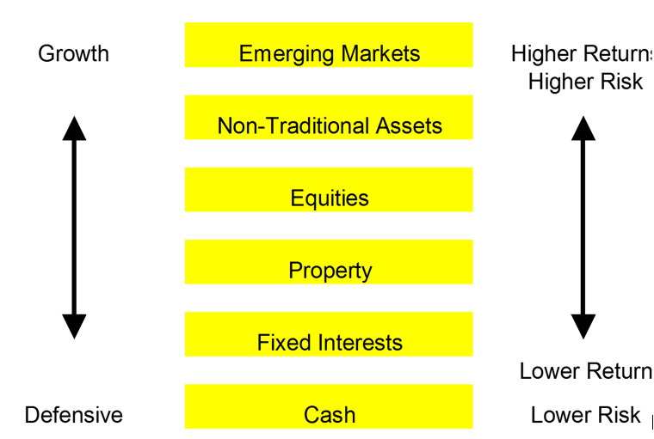
Real Estate Fund Manager
of 20
Notes:
Investment asset classes features
Investors requirements depends on individuals risk return profiles
- profile for a 20 year old is different for a 60 year old etc
Performance – Increased returns increases the risk
Investment profile
– defensive income return focus
– growth, capital return focus

Slide 11
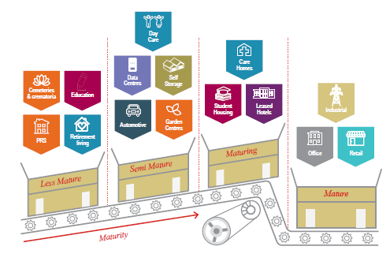
Future Real Estate Opportunities
Maturing Real Estate Asset Classes
Source: JLL 2016
of 20
Notes:
Types
Non Core Property
- about 50% of the property universe (hospitals, sport stadiums etc)
– Major investors participating in new developments
- higher returns with high risk
– Asset pricing challenges – ie marinas
– 3 key categories –even see companies called by these names ie ING Community Living Trust, Macquarie Entertainment Property Trust
– Community facilities: hospitals, prisons, retirement villages, childcare centres
– Entertainment facilities: amusement parks, marinas, ten pin bowling centres - Australian Big Brother
– Sport facilities: golf courses, sport stadiums
- Sydney Olympic Stadium, prestigious new golf courses

Slide 12
Future Real Estate Opportunities – Going Global
of 20
Notes:
12
Growth of REITS
Where is China – will happen as other countries will take advantage offer operating platform and China properties

Slide 13

Why a Career in Real Estate
Exciting
Satisfaction of developing assets
Huge diversity in job prospects
Not in an office all day
Huge variety of skills required
Financial rewards
Internationally transferable skills
of 20
Notes:
Why Real Estate
Interesting and Challenging work
- Dynamic industry that is evolving with new ideas and approached
- Changing workplaces
- Supply Chain management - Distribution centres

Slide 14
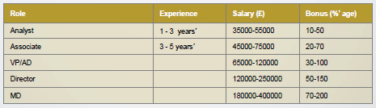
Why a Career in Real Estate
Real Estate Fund Management Salaries
Source: Michael Page 2016
of 20
Notes:
Salaries
Graduate earns £23 – 25,000pa
Analyst - £40,000pa depends when you become RICS qualified as salaries can increase by 30%

Slide 15
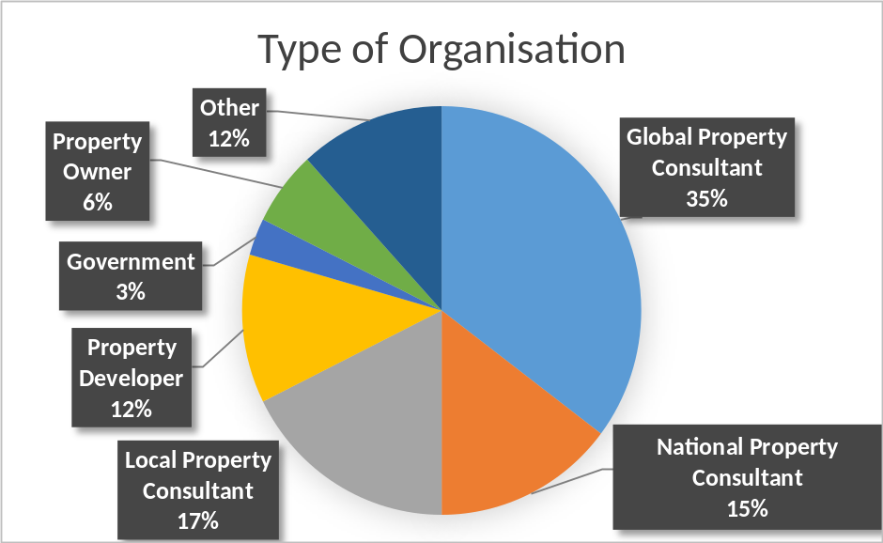
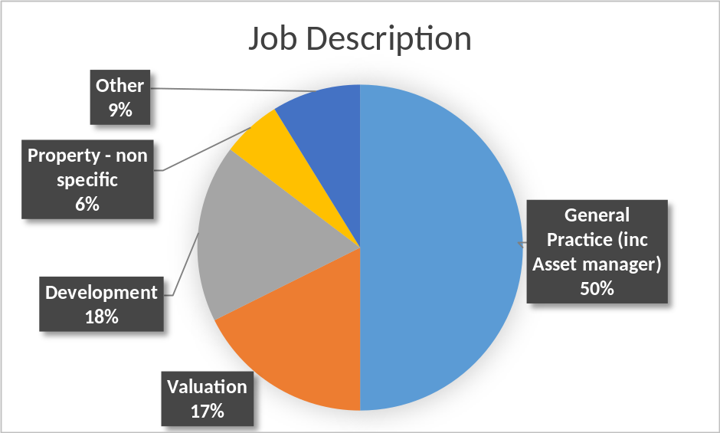
Bsc (Hons) Real Estate
(2011 – 2014)
Graduate Destinations
of 20
Notes:
Looked at survey responses when graduates leaving BCU
Jobs primarily located within 2 hour radius of Birmingham
Types of organisations
- Property consultants 67%
– leading global property firms
Job Description
- General Asst manager – loose term which covers Property assert manager – managing the physical property

Slide 16

Bsc (Hons) Real Estate
Royal Institution of Chartered Surveyors
Accredited Program
Once you have completed an accredited degree the next stage is to get a job as a trainee surveyor. In order to become chartered you need to complete your Assessment of Professional Competence (APC) which involves completing a period of structured training with an employer. Structured training usually takes between two and three years and consists of on-the-job learning and assessment.
Source : RICS 2017
of 20
Notes:
Bachelor of Applied Science
Honours degree Three year program
Peak industry body Royal Instruction of Chartered Surveyors
Three year accreted degree and 2 year work experience
- diary
- report
- interview
1

Slide 17
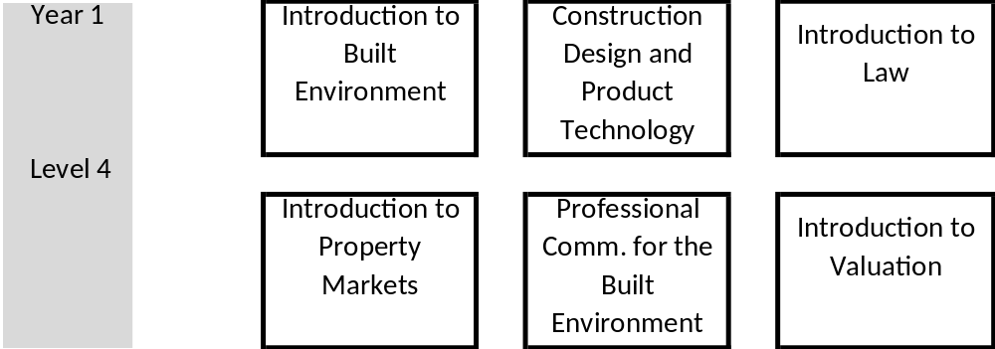
Bsc (Hons) Real Estate Year 1
All modules subject to change
of 20
Notes:
Bachelor of Applied Science
Honours degree (Property and Valuation)
Three year program
Year 1 – Key modules with other built environment courses
Introduction to property
Coverage across Property, Construction and project management programs
Plus important course Professional Communication

Slide 18
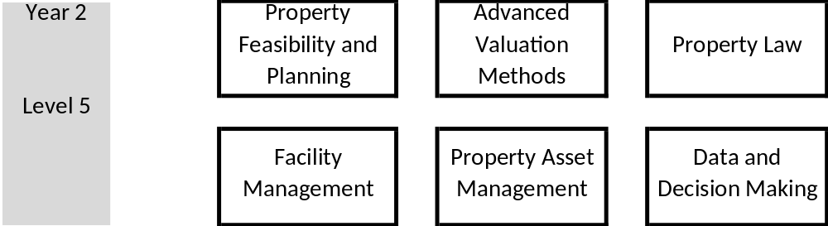
Bsc (Hons) Real Estate Year 2
All modules subject to change
of 20
Notes:
Bachelor of Applied Science
Honours degree (Property and Valuation)
Three year program
Year 2
- Covering Theory and application
Key areas of
Property development and planning
Key Valuation techniques - future performance discounted cash flow
Facility Management – building repairs and services
Landlord and tenant

Slide 19
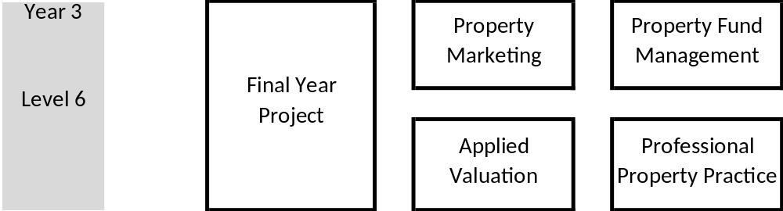
Bsc (Hons) Real Estate Year 3
All modules subject to change
of 20
Notes:
Bachelor of Applied Science
Honours degree (Property and Valuation)
Three year program
Year 3
Application
- Property Marketing
- Applying valuation techniques to difference property – retail premises, winery etc,
- Final Year Thesis – capstone project
Plus two important course Professional Communication and Sustanability

Slide 20
Summary
Location, location, location
– Location: geographically
– Location: in asset class
– Location: in time
– New 4th location : property investment product
of 20
Notes:
Property Market Structure
Location, location, location - real estate agent talk
– Location: geographically as the space market (occupier demand) is focused on a specific location
– Location; in asset class as the various property types are driven by different determinants
– Location: in time as property is cyclical with the rapid changes in the space market compared to the lengthy time line for new property supply market
– New 4th location : property investment product

Slide 21
Thankyou
Notes:
Thank you for the invite to speak
Coverage in 3 areas
What is Real Estate - 6 slides
Real Estate Career Opportunities - 6 slides
BC Real Estate Undergraduate program - 6 slides
Information on David Higgins
- Orginally from the UK
- Spent the last 25 years in New Zealand and Australia industry and academica

