Slide 1
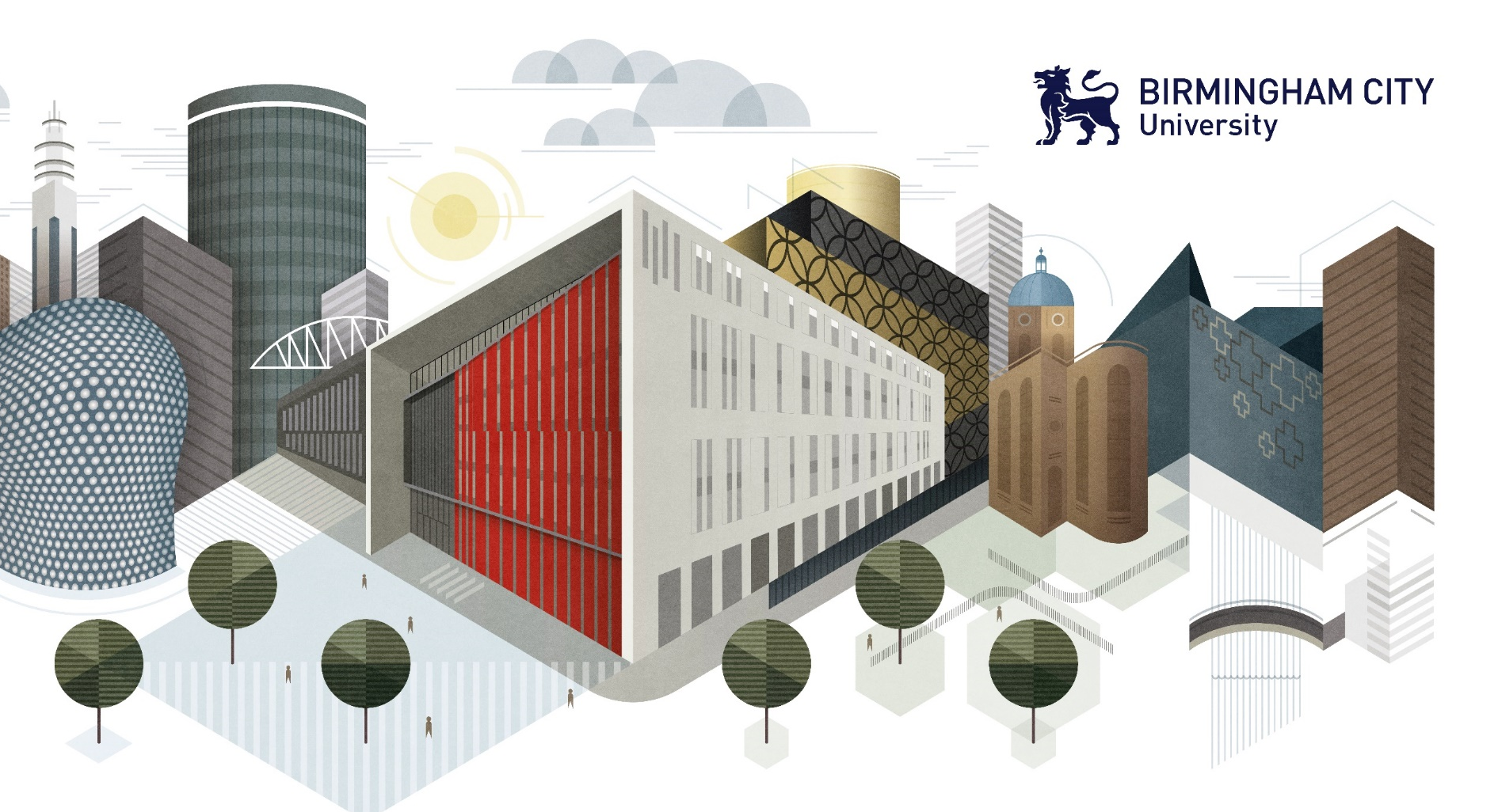
STUDY SKILLS
Notes:
Get students to get a piece of paper and pen before you start the presentation.
We all have different ways to study and revise. This presentation will outline different methods – some may be familiar and others you may not have come across. But they may be worth a try.

Slide 2
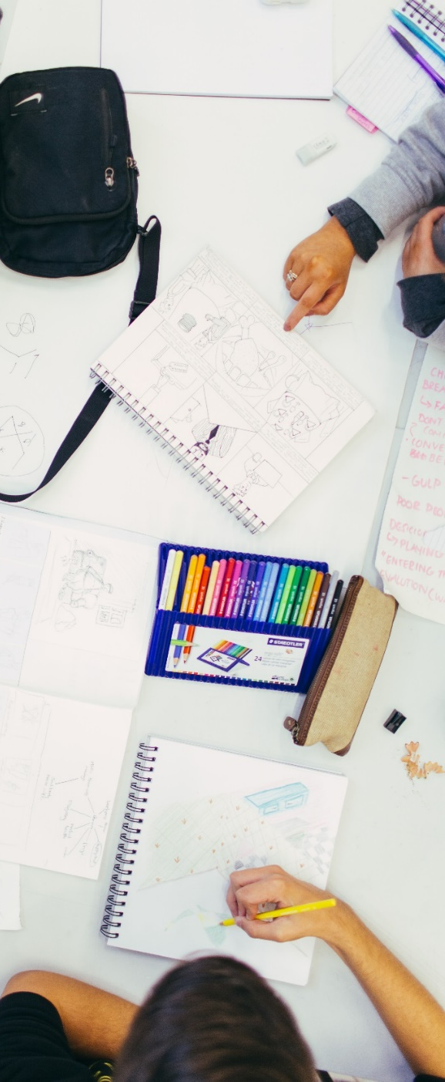
Study skills
To improve our study skills, there are 3 key questions we need to think about:
How can we improve our memory?
What methods and strategies can we use?
How can we plan our study time?
Notes:
To improve our study skills and achieve better results we need to think about 3 key things:
How can we improve our memory?
What methods and strategies can we use?
How can we plan our study time?
We’re going to explore these today so you can begin to improve your memory, study techniques and organisation to have affective revision sessions

Slide 3
MEmory
How good is your memory?
You have 60 seconds to remember as many shopping list items as possible
Notes:
Ask students to just read the list and try to remember as many as they can, don’t write them down just yet

Slide 4
STOP!
Onions
Milk
Granola
Orange Juice Brownies Tomatoes Chicken Potatoes Chocolate Baked beans
Tea
Pineapple
Cocoa
Lettuce Shampoo
Beef
Flour
Bananas
Doughnuts Grapes
Rice
Cinnamon Cauliflower Lemons
Crisps
Coffee
Avocado
Pasta
Pizza
Cream
Toothpaste
Oranges
Cucumber
Cheddar
Limes
Cereal
Bread
Croissants
Bagels
Parsnips
Butter
Ginger
Cookies
Bacon
Broccoli
Yogurt
Apples
Olives
Notes:
The purple bar at the top of the screen times 60 seconds – starts automatically at the beginning of the slide

Slide 5
NOW WRITE THEM DOWN
STOP!
Notes:
Timer will start automatically
A further 60 seconds is given to students to see how many they can write down. After the time, ask students how many answers they think they have.

Slide 6
HOW MANY DID WE GET?
Onions
Milk
Granola
Orange Juice Brownies Tomatoes Chicken Potatoes Chocolate Baked beans
Tea
Pineapple
Cocoa
Lettuce Shampoo
Beef
Flour
Bananas
Doughnuts Grapes
Rice
Cinnamon Cauliflower Lemons
Crisps
Coffee
Avocado
Pasta
Pizza
Cream
Toothpaste
Oranges
Cucumber
Cheddar
Limes
Cereal
Bread
Croissants
Bagels
Parsnips
Butter
Ginger
Cookies
Bacon
Broccoli
Yogurt
Apples
Olives
Notes:
Get students to check their answers – did they get many? Possibly ask how many got 10 or above (put their hands up). Keep increasing number and get students to lower their hands as you go through. The average that students tend to get it 15. The most someone has got so far is 19. (There are 48 items).
Were there any they put on their list that weren’t originally there? Because we sometimes make assumptions when we see a number of items that connecting items may be there. This is sometimes a good exam technique – we can take a logical guess as to what the answer might be, this is better than no answer at all.
Ask students how they went about remembering them – did they use any methods? (Will come on to to other methods as we go through the presentation).

Slide 7
OUR BRAINS FIRST PICK OUT THE WORDS WE FIND MOST INTERESTING/RELEVANT AT RANDOM…
Onions
Milk
Granola
Orange Juice Brownies Tomatoes Chicken Potatoes Chocolate Baked beans
Tea
Pineapple
Cocoa
Lettuce Shampoo
Beef
Flour
Bananas
Doughnuts Grapes
Rice
Cinnamon Cauliflower Lemons
Crisps
Coffee
Avocado
Pasta
Pizza
Cream
Toothpaste
Oranges
Cucumber
Cheddar
Limes
Cereal
Bread
Croissants
Bagels
Parsnips
Butter
Ginger
Cookies
Bacon
Broccoli
Yogurt
Apples
Olives
Notes:
Sometimes we pick out the items tat most appeal to us, sometimes we use other methods too.

Slide 8
MEmory
Memory chunking
Processing large amounts of information into smaller chunks can help us to remember things…
Notes:
Memory chunking is when we try to process large amounts of information into smaller chunks to help us remember information. We can use this as a memorisation technique or simply as a way to organise our revision to make it more memorable and easier to manage

Slide 9
MEmory
Memory chunking
Whether by type, colour or even alphabetically…
STARTS WITH‘B’
Apples
Oranges Bananas
Limes
Lemons Grapefruit Grapes
Pineapple
Banana
Lemons
Cheddar
Croissant
Butter
Ginger
Pineapple
Parsnips
Bagels
Baked beans
Bananas
Beef
Bread
Broccoli
Brownies
FRUITS
YELLOW
Notes:
Interestingly, some people will argue that a pineapple is green or that croissants are brown.
That doesn’t matter, It’s about making connections that work for you and memory chunking in a way that is memorable for you. Once our understanding of the information we want to revise is accurate, our revision can begin.

Slide 10
Memory
Visualisation
Visualisation is another method that people use when trying to remember information.
So we are going to try an experiment…
Notes:
Visualisation is another method that people use when trying to remember information.
So we are going to try an experiment – everyone will need a piece of paper and a pen (A5 or A6 will do).
Going to be given one instruction at a time – must just follow the instructions.

Slide 11
DRAWING FROM INSTRUCTIONS
HOW WELL CAN YOU CREATE AN IMAGE IN YOUR MIND FROM INSTRUCTIONS?
Draw a large circle
Draw a square inside the circle
Draw a line across the square
Draw another smaller circle inside the square
Finish by drawing a triangle on top of the first circle
Notes:
Go through one at a time. If asked any questions, do not answer. Must just follow each instruction as they understand it.
Get people to make comparisons between their drawings – see if any have the same as someone else in the room.
Ask them if they would like to see how it ‘should have looked’.
Instructions will appear one by one – will appear with a click.

Slide 12
DID YOURS LOOK LIKE THIS?
Everybody interprets information differently, so make sure that you understand what you’re learning before you commit to memory!
Notes:
Ask students to compare their drawings with other members of the class. Perhaps highlight how different the range can be.
This again shows that we need to organise and understand the information we are trying to learn before revision begins, otherwise we may be committing the wrong information to memory and the outcome might not be the one we were looking for.

Slide 13
Memory
repitition
How we think we learn…
Revising over and over and over
Become familiar with topic, but don’t truly understand it.
Passive learning =
Weak recall muscle
“I know that I know this!!! I just can’t remember what it is…”
Notes:
We think that by going over a topic until we are familiar with it will help us remember information.
Revising a topic over and over means you may become familiar with the topic and memorise all the words you need but you don’t truly understand it. This is passive learning, and as we saw earlier, learning without fully understanding doesn’t improve our memorisation of the topic.

Slide 14
Memory
repitition
How we should actually learn…
Learn once but test and recall over and over!
Active learning = Strong recall muscle
More efficient (and less boring!)
Notes:
Instead of just repeating the information, we should learn something accurately and then test ourselves and recall over and over. This is what we call active learning, it activates our strong recall muscle ad makes learning more efficient and much less boring!

Slide 15
SO, WHAT STRATEGIES DO
YOU USE...?
Notes:
Ask students what strategies that they currently use to revise, what do they think works best? Can pair and share for discussion.

Slide 16
ONLINE RESOURCES
PODCASTS
FIND WHAT WORKS BEST FOR YOU
STUDYGROUPS
VOICE NOTES
FLASHCARDS
Notes:
Ask students if they have tried any of these or touch upon what they might have already highlighted in these previous discussion.
A lot can use voice notes/ Dictaphone function on their phone and will find this useful, some might need the motivation of others to study, some might prefer to use physical resources where as some may prefer online.
Now we’re going to run through a few revision methods and techniques that you may find useful.
Animations triggered with a click

Slide 17
Notes:
This video shows us one revision method that we find useful for active learning and effective revision. Video to be played – click at bottom of page.
After video: There are ways of going about memorising things by making revision a bit more interesting. Creating a story that we can remember can do this, the story may be odd or not make a lot of sense, but that doesn’t matter, as long as you remember them.

Slide 18
Revision techniques
making mental associations
CHOOSE THREE OBJECTS
Now, turn each object/ fact into an element of a story…
?
?
?
Notes:
We can think about three key things we need to remember and turn them into a story to help us remember them.

Slide 19
Revision techniques
making mental associations
Physics: Types of radiation
VISIBLE
UV
X-RAY
?
?
?
Looks like the weather will be awesome on holiday, so I must remember my sunglasses and to put my sunscreen in my suitcase before baggage security!
Notes:
Let’s use an example from physics revision. It’s important to pick out the key images that relate to the information you are trying to remember.
Looking at different types of radiation, you may wish to link an object to the key types. So for visible, you might think about using some sunglasses as you’ll see them on your face when protecting yourself from the sun’s rays; sunscreen for UV as you put in on to protect your skin from the UV light from sun; baggage check at security as they will scan your bag at the airport before you head off on your holiday.
Then you can turn it into a story: Looks like the weather will be awesome on holiday, so I must remember my sunglasses and to put my sunscreen in my suitcase before baggage security!

Slide 20
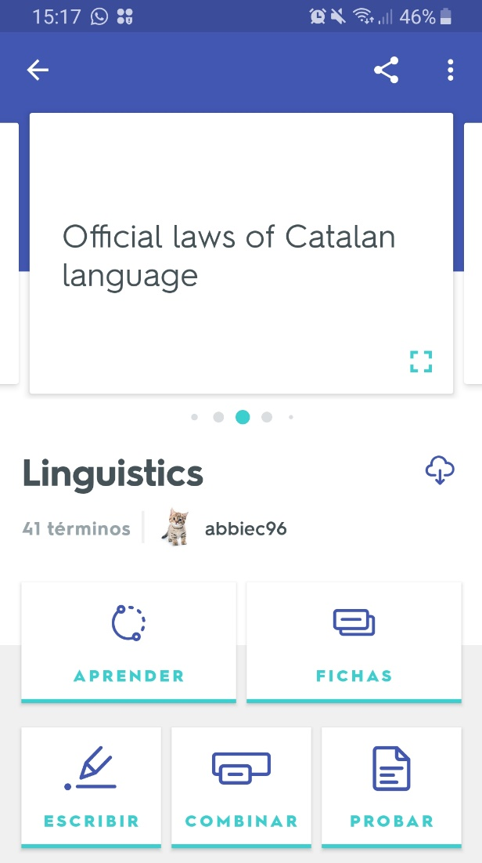
Revision techniques
APPs
Quizlet
Bitesize
Gojimo
Memrise
Brainscape
Flashcards+
Sporcle
GetRevising
Notes:
Another revision technique which encourages active learning as well as being an easy, convenient way to revise is the use of apps insteadf of physical flash cards, notes or activities
These are some of our favourites:
Quizlet – makes simple learning tools that let you study anything such as flashcards, games and learning tools — all for free
Memrise – languages focus website with games, humorous chatbots and over 30000 native speaker videos
Brainscape – flashcards app
Flashcards+ - makes online flashcards – app for your phone
Bitesize – BBC – lots of information and quizzes to test
Sporcle – quizzes available so you can test yourself
Gojimo - Access over 40,000 practice questions for free. Covers lots of GCSE subjects. App for your phone. Download quizzes for offline use, track your progress, strengths and weaknesses, check off each topic as you learn it.
GetRevising - unique revision timetable creator, interactive revision cards, games, and a shared resource library created by its members

Slide 21
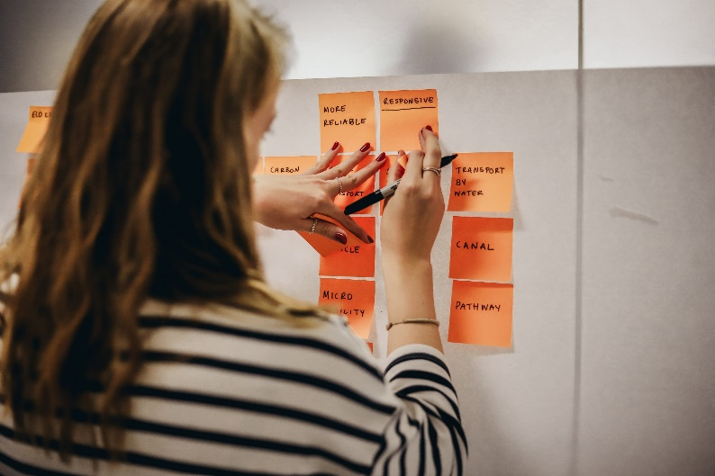
Revision techniques
Using colour
Post-it notes
Highlighters
Colour codes
Flashcards
Mind-maps
Notes:
Using colours is a great revision technique for many learners, it’s a great way to organise your notes and topics and also make your revision more interesting.
Here are a few ways that you can include colours in your revision.
Mind maps are a great way to map out information you need to remember, using colours can help visual learners remember important information
Post-it notes alongside your work or stuck around your room can help visual learners remember important facts
Colour coding the work you need to remember can help visual learners sort their revision and remember each topic or subject area

Slide 22
Revision techniques
Essay planning
Step 1: Reading the question
‘In Oliver Twist, Dickens presents criminals as products of their society.’
To what extent do you agree with this view? Remember to include in your answer relevant detailed exploration of Dickens’ authorial methods.
[25 marks]
2015 A-level ENGLISH LITERATURE B (AQA)
Paper 2A: Texts and Genres: Elements of Crime Writing
Notes:
One of the most effective revision methods is planning and practicing essays or past papers.
As mentioned earlier, it is important that you understand what the questions is asking you to do: the skills to be used, how long they expect the answer to be, what the key focus might be.
What would you say are the key words in the question? Ask students to select 3 words that they think are the most important and that signpost what skills they have to use.
Highlight that this is a 25 mark question so a detailed answer will be expected.
Click to ‘highlight’ keywords
In the exam, underline or highlight these key words.
If you aren’t sure what they mean, take a guess.
What does authorial methods mean? Tease out what it might mean – what word does it look like, what words are synonyms.
What is it asking you to do?
‘To what extent do you agree’: look at more than one viewpoint
‘Authorial methods’: names of writers’ techniques eg metaphor, simile, emotive language
‘Relevant detailed exploration’: small quotation with detailed analysis of quote

Slide 23
Revision techniques
Essay planning
Step 2: planning a response
10 minutes | Read paper and choose your questions
30 minutes | Plan all 3 essays
45 minutes | Question 1
45 minutes | Question 2
45 minutes | Question 3
5 minutes | Check answer
3 HOUR PAPER
3 QUESTIONS (25 marks each)
Make sure that when you are attempting past papers, you remember to set a timer!
Notes:
Your teachers may discuss with you what time to spend on each question in your exam for specific papers but here is an example of how to plan your response to an exam question.
It’s really useful to look at how many marks a question is worth. If it is a 1 mark question, don’t spend long on it – maybe 30 seconds. If it’s a 12 mark question, you may wish to spend 6 – 10 minutes on it.
First of all, you need to read the exam paper and consider what questions you are being asked to answer: Above we can see an example of an exam paper that has 3 longer questions, we need to know how long to spend writing these answers and also how long it will take to write to your response.
Planning may feel like a waste of writing time but planning your improve you answers, help you focus and make your instead of ust being a stream of conscienceness so always take time to write a plan, your answers will be better for it and you can write faster if you already know what you want to write.
Then, as these questions all have equal weighting, you would split the remainder of the time equally between the three. But make sure you leave 5 mins at the end to check over your paper and read through – this is important to check for any little mistakes.

Slide 24
QUICK TEST...
Can you remember THREE of our yellow foods?
Notes:
Banana
Lemons
Cheddar
Croissant
Butter
Ginger
Pineapple
Parsnips
Select 3 students that can remember one

Slide 25
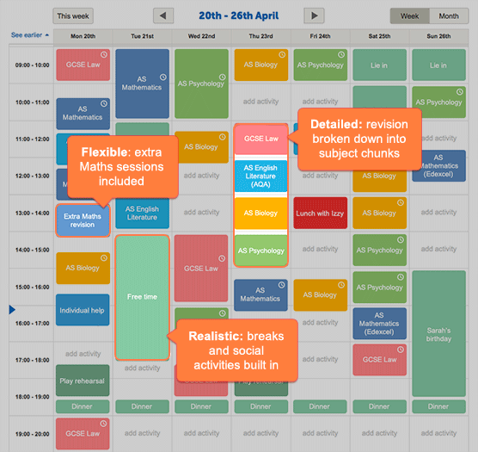
Planning your study time
Create a revision timetable
GetRevising will create a timetable for you
You can input the dates of your exams and any commitments you have e.g. football practice, a birthday party
You can prioritise certain subjects and topics
Notes:
Planning your study time is also an important aspect of the revision period. You ant to make sure you know when you can revise different subjects and what you need to prioritise so you can do everything to prepare for your exams.
Schools often provide dates of exams between January – March. However, if this isn’t the case, they can use the start of May as a guide as to when they will start.
GetRevising can create a timetable for you to save time. You can input the dates of your exams as well as any other commitments you have.
It is important to create a realistic timetable to make time for other things alongside your revision. You will still need time to relax, exercise or play sports, see friends or family. All of this is important alongside your revision to stay healthy and focused.

Slide 26
Planning your study time
The ‘pomodoro’ technique
25 : ENGLISH LITERATURE
5 : Social media break
25 : BUSINESS STUDIES
5 : Grab a snack
25 : PSYCHOLOGY
5 : Play with the dog
25 : HISTORY
30: Go for a walk
25 minutes study x 4
+ 5 minute break x3
+30 minute break x1
It’s easier for your brain to retain short chunks of information.
Short breaks means you can refresh your brain and stay focused.
Notes:
It is important to plan how you will study – so you may wish to break down your revision block on your timetable into a structure.
That’s where the Pomodoro technique comes in! Looking at revision as a 2 hour block can be daunting and put you off starting. However, if you chunk it into manageable 25 minute blocks with shorts breaks between, it can be useful to help maintain concentration and build in time for rewards/ rest breaks.
Always start with the subject that you find most challenging first and end with something that you enjoy to ensure that you feel positive at the end of a revision session. You can tailor this to suit you, you could revise one subject for 2 hours but take breaks or you could revise 4 subjects divided by the breaks as above.
You can always highlight and make notes on topics that you need to revisit at the end of any block of revision.

Slide 27
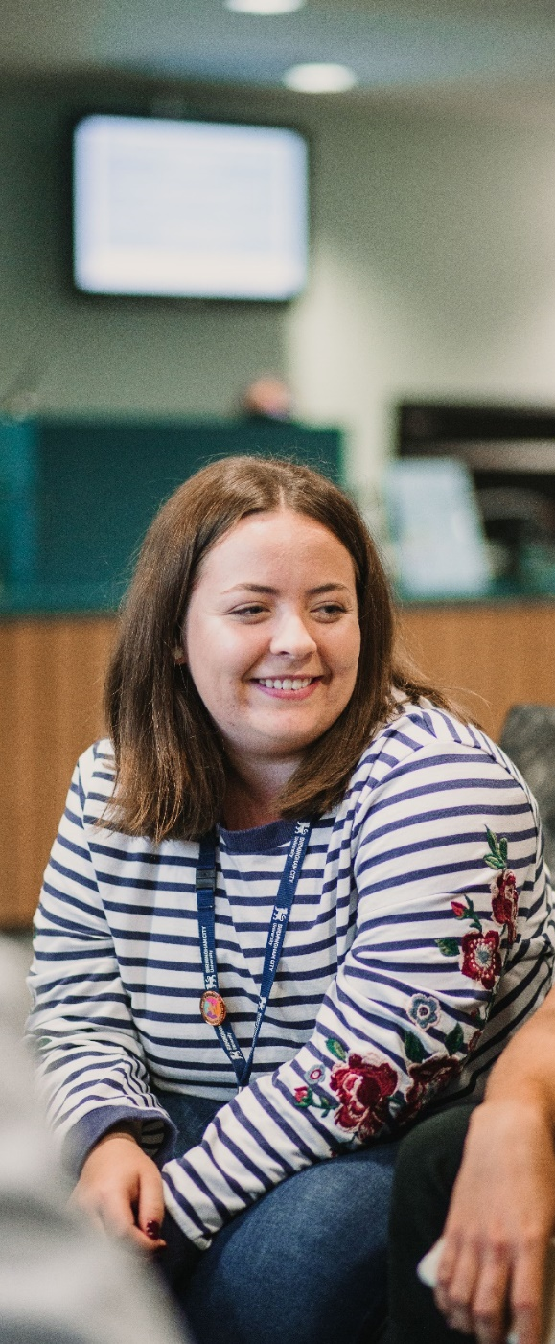
Planning your study time
Rewarding yourself
Set yourself realistic short term goals, so that you have something to work towards – this will motivate you, give you something to look forward to and also help you relax during the revision period.
Completed a practice paper
Have a chilled out movie night, free of revision
These can be hourly, daily or weekly tasks that you are aiming to complete with small or big rewards.
Notes:
Arrow activated on click
Ensure that you reward yourself in a way that suits you. This might be telling your parents about what you have achieved in the day, reflecting upon what you have achieved yourself, giving yourself a sweet for every section you’ve revised, watching your favourite show or maybe having an evening off. If you have done all that you planned to do and feel that you’ve worked hard, you will have earned it.

Slide 28
Planning your study time
Avoiding distractions
CHECKLIST
MUSIC
Spend 10 minutes at the start of the day writing a list of everything that you would like to achieve.
Crossing things off releases dopamine into your bloodstream – making you feel happy!
Listening to music can help keep distraction at bay.
Studies suggest that instrumental/unfamiliar songs may be more beneficial (and prevent you from getting carried away lip synching!)
Notes:
There are a few extra things that you can do to stay focused. It’s not always easy to avoid distractions but we have a few tips.
Click at start of each tip for animation
A checklist is always a great way to start a day or revision session. But it is also nice to tick things off it. Crossing things off your lists release dopamine into your bloodstream and it makes you feel good.
Who listens to music when they study? Some people like it, other people need it to be silent. However, it is important to think about the volume of music and whether you may end up signing along – you are trying to revise a subject and not the lyrics of your favourite band.

Slide 29
Planning your study time
Avoiding distractions
BE BRAVE
BRING SNACKS
It’s tempting to avoid your worst subjects and do absolutely everything else first…
However, if you start with the ‘hard stuff’ you can relax knowing it can only
get easier!
There is no point trying to focus if you are hungry!
Keep a stock of healthy snacks near your desk so that you don’t have to stop ‘mid flow’ to hunt for a Kit Kat...
Notes:
Click at start of each tip for animation
Try and start your revision with your toughest subjects – dive in. The beginning is when your brain is at it’s freshest. Also, you know that revision will get easier throughout the day. It’s always good to end the day on a positive note rather than feeling demotivated by a subject that you may have found difficult. It’s about finishing with a sense of achievement and positive outlook.
It’s really important that you fuel your brain so eating the right thing will help. You may find that having snacks to hand means you won’t have to get up every time your tummy rumbles and you can remain in the flow.

Slide 30
Planning your study time
Avoiding distractions
GO OFFLINE
RELOCATE
We know. The HARDEST one…Put your phone on airplane mode and hide it out of sight.
You don’t have to be cut off all day – a few minutes online could be a reward for completing your next Pomodoro!
Suddenly feeling a desperate urge to deep clean your bedroom?
A change of scenery can be helpful. Head to your local library or go study with a friend.
Notes:
Click at start of each tip for animation
We all know how attached we are to our phones and we’ve even talked about doing revision on our phones. But we can be distracted by so many different things on our phone or even our laptop or tablet. It’s tough but switching off for a bit is useful. Doing 25 mins revision and then catching up with zillion messages on the group chat might be a reward or might encourage to switch off for a further 25 mins. If you feellike you don’t have the best self-motivation with this, give your phone over to someone else so you can only get it back after a couple of hours revision.
Most of us may revise in our room – it can be the place where you feel you have most privacy and quiet space. However, it is important to think about whether it’s the best space for you. Do you get distracted there? Would you be better having someone keep an eye on you? Always consider other places around the house or places such as the local library. You can mix it up and have a variety. Also, consider that your bedroom should be your place of sanctuary. If you are trying to switch off and unwind at the end of the day, your room shouldn’t remind you of exam stress.

Slide 31
Planning your study time
Looking after yourself
Prolonged levels of stress experienced during the exam period can take their toll on both your physical AND mental health.
Make sure to get plenty of sleep, drink lots of water and do things that you enjoy and help you relax!
Notes:
Most important thing to do, especially during the exam period, is to look after yourself and be kind to yourself.
This means eating healthily, staying hydrated, being active, getting lots of sleep and also making time to do things you enjoy and that will help you relax.
Sleep is really important for concentration and memory. Try to have a healthy night time routine away from your phone and staying up late.
Exercise will physically tire you and releases endorphins that make you feel good. Also, a nice relaxing hot bath before bed could help as well as non-caffeinated hot drinks before bed like hot chocolate.
Make sure if you’re feeling stressed, overwhelmed or too tired to carry on, take a break.

Slide 32
Remember why it’s worth it
Push yourself because no one else will do it for you!
Getting good exam results can lead to so many things:
Future Career
Further/ Higher Education
Family and friends
Good salary
Professional success
Life experiences
GOOD LUCK!
Notes:
Think about why you are working this hard and what you want from all your hard work.
It could be lots of different reasons. Getting your qualifications may be one but essentially gaining those qualifications are going to open the doors for other things, and you should think about where that can take you.

Slide 33
Study skills
Recap
To study successfully:
Organise your notes, work from class and revision materials – make sure you understand everything before you start revising
Experiment with different revision methods and techniques to find what works best for you
Create a revision timetable, find a place to study, avoid distractions and take care of yourself during the revision period
Notes:
Run through the slide to recap and take questions

Slide 34
Notes:
Thank you very much for listening. Does anybody have any questions?

