Slide 1
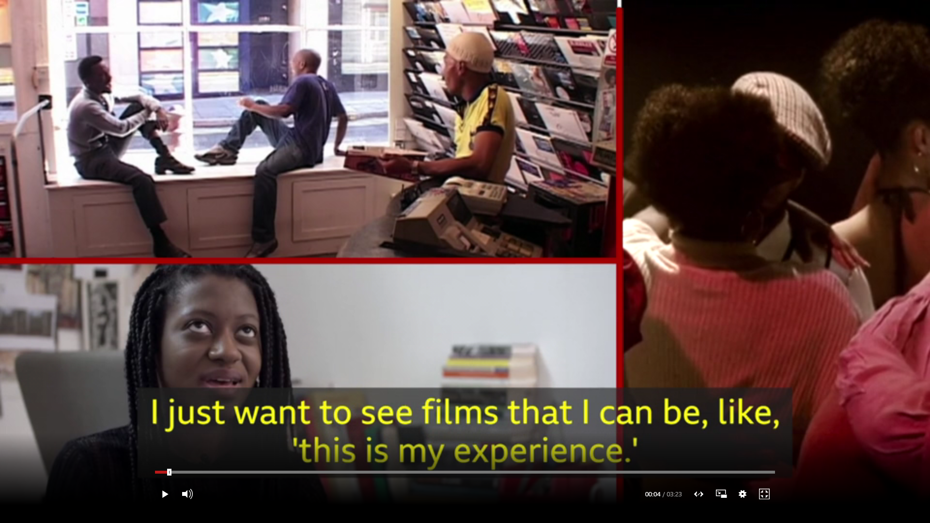
Diaspora Screen Media Network
What Now?- Ian Sergeant
Notes:
My presentation is a provocation as to the proliferation and consumption of Black and South Asian film via new technologies or in cinema spaces of said product by global/glocal audiences
My question to the panel/research project and to you the audience is that of the qualitative. I would like to ask you to consider what is the thematic quality of the narrative of films being produced and consumed via such platforms as YouTube, Netflix etc.
Is there a responsibility of the filmmaker and investor to challenge said quality of films produced?
This provocation is in response to DSMN’s research question of Does new media's remapping of diasporic screen texts' traditional concerns encourage a more nuanced 'glocal imaginary' and how might this be defined?
Before I continue I would like to share a short clip made recently which I think addresses some of these issues
Introduction of short clip Black Filmmakers on diversity, craft and awards
https://www.bbc.co.uk/news/av/entertainment-arts-51329843/three-generations-of-black-filmmakers-on-diversity-craft-and-awards

Slide 2
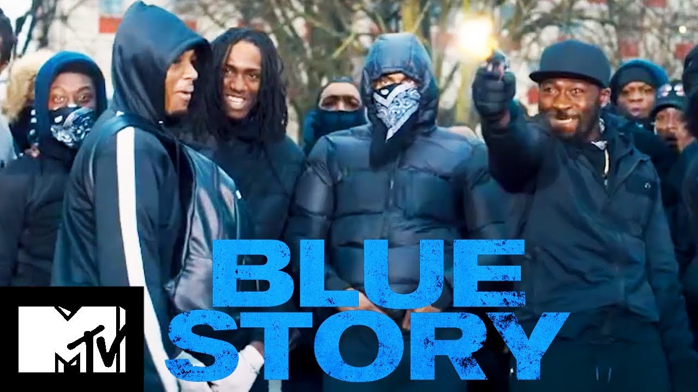
From YouTube Sensation to Box Office Phenomenon?
Written/Directed by Rapman aka Andrew Onwubolu
Developed from his YouTube mini-series Shiro’s Story – which amassed 20m plus views; the final episode received over 1m views in five hours
Such figures attract investment from BBC Films and Paramount to enable the production of a feature length film Blue Story
Screenings are marred by violence at Vue cinema, Birmingham and other national locations
Vue and Showcase cinema initially withdraw the title from their screens because of the violence
At the box office Blue Story earned £1.3m on its opening weekend alone
Actor Michael Ward is nominated for a BAFTA
Notes:
My practice-based research interrogates visual representations of black British masculine identities and my concern is despite the proliferation of technologies and platforms to view films, does the thematic narrative particularly Black British films I have recently seen portraying the Black male challenge historically racist stereotypes? And should they?
Take for instance Blue Story, whilst I applaud the importance of the filmmaker to portray the realities of street life for many young Black males growing up in urban environments today. Is this the only narrative that appeals to audiences and investors like BBC Films?
Dr Clive Nwonka film studies fellow at LSE said the decision to ban the film smacked of the morale panic that Hall referred to in Policing the Crisis in relation to muggings in the 70s
To me Blue Story reinforced Black male stereotypes of nihilism, hyper-masculine identities, gang violence and homophobia. Whilst the female characters were portrayed as fragile and victims. Blue Story reaffirms what has been said in the earlier clip about the quality of films being produced, that play to stereotypes and pathologies of Black life as violent, homophobic, misogynistic, gang-related urban lifestyles of living fast and dying young with no hope of ever leaving the “ends”. Yet the box office figures speak for itself this is what the audience wants and perhaps there is a place for this kind of filmmaking, like the Blaxploitation cinema of 70s?

Slide 3
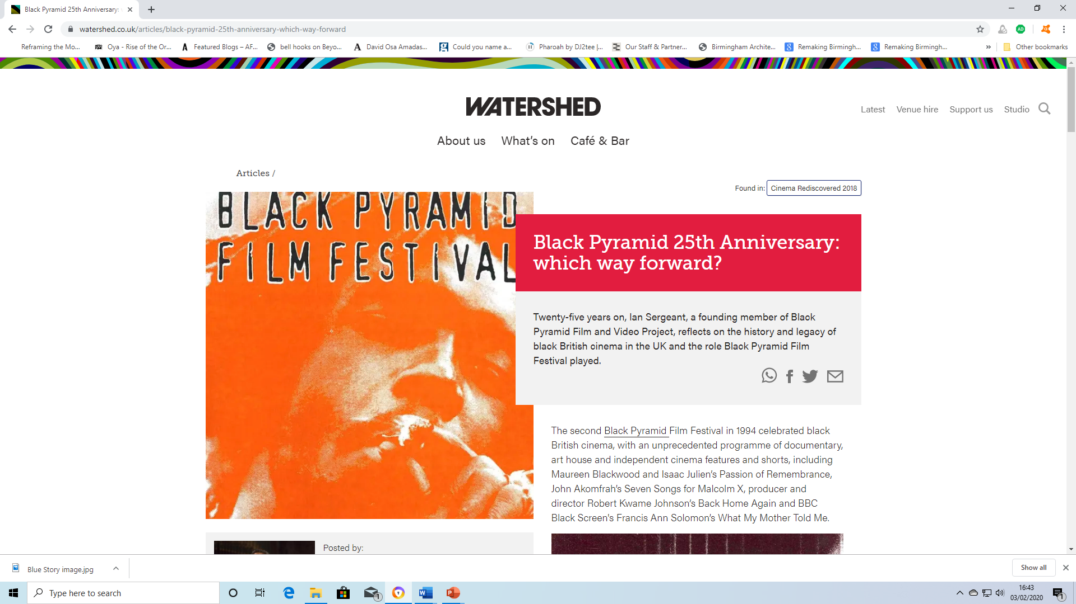
Back in the Day
Notes:
My background is as a founding member of Black Pyramid a training, production and exhibition entity, set up in Bristol in 1993.
BP’s aim was to provide a platform to portray the diverse “nuanced” voices and narratives inherent in black British filmmaking, away from the more commercial and stereotypical images of black people prevalent within mainstream cinema and on TV, we screened Handsworth Songs, Darker Side of Black, Daughters of the Dust and Coffee Coloured Children.
Our screenings and production of film was informed by the Black film workshop movement of the 1980s funded by C4 that saw the likes of Black Audio, Ceddo, Sankofa and Retake Film collective come into being
Our aim was to address quality of consumption, widening the audiences appreciation for more film in relation to their lived experiences and not just to re-affirm tropes that fulfil the perceived Black lived experience as violent and urban.
Screenings were often supplemented by Q&A’s with the likes of Kobena Mercer, Menelik Shabazz, June Giovanni, Gaylene Gould and Karen Alexander to name a few
At our 25th anniversary event at Cinema Rediscovered, which included Kolton Lee we asked what has changed since those heady days and we agreed that little has changed in opportunities to produce more nuanced narratives for Black filmmakers

Slide 4
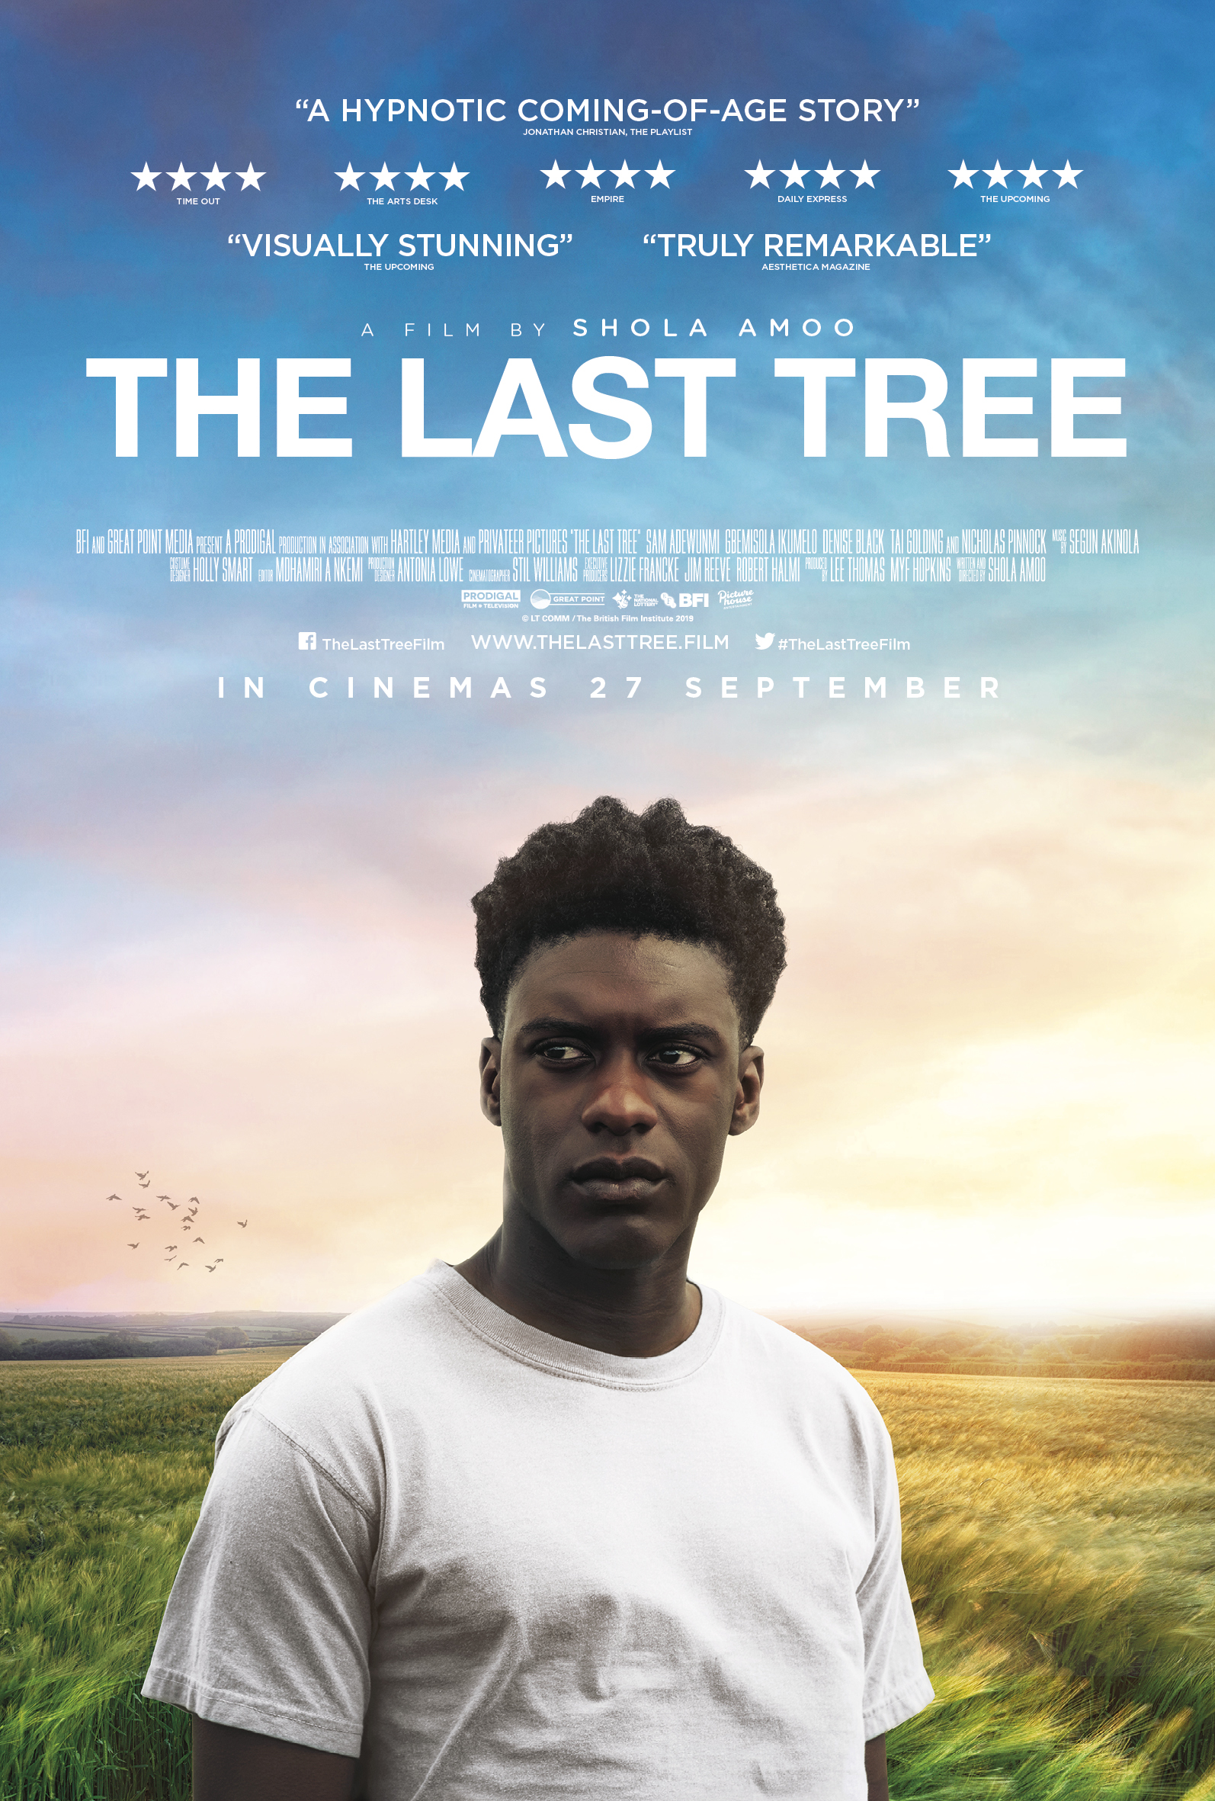

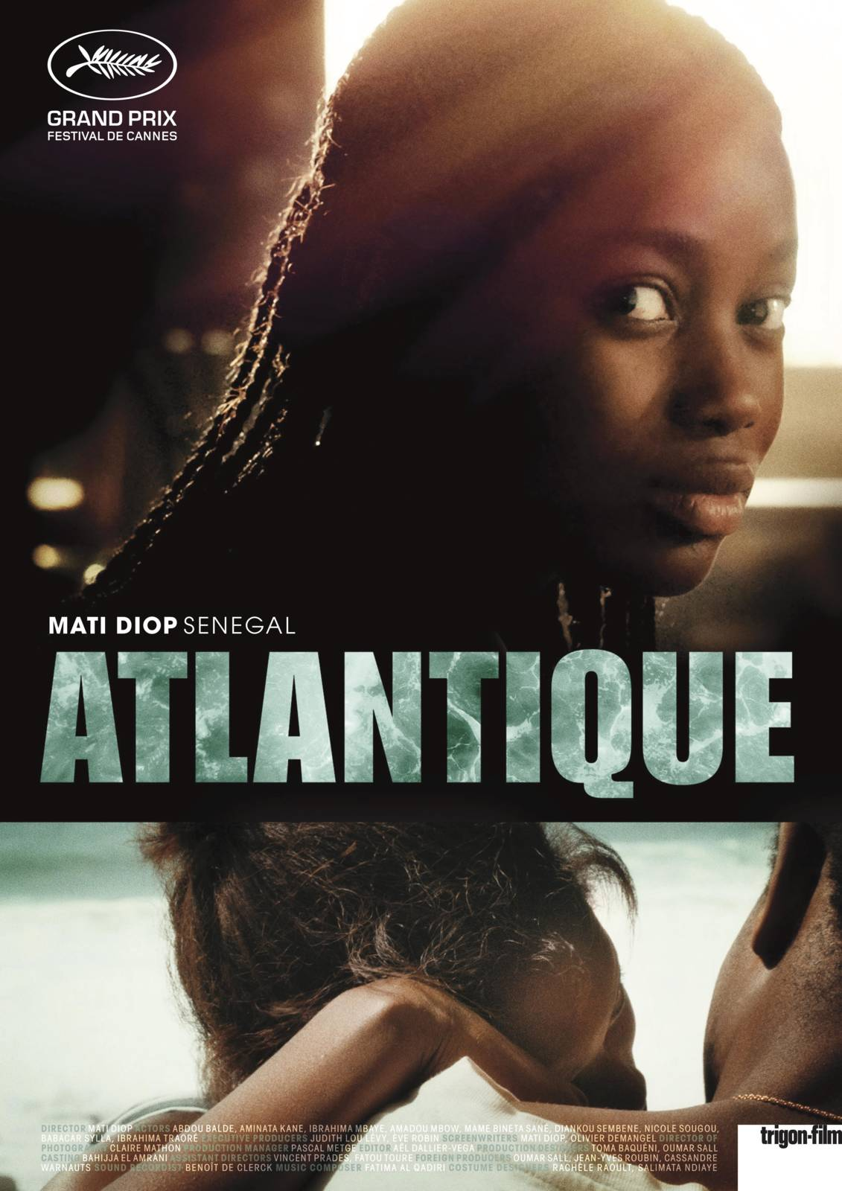
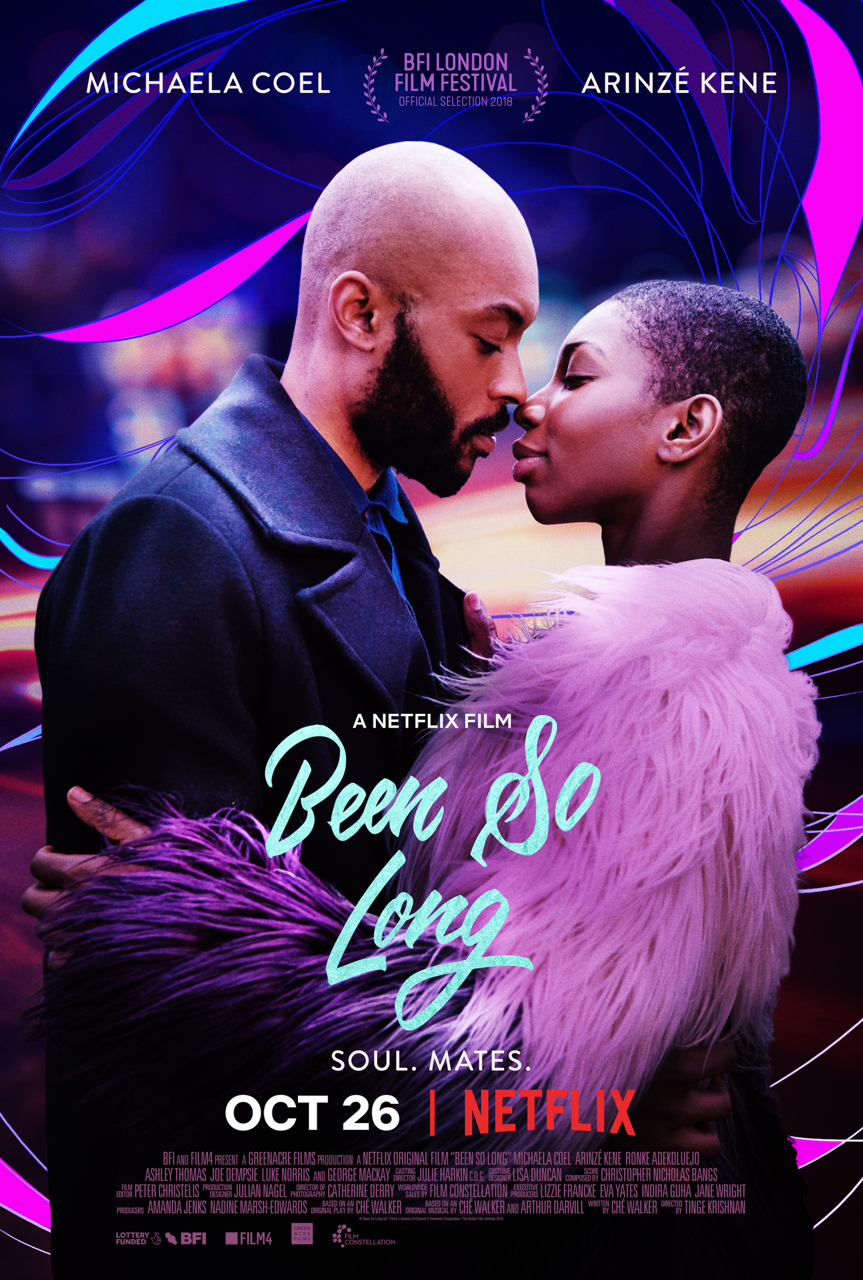
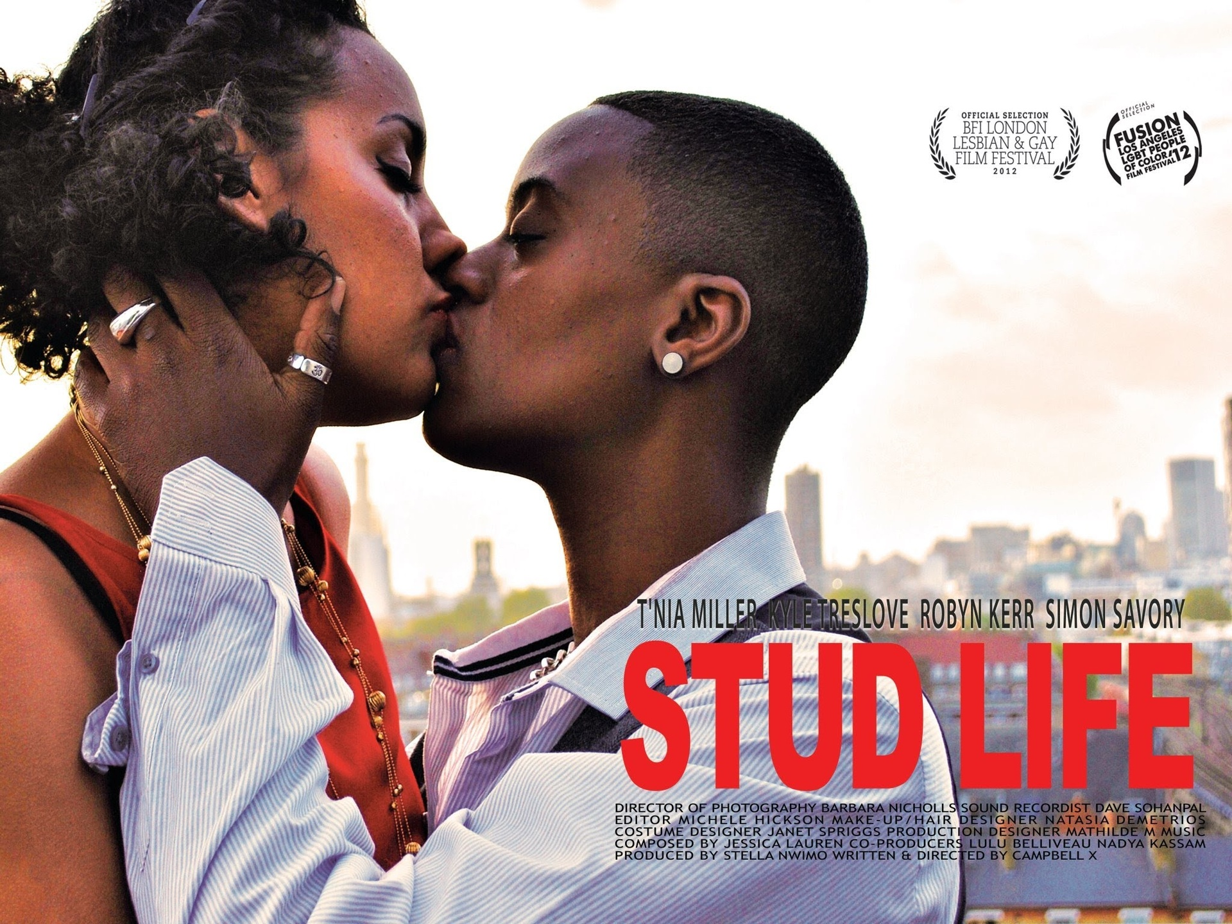
How do we Change the Narrative?
How do we change the narrative, whilst ensuring that we reach and engage a wide audience?
Whose responsibility is it to ensure there is a place for stories of the Black female, queer culture, non-binary or non-urban experience?
Do recent releases such as these suggest that we are widening our understanding of the Black lived experience?
Does new media's remapping of diasporic screen texts' traditional concerns encourage a more nuanced 'glocal imaginary' and how might this be defined?
Notes:
To conclude I only have more questions and hopefully today we might start to have some answers
How do we change the narrative, whilst ensuring that we reach and engage our audiences?
Whose responsibility is it to ensure there is a place for stories for instance about the Black female, queer culture, non-binary or non-urban Black experience?
Do recent cinematic releases such as these suggest that we are widening our understanding of the Black lived experience?
Finally, I would like to return to the DSMN research question Does new media's remapping of diasporic screen texts' traditional concerns encourage a more nuanced 'glocal imaginary' and how might this be defined?
Thank you!

Slide 5



Ian Sergeant
PhD Research Candidate
Birmingham City University
Art, Design & Media

