Slide 1
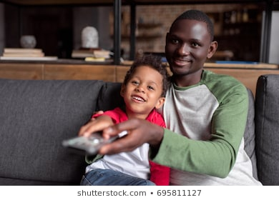
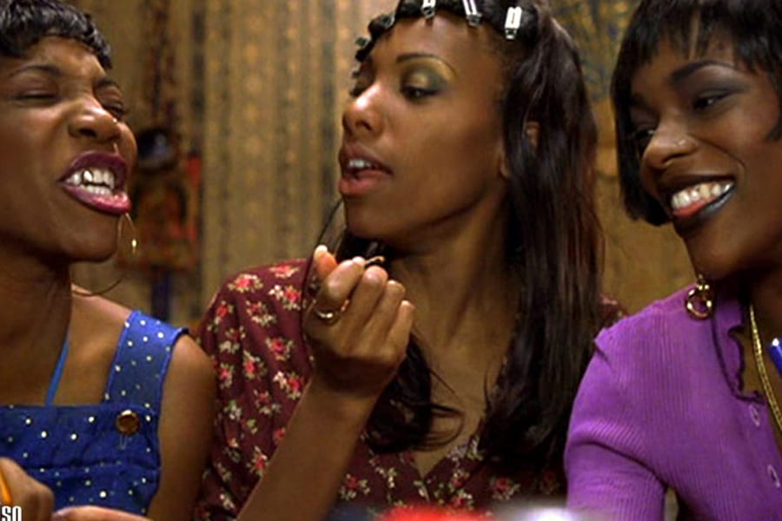
Digital Diaspora Audiences
Professor Janet Wilson, Principal Investigator, Diaspora Screen Media Network

Slide 2
Audiences of mediatised digital diasporas changing face of media industry
Who are the audiences of mediatised digital diasporas? i.e. who use the social media and might contribute to changing consumption patterns
What are drivers in accessing diaspora visual culture?
How does the UK TV industry target audiences and viewers esp regarding Black British/British Asian visual culture ?
“The lens of active audience is missing link.” Gap in knowledge of diaspora media’s production practices, news processing and audience consumption. (Ogunyemi 2015, 2)
in conceptualising appropriation of media by diaspora groups frameworks are: public sphere, identity, alternative media (hybrid-- using alternative and mainstream media)
Notes:
This is one of the key areas that this network is interested in—how patterns of c onsumption are changing. Audiences/viewers can be approached from different angles and I report on two different frameworks of investigation - one in cultural studies terms that examines the effects of engagement of diasporic subjects in visual culture from their home country; related to this is the issue of forming a digital/virtual community through blogs, social media that gives them a sense of belonging; and the other is the media industry’s approach to views and gaining information about their likes/dislikes in order to improve their ratings, prioritise programmes that will increase sales/viewers. I begin with this question about audience as it involves everyone here today. You may be from the Asian African diaspora or know about it due to yr professional life if you are involved in production, direction or arts management in the professional sense

Slide 3
Definitions of diasporas
Diasporas: immigrant, and relocated communities in (potentially hostile) hostland that retain bonds of loyalty and affiliation to their original homeland, may share with co-diasporans in cyberspace.
Imagined communities, as deterritorialised nations making homes in diasporic space
Exchange symbolic goods and services through media in context of global networks (Karim)
Migration aligned with technology, which has facilitated movement in our time (Alonso and Oiarzabal, 2010). Some groups seek migration because lack of “high technology environment at home deprives them of opportunity and free choice for personal development” (Ogunyemi, )
Notes:
Reconceptualisation of space with diaspora theorisations

Slide 4
The politics of ‘home’
Strategies of digital “Homelanding”, i.e. forge inclusive home space –imagined affiliations, multiple, contradictory notions of home(Gairola, 2019)
Connecting to the visual culture of original homeland helps forge a home space,
Home matters most to first generations diasporans.
For 2nd generation diasporans what motivations in accessing Black British/British Asian TV & cinema?
Notes:
Technology and cyberspace allows for connectivity and for retaining idea of home away form home- building a new homeland in hostland-

Slide 5
Post-Imperial British identity
Diasporic site is a 3rd space (Homi Bhabha) i.e. between cultures- place of creativity and resistance to colonisation,
In digital diasporas, a multiplicity of representations, mass-media broadcasts, textual and visual performances, and interpersonal interactions occur.
’The material and discursive shaping of community through digital encounters indicates nuanced and layered continuities, discontinuities, conjunctures, and disjunctures between colonial pasts and a supposed postcolonial present’
Radhika Gajjala ‘3D Indian Diasporas’ in Alonso and Oiarzabal (2010)
Notes:
Mediatised spaces of diaspora New online/offline communities are forged in cyberspace- are the communicative space of an imagined community, a virtual community or idenitiy production or economic quest – link between memory and nostalgia-- Radhika Gajjala, 3D Indian Diasporas

Slide 6
Channel 4: shift to digital TV in 2012
“… we are dealing with an unprecedented amount of change in the way people access, consume, and engage with our products.” (David Abraham, June 2013, qtd in Hadida and Astandu 2013)
Rapid nature of development in media technologies poses conceptual methodological challenges for studying current audience practices (Hight and Harindranath 2017)
Notes:
Refers to switch from analogue terrestrial TV to digital TV by October 2012- social media and twitter facebook increase media connectedness allow live interactions between broadacters and viewers, High sped broadband internet (80%V Uk households in 2012) heralds era of public TV, 4G mobile networks demand content on the go BBC4 provides on demand content from multiple platforms /devices Xbox, I pad, Virgin, Sky, You View

Slide 7
Big Data analysis
‘From a viewer's perspective, Big Data allows C4 to engage its audience in a meaningful relationship by enhancing their viewing experience. C4 in 2013 set up a research panel of 10,000 registered users to partake in on-going viewer research to help shape future content on C4. The panel provides vital feedback on program commissioning and content quality.’
https://www.channel4.com/4viewers/
Twitter comments improved ratings by 29% in 2013
Data pairing-- ads that target audience members
(Hadida and Astandu 2013)
Different types of audience: e.g. paying; attentive; target
Notes:
Issues with big data- used for quantitative analysis, superficial and commercially oriented-problems of data protection and storage (Channel 4 was hacked into) user profiles limited to likes/dislikes, should not be confused with user’s identity; privacy concerns in relation to state enforcement agencies( Snowden)

Slide 8
Youth Audiences: Media Representation
Streaming channels YouTube, I-Player and Netflix oriented to youth audiences,
Channel 4 provides on demand content- has 9 million registered viewers in 2013; that included one third of 16-24 year olds living in UK
Themes: gang warfare, knife crime, street violence, grooming- more eclectic representations needed?
C4 data analysis shows how platform linked to commerce and branding

Slide 9
Mainstream and Older Audiences
Dedicated digital channels available via Freeview (Zee TV) cater for broader audiences (Cf YouTube, Netflix and Amazon for younger )
Mid 1990s Goodness Gracious Me, Citizen Khan, Kumars of No 42 - middle class films & stereotypes
2019 Gurinda Chadha’s Blinded by Light, also for traditional audiences
Diversification and widening of representation needed
Do BAME people need to be represented by Black directors?
How are older people catered for? Are youth audiences catered for above all other types?

Slide 10
Knowledge diasporas- why use social media
Politics of representation of 70s and 80s demarginalizing Black British/British Asian, “members of misrecognized groups reject [negative] images in favour of new self-representations of their own making, jettisoning internalized, negative identities and join collectively to produce a self-affirming culture of their own” (Ty quoting Fraser 2000). Use wider range of aesthetic strategies
Knowledge diasporas outside usual frames of diasporas- more complex condition, many as insider/outsider (Georgiou 2006 cited by Ogunyemi)
Diasporic groups use social media in relation to “broader fields of practice: information, entertainment, engagement, commerce and faith” (Bozdag 2012 99-100), rather than for political awareness of minority culture
Notes:
Ogunyemi says best frame is not political but knowledge diaspora- (one argument) as people seek to benefit by technogical advances

Slide 11
Conclusions: Diasporic media (hybrid)
Move away from ‘burden of representation’ of 1990s (one person spoke for whole community) . Does audience reaction to content indicate representation itself is changing?
Relationship to mainstream channels that provide on demand online content – compete with alternative platforms, providers?
What does Big Data analysis tell us about Black British/British Asian viewers – is this still minority cinema ?
Knowledge diasporas? Impact of globalisation. Other alternatives to homeland politics and politics of identity associated with 1980s and 90s for 2nd generation?
Notes:
Argue that not an alternative media provider to mainstream or alternative public sphere but more hybrid (between both. Concerned with networking identity formation in relation to location; counter discourses; ethnic pride and symbolic ethnicity; unifying subgroups???

Slide 12
References
Allègre Hadida & Timothy V. Astandu. [2013] 2016. Big Data and Channel 4 (Case B). Cambridge: University of Cambridge, Judge Business School. DOI: http://dx.doi.org/10.4135/9781473974913 | Online ISBN: 9781473974913
Alonso, Andoni and Petro J. Oiarzabal. 2010. “The Immigrant Worlds’ Digital Harbour: An Introduction”, in A Alonso and P. J. Oiarzbal, eds. Diasporas in the New Media Age : Identity, Policy and Community. Reny: University of Nebraska Press. 1-19.
Gajjala Radhika. 2010. ‘3D Digital (Indian) Diasporas’ in Alonso and Oiarzabal, eds., 209-224.
Hight, Craig and Harindranath Ramaswami, eds. 2017. Studying Digital Media Audiences: Perspectives from Australasia. Routledge
Karim. H. Karim, ed. 2003. “Mapping Diasporic Mediascapes”. Introduction to Media of Diaspora: Mapping the Globe, 1-16 . Routledge.
Nimrod, Galit. 2017. “Older Audiences in the Digital Media Environment.” Information, Communication & Society, 20.2: 223-249.
Ogunyemi, Ola, ed. 2015. ‘Conceptualising the Media of Diaspora’, Introduction to Journalism Audiences & Diaspora, ed Ola Ogunyemi .London: Macmillan..
Roopika, Risam and Rahul Gairola. 2019. “Studying Digital Humanities: Then and Now.” Introduction to Special issue of South Asian Review. https://doi.org/10.1080/02759527.2019.1599548
Ty, Eleanor. “Representing Other Diasporas in Recent Global Canadian Fiction”. College Literature 8.2 (Fall 2011): 99-114.

