Slide 1
The term ‘Diaspora’
The social condition of diaspora – represented as a triadic relationship:
Diasporic Consciousness
Place of origin
Place of settlement

Slide 2
Issues of production and consumption:
  Audiences and media representation or what audiences ‘do’ with representation
Textuality and content:
  Stereotyping and ideology
  Types of images used to represent ethnic minority groups
  New kinds of representations
  Aesthetics and pleasure and tensions
Power and politics:
  Who controls, is controlled by, media representation?
Digital Media:
  Analogue to the digital – histories
  New media, convergence and remediation

Slide 3
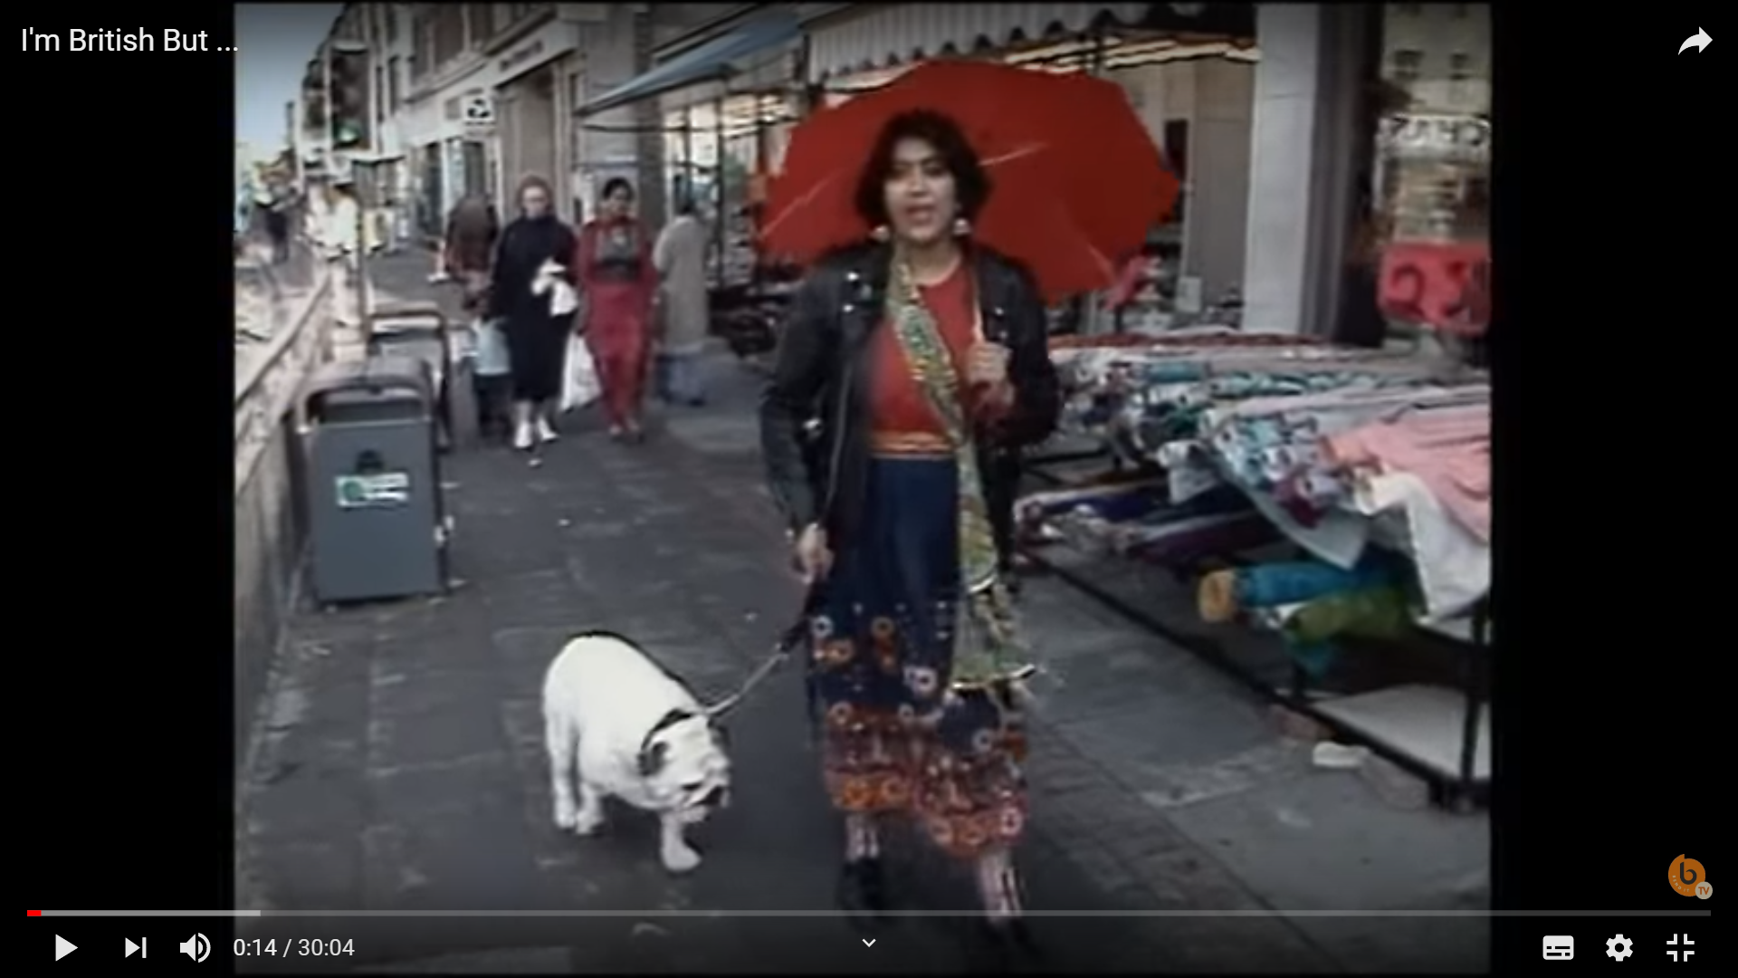
Gurinder Chadha (1989) I’m British But…
  https://www.youtube.com/watch?v=lIbTHhayK3w

