Slide 1
The Game of Growth
Greater Birmingham and Solihull Local Enterprise Partnership
Spatial Plan exercise

Slide 2
Purpose
To gather views on the draft spatial plan of the GBSLEP
Series of workshop events across the GBSLEP
Game designed to gather views on the different models of growth using specific scenario type questions

Slide 3
Audience
Policy and Practice professionals
Agencies
NGOs
Economic development and growth interests
Publics who asked (web publicity)

Slide 5
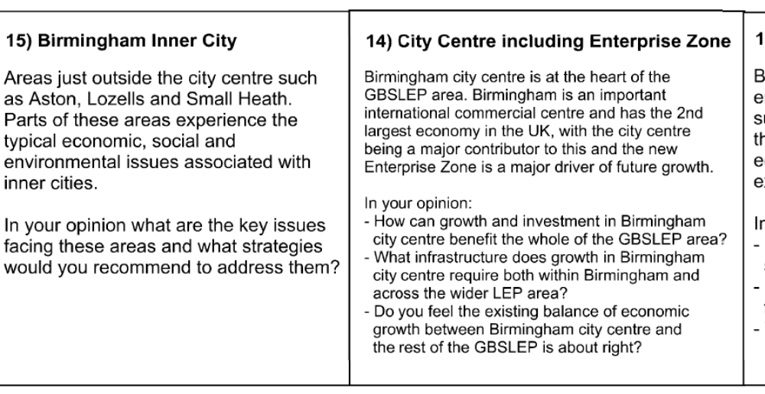
Questions

Slide 6
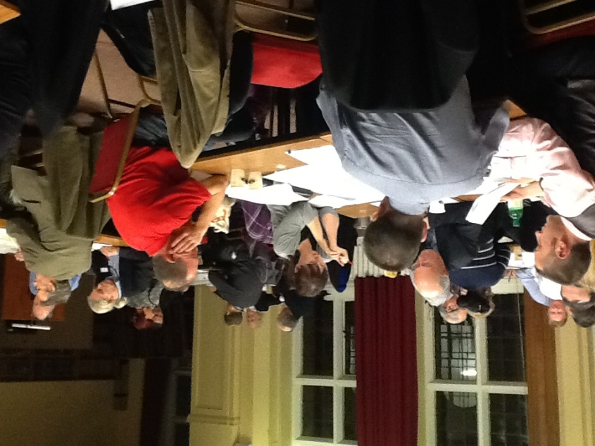
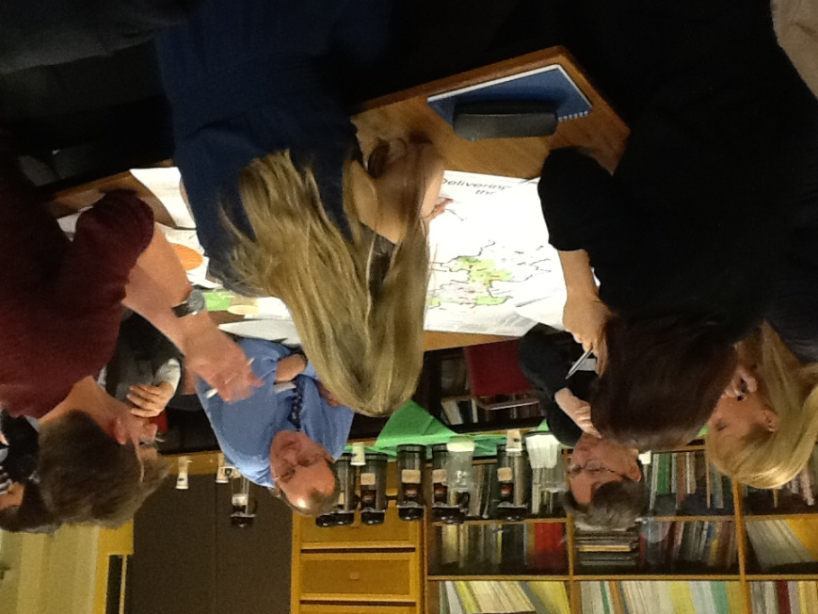
What happened
4 events held across region
Very positive feedback and engagement
Facilitator noted key points on flip chart

Slide 7
What happened
Game /Questions design 10 days plus full group meeting
4 workshops held involving over 160 people
Accompanied survey questionnaire for individual completion
http://centreofenterprise.com/strategic-spatial-framework-plan/
Currently using responses for further iteration

Slide 8
Lessons learnt
Great evaluations BUT……….
Need to decide at outset how data collected is to be analysed/used
Issue of qualitative data acceptability for policy and decision-makers
Secure individual responses after group discussion
Time invested vs value got out.

