Slide 1
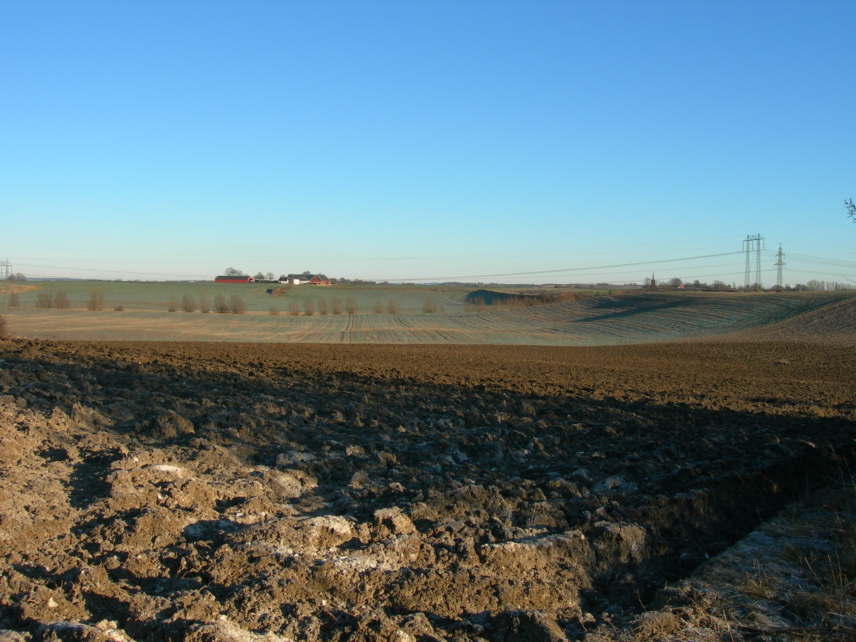
Rufopoly, Malmö urban fringe, 2012 - 2014
Mattias Qviström, Swedish Univ. of Agricultural Sciences (SLU)

Slide 2
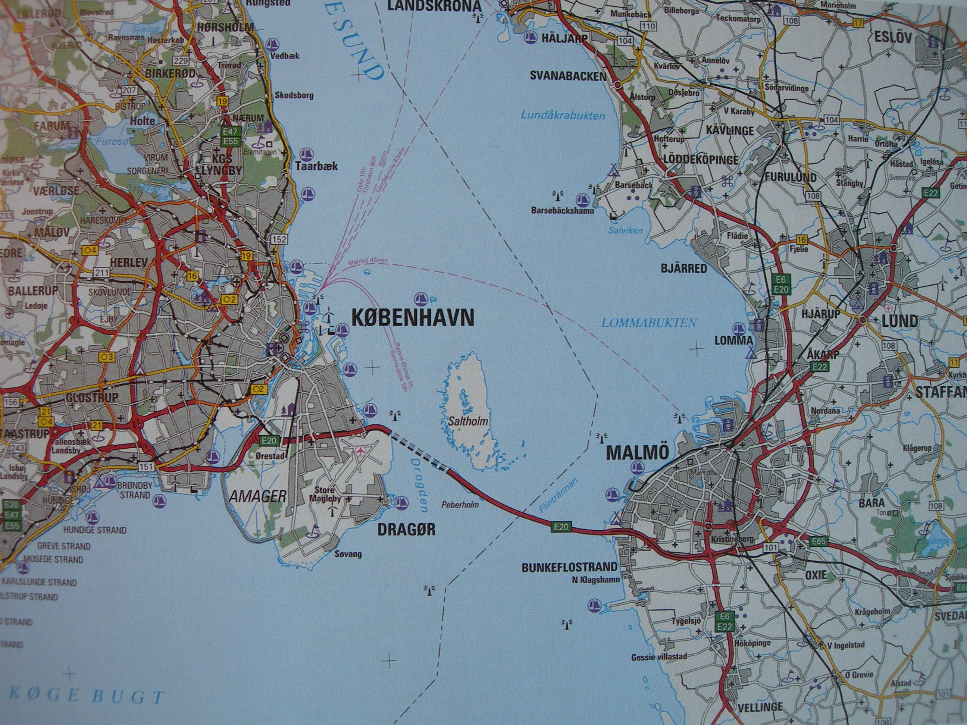

Slide 3
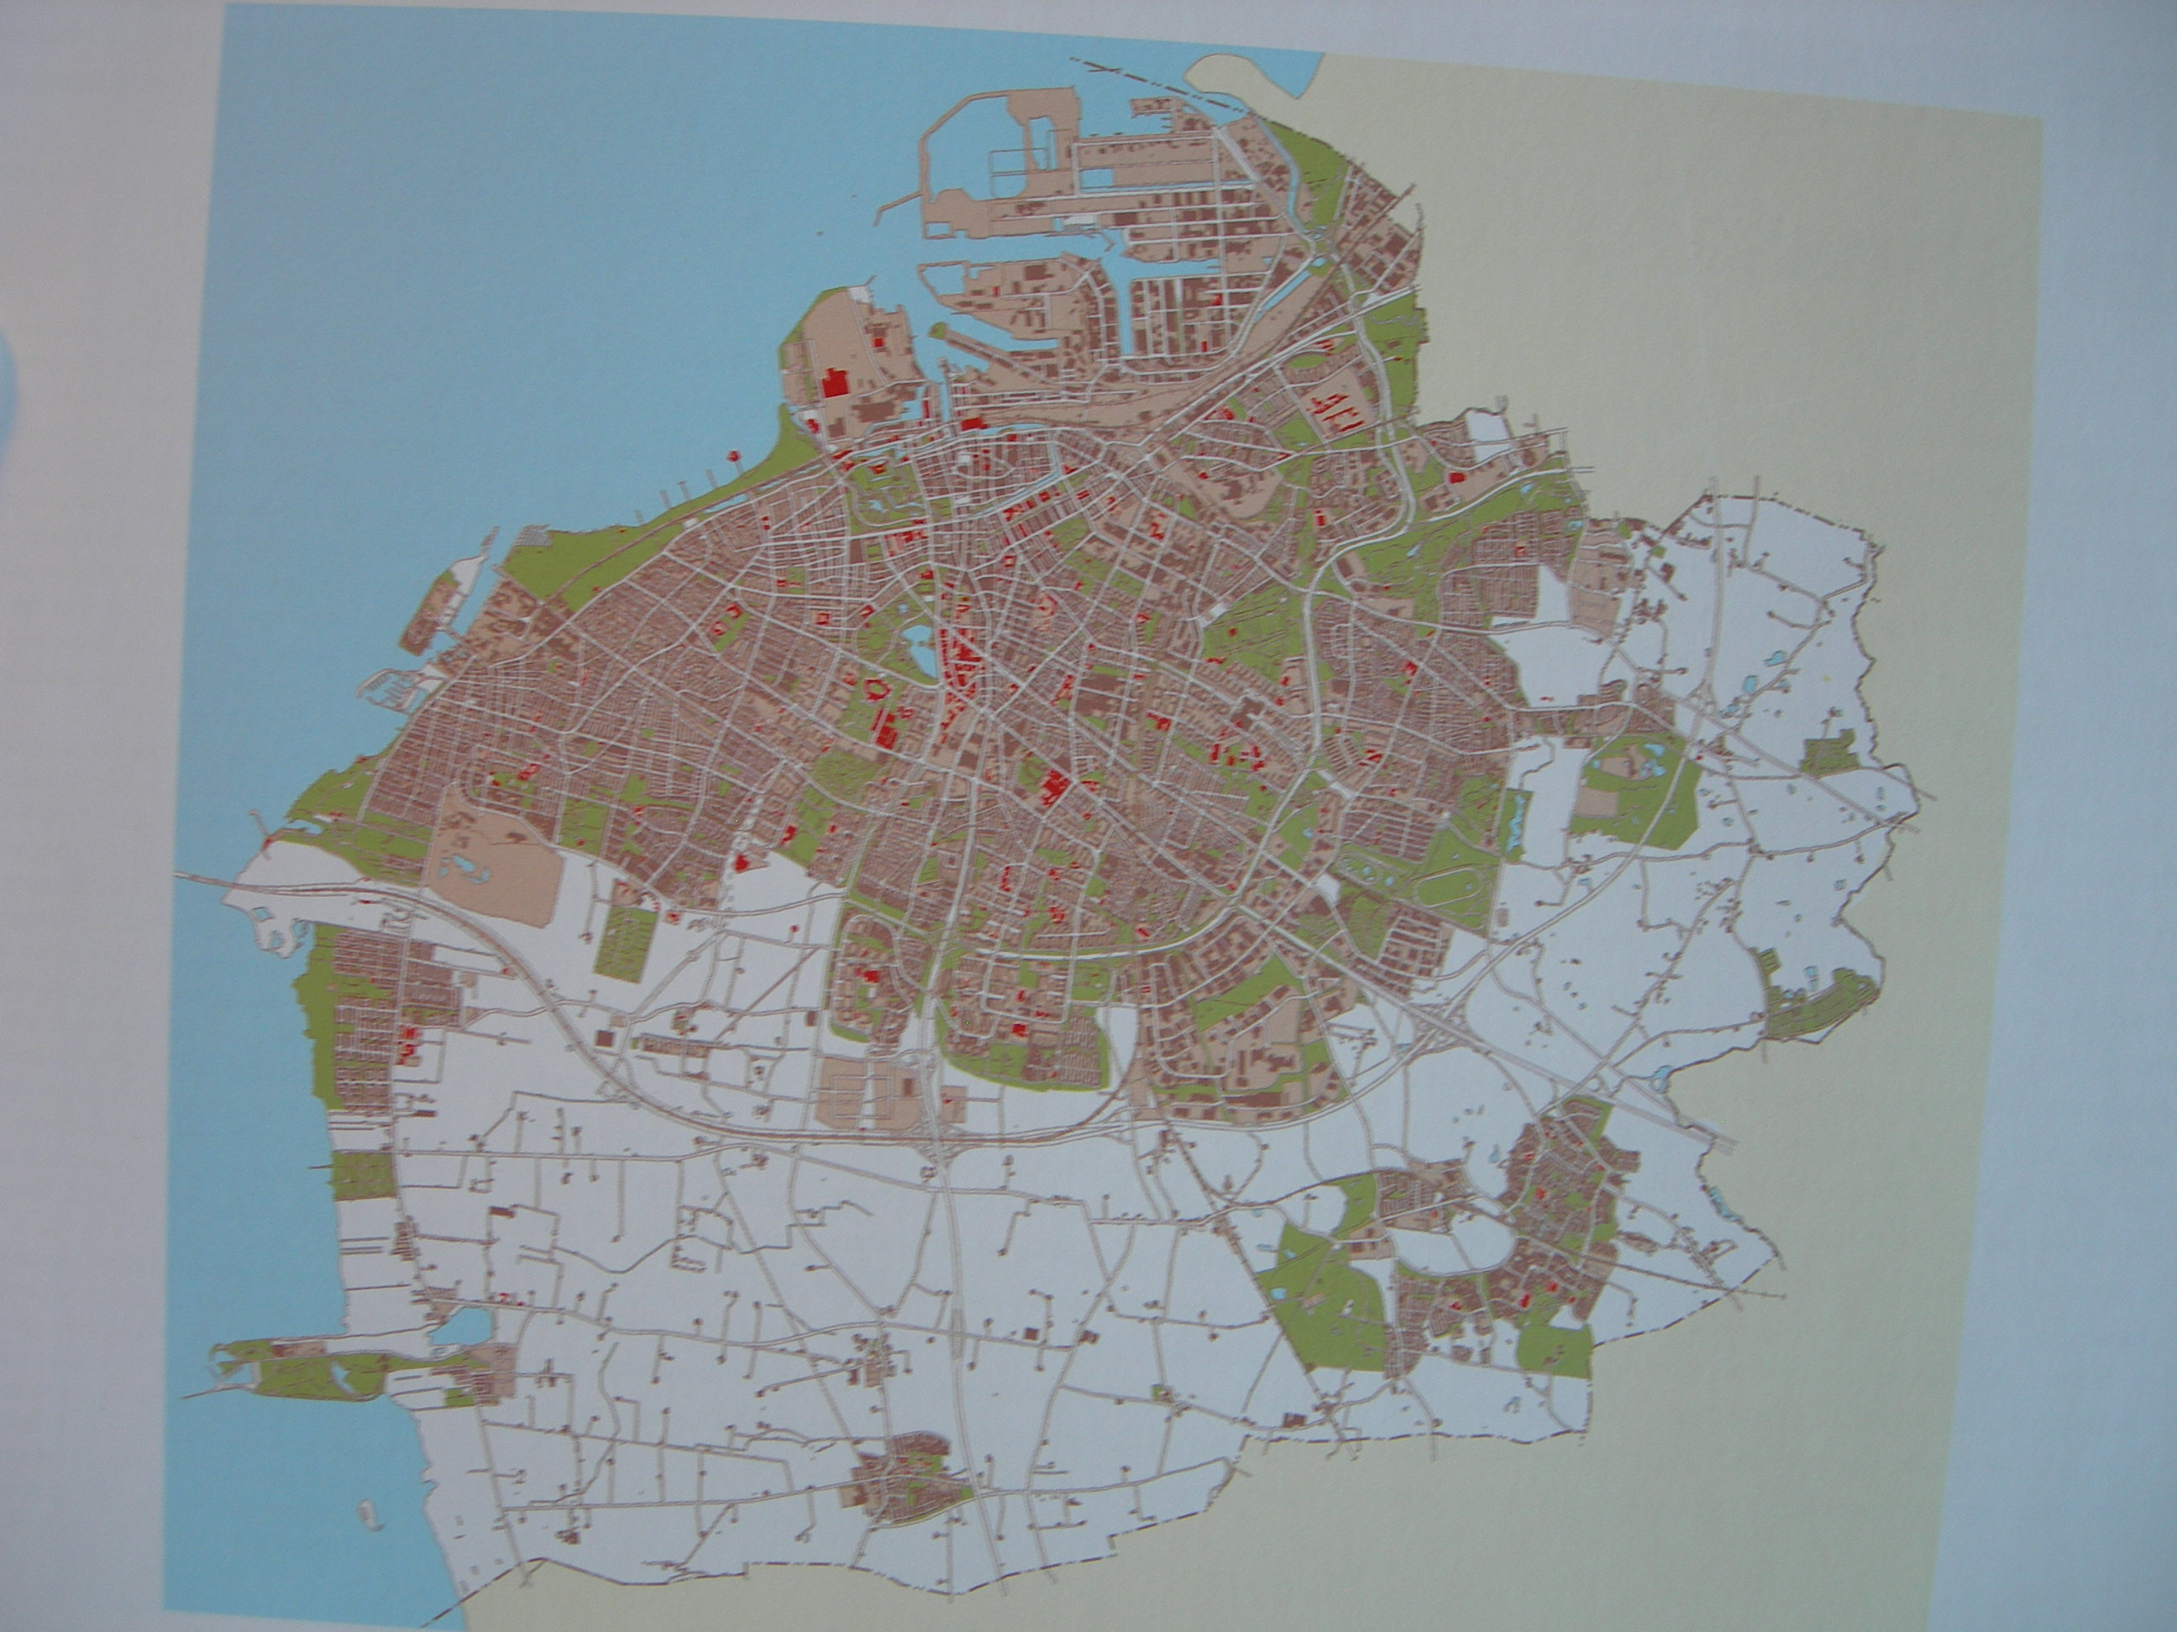

Slide 4
Malmö municipality (Malmö city)
300 000 inh. (ca 3 000 000 in the region)
Expanding region, small municipalities: competition over industries, shopping centres, housing
Urban sprawl – threatens the best farmland in the country
International reputation as a sustainable city
Aims to develop a strategic plan for the fringe (2016 – 2017)

Slide 5
The farm landscape is dominated by mono-functional, conventional farming
The municipality: open up the countryside for recreation, increase biodiversity, preserve features of the cultural landscape, support organic farming, etc.
Farmland is extremely productive – no need for the large farms to consider multi-functionality

Slide 6
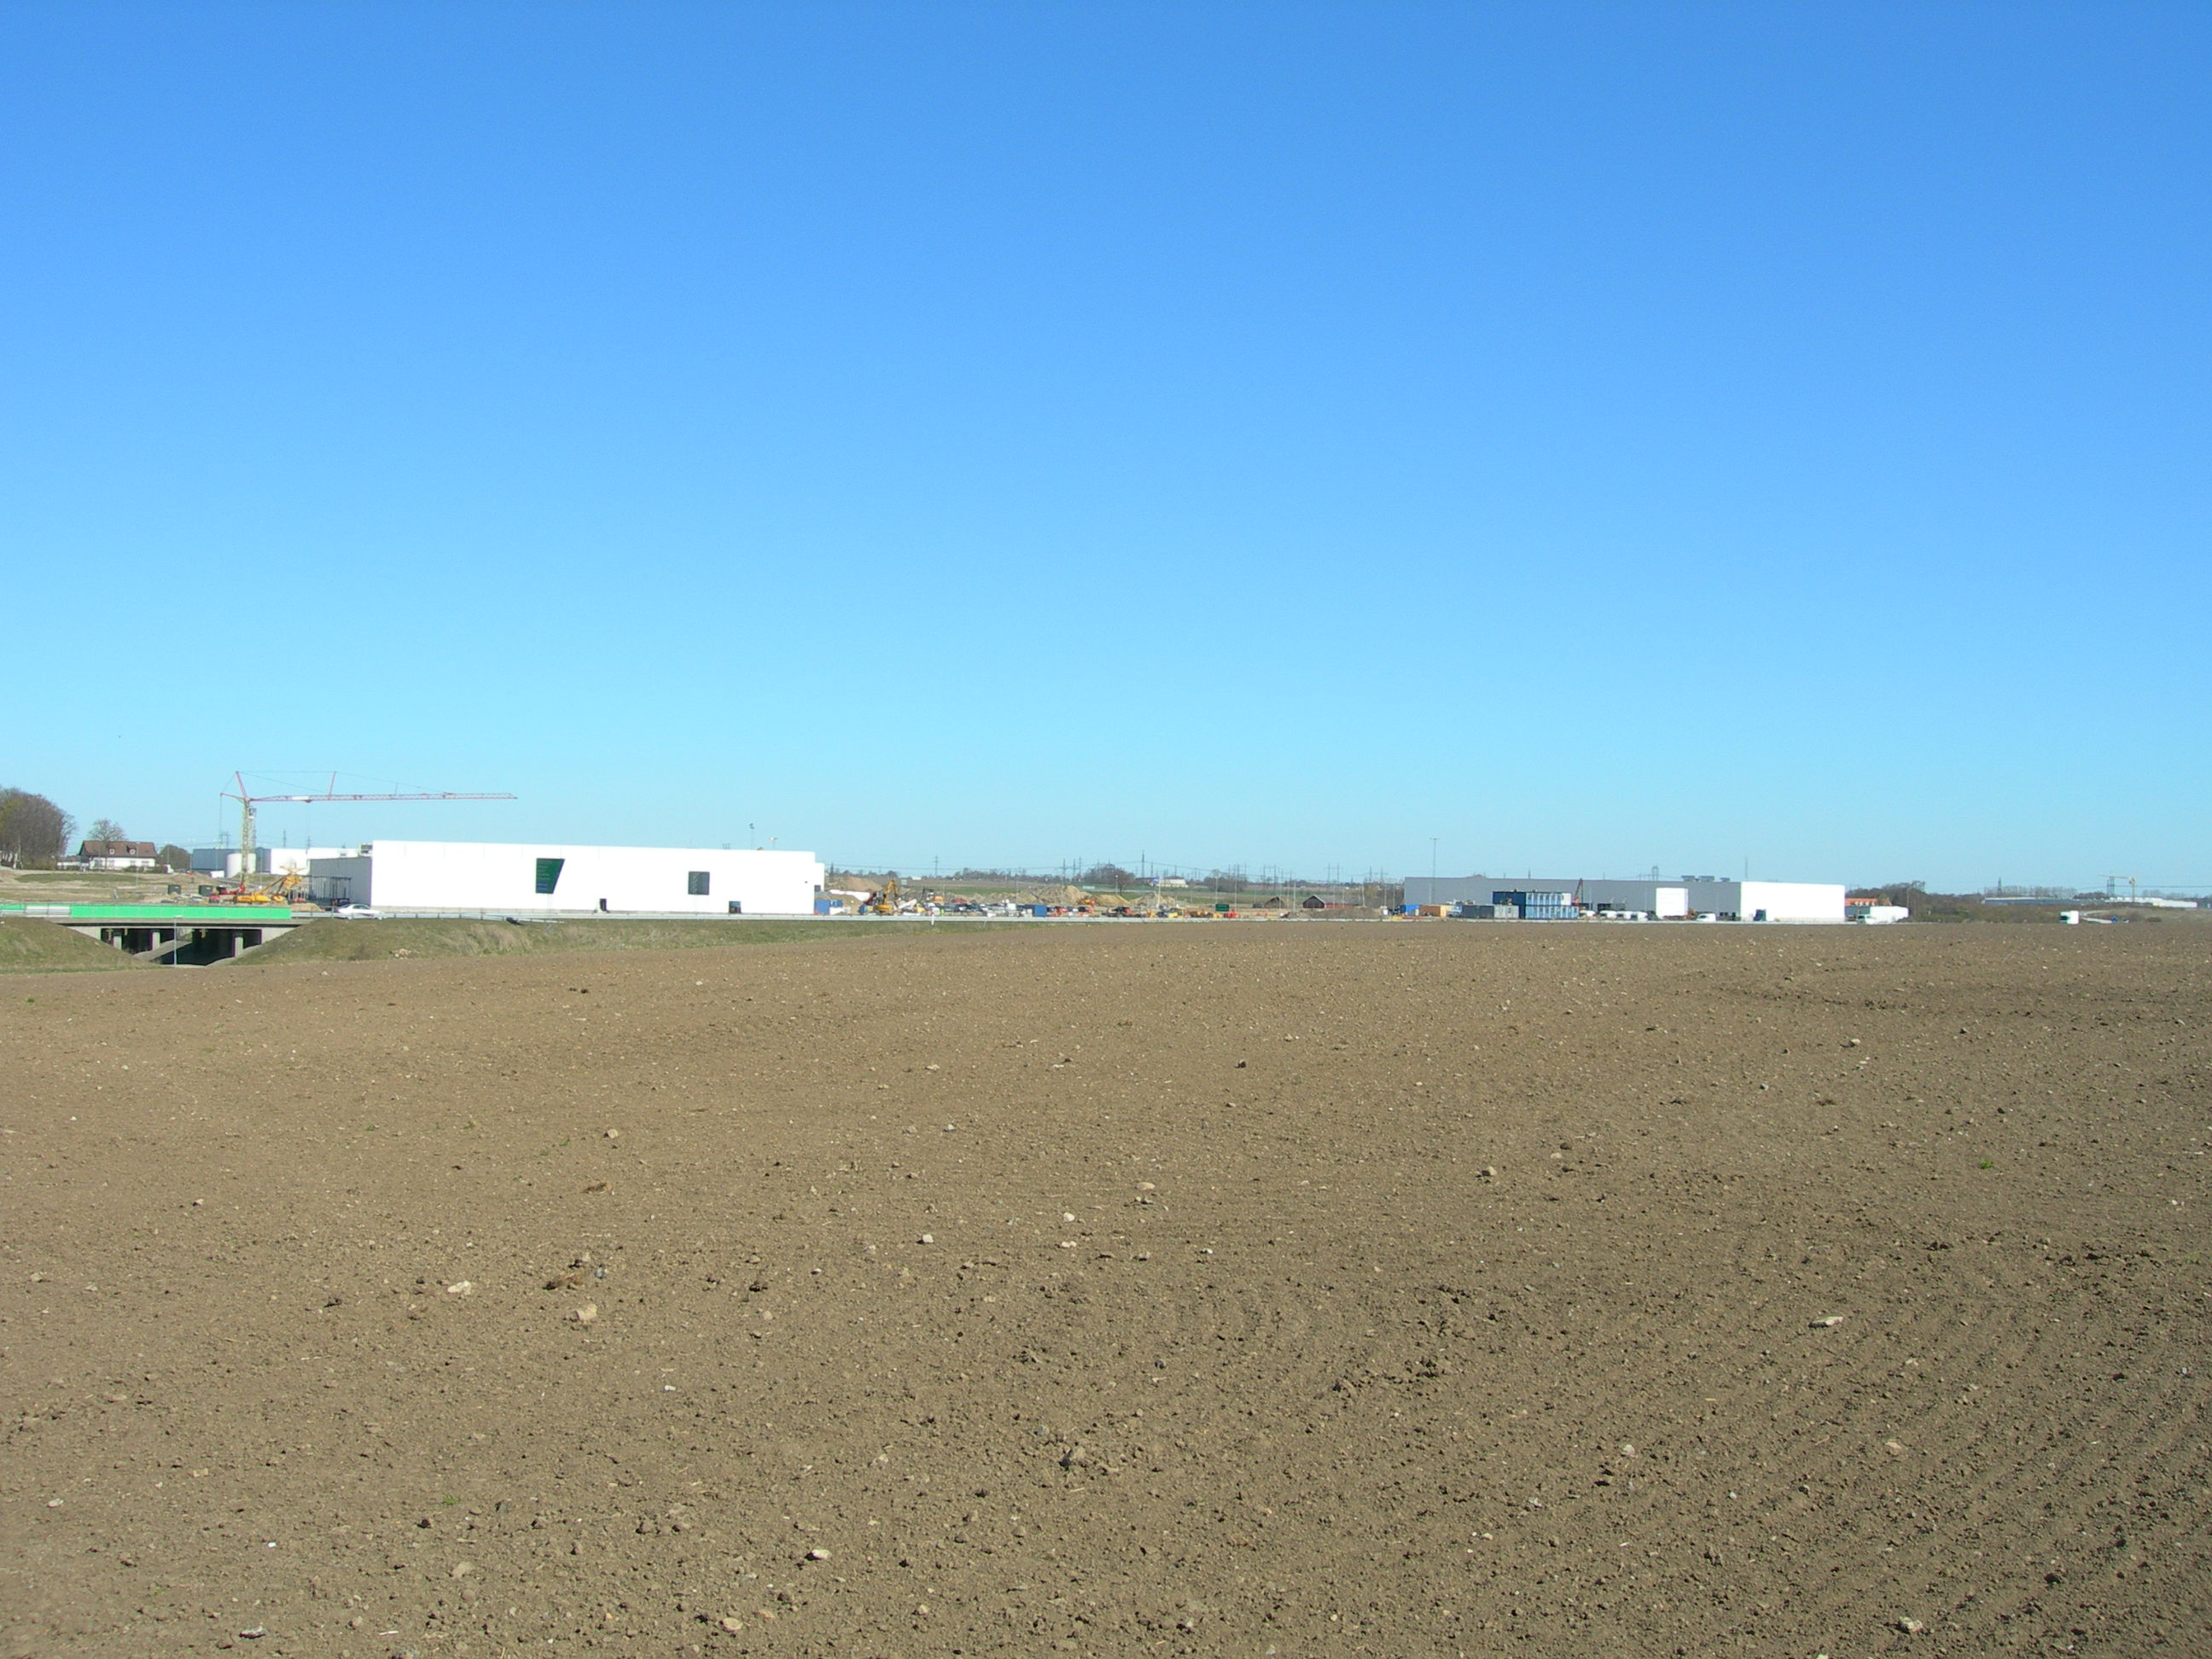
A contested and polarised landscape:
Conflicts between farming and an expanding city: polarised debate which doesn’t lead anywhere
Large conventional farms dominate the land-use
Tiny “horse farms” (leisure farming), small organic farms, local entrepreneurs, etc.

Slide 7
Two Leader-projects, 2012 – 2014
Project group: Malmö municipality, SLU, the local Farmer’s Association, local “rurban” entrepreneurs
Aim 1: to facilitate a fruitful dialogue concerning the urban fringe
Aim 2: to adapt Rufopoly for Malmö
Aim 3: facilitate strategic planning for the urban fringe

Slide 8
The workshops
Ca 10 workshops, 5 – 40 participants/workshop
Students, farmers, representatives for Farmer’s association, local planners and politicians, local entrepreneurs, researchers (planning and agriculture)
Primarily an educational or explorative setting

Slide 9
Playing/evaluating/translating the game
Initially: the original game board, translated (most of the) questions
Successive transformations of the rules and questions
New game board for the final workshop
The successive translation has been useful for the dialogues within the project group, but makes the evaluation of the game difficult (only one group has played the most recent version)

Slide 10
What happened
Introducing RUF + the project + the rules = time consuming. The game required 1 hour. Limited time for general discussions
The game board was difficult to interpret: simplifications + active facilitation
Discussions due to differences between the board and the Swedish context

Slide 11
What happened, cont.
Focus on the dialogue, using the “board game atmosphere”. The joint discussion was set in focus, not the individual notes
The open and relaxed dialogue would have been impossible without the game board and its “neutral” setting
Role play
Consensus questions
Final step: suggest new questions or themes

Slide 12
What happened, cont.
Minimalistic game board was developed
The new game board inspired/required a new set of questions
Positive (not overwhelming) feedback on the game, sometimes overshadowed by the “so-what” dilemma
We didn’t manage to engage with the conventional farmers – not important enough ?

Slide 13
Positive feedback
Excellent for teaching (planning, urban fringe)
Excellent warm up exercise for “the real thing”
Could be used to inform planning, needs to be developed: the process of phrasing questions is a key
The combination of role play + consensus was a success
Very basic game board + active facilitator a good combination

Slide 15
Negative feedback (and solutions)
Difficult to understand the game board (needs to be introduced by the facilitator)
Difficult/long questions (guidelines for a good question has been developed)
When/how to use it in planning? (A second step: phrase questions regarding your urban fringe)

Slide 16
The game has been adjusted to:
The Swedish planning context
The local landscape/conflicts
Swedish perceptions of the landscape (visual bias)
To another tradition of participatory planning?

Slide 17
50% of the farmland is owned by the municipality and leased out to farmers on one-year contracts.
The farmers don’t trust the municipality, due to the purchases of farmland in the 1960s and 1970s.
The contracts are renewed annually, not revised: difficult to bring in new regulations in old contracts.

