Slide 1
UCAS Resources for Advisers
James Durant
Professional Development Executive

Slide 2
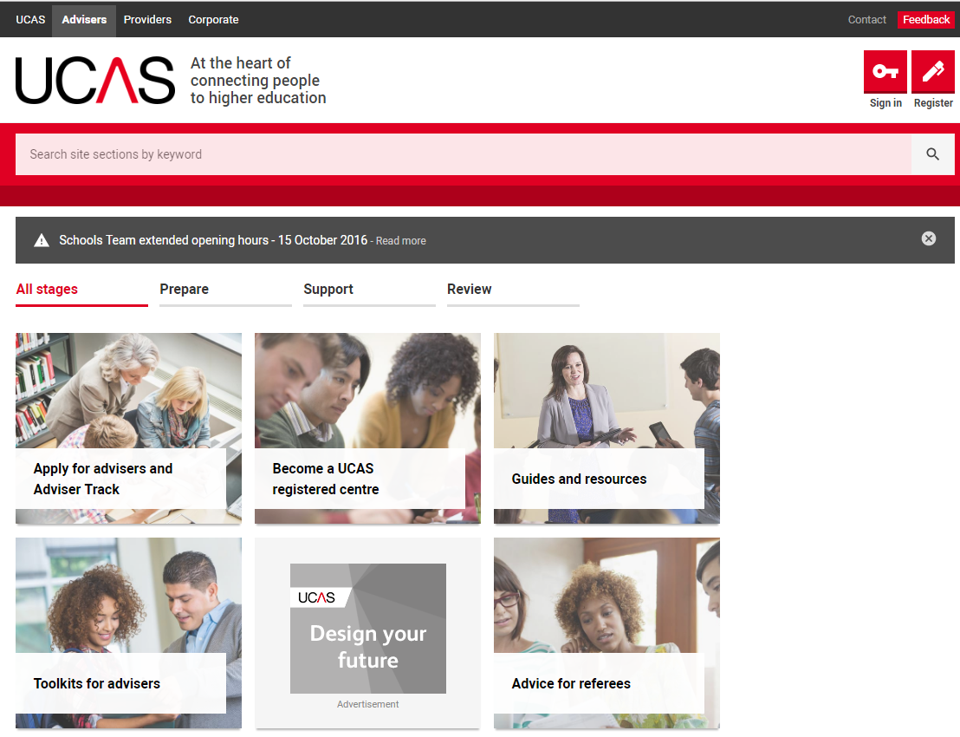

Advisers’ area of UCAS.com

Slide 3
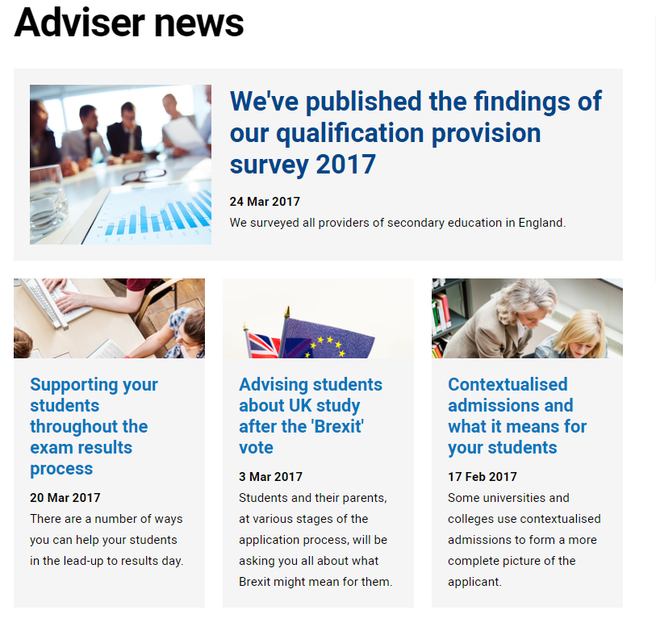

Keep up to date:
Sign up for our free adviser newsletter
Adviser news tile
@ucas_advisers for the latest info.

Slide 4

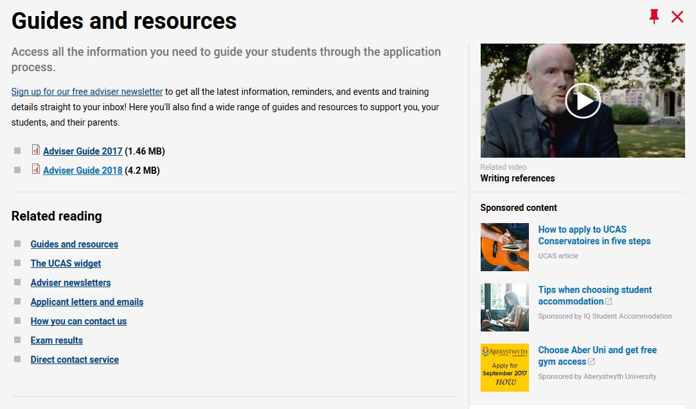
Advisers’ resources

Slide 5
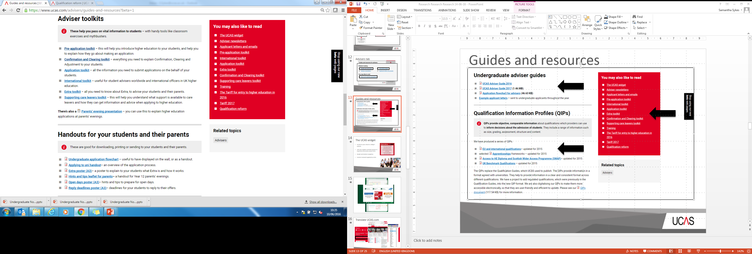
Advisers’ resources

Slide 6
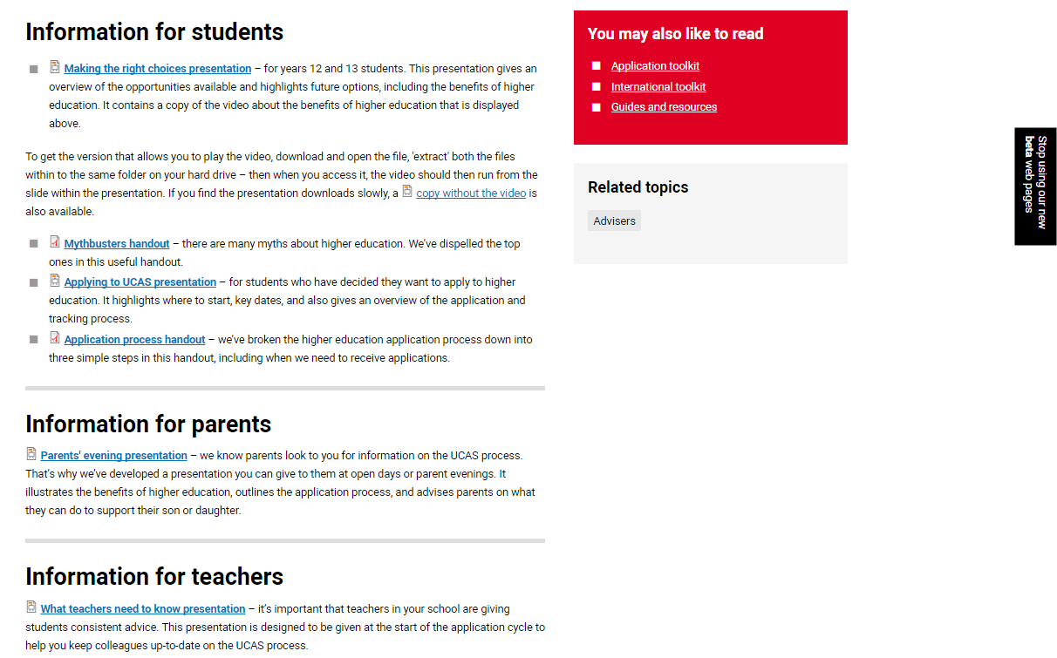
Toolkits
Downloadable
Printable
Adaptable
Updated
Time saving

Slide 7
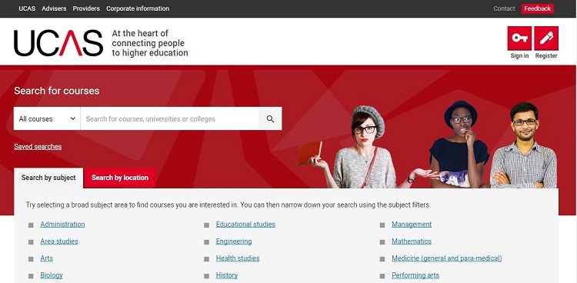
New look search
Multi-destination search tool
Single destination for all applicants.
2017 & 2018 search tool to run concurrently.
Key features include:
new mobile-friendly design
advanced filtering and sorting options
ability to shortlist and save course searches
free text search
suggestions for misspelt searches

Slide 8
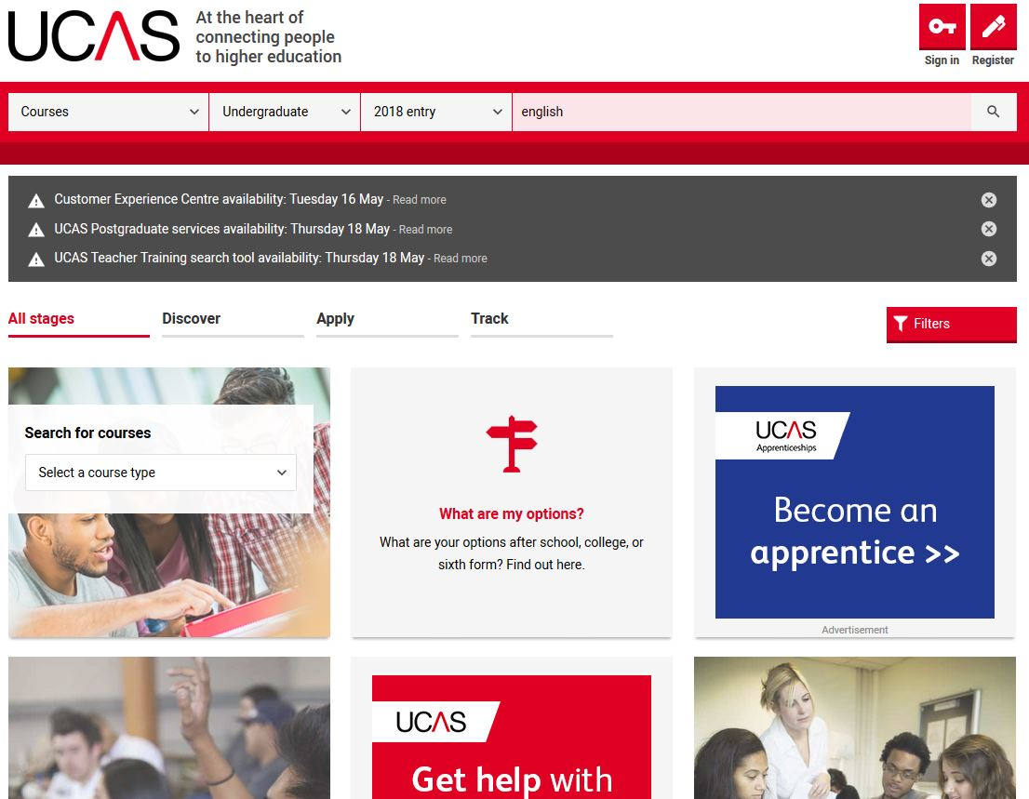
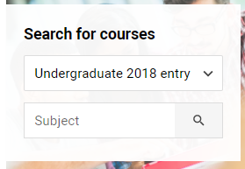
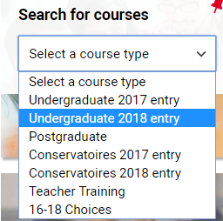
Search tool

Slide 9
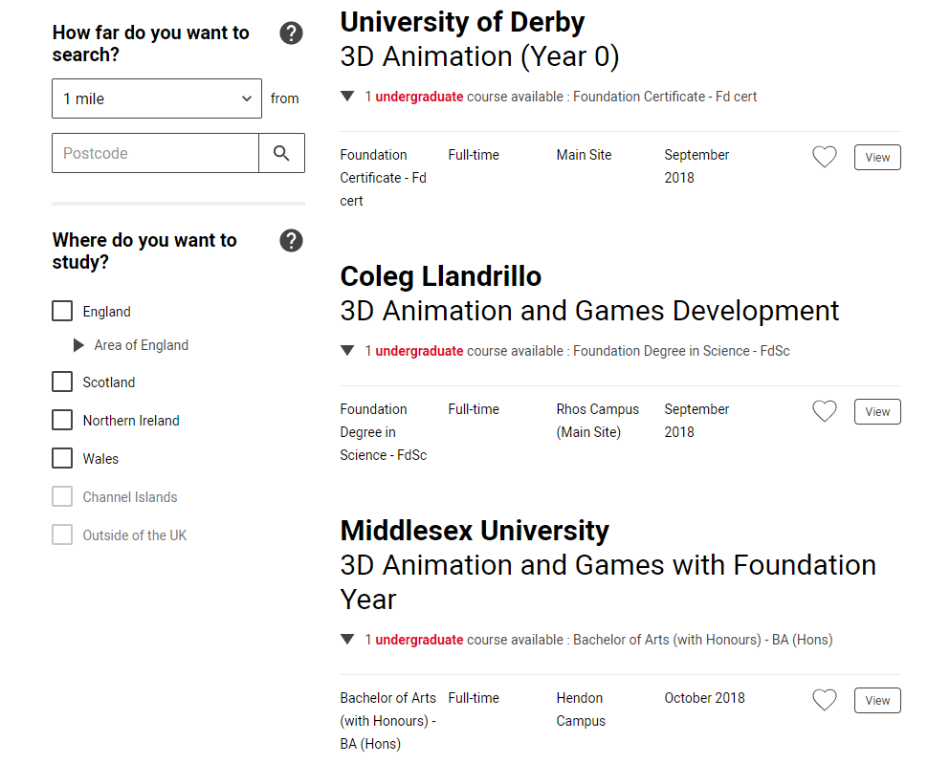
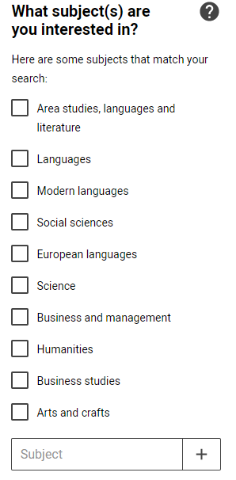

Slide 10
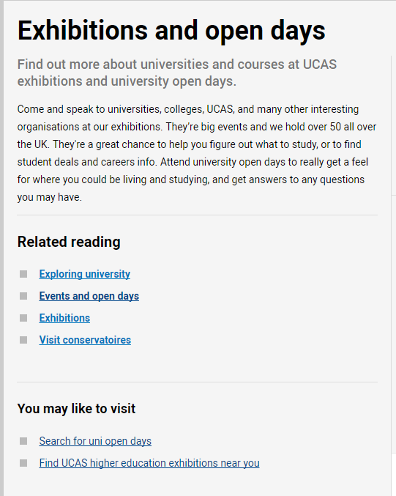


Open days and virtual tours

Slide 11

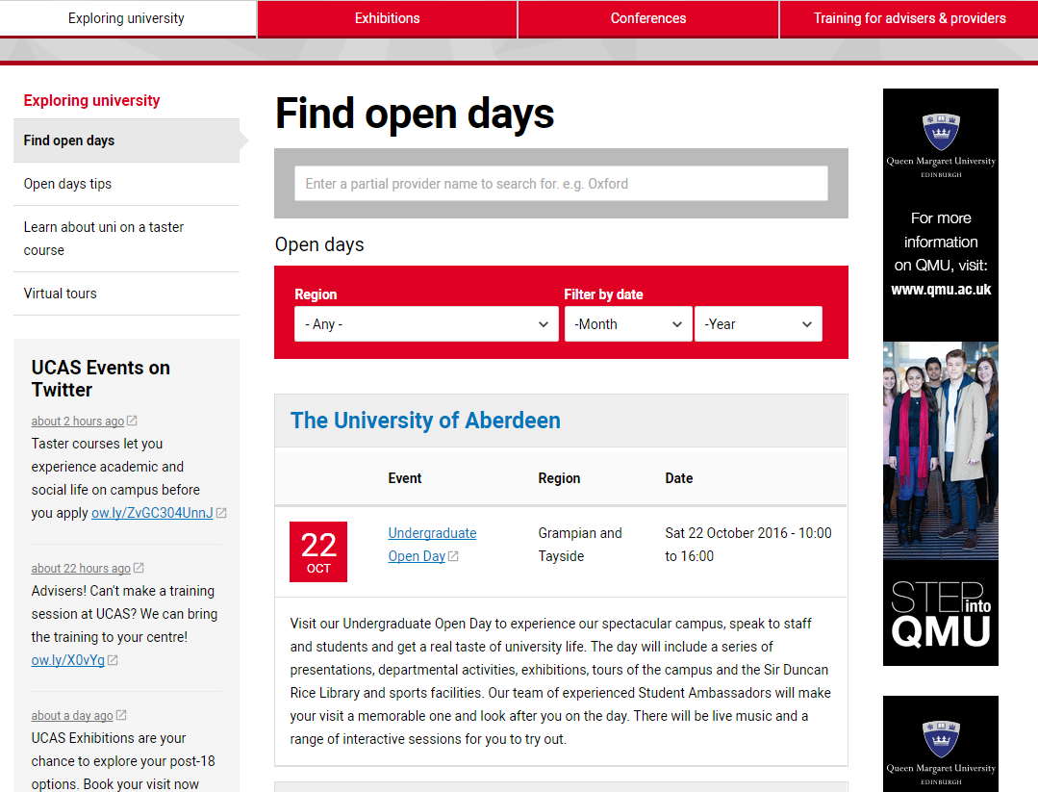
Open day search tool

Slide 12
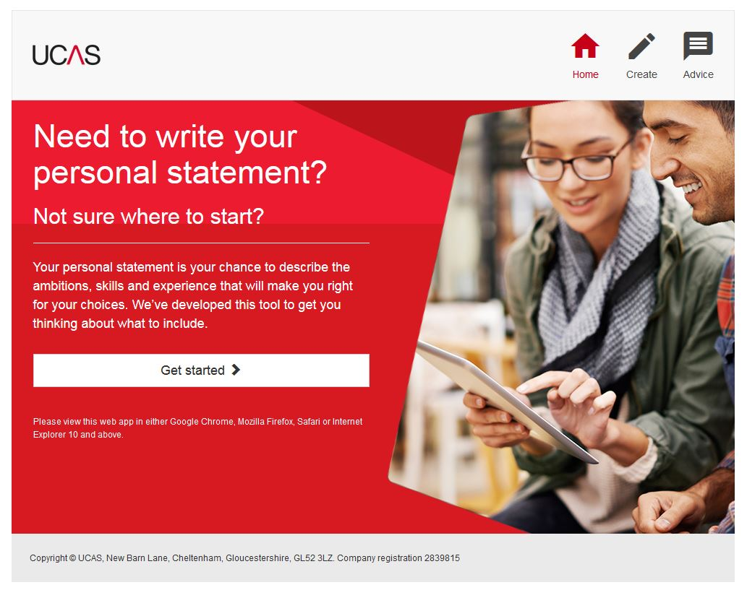
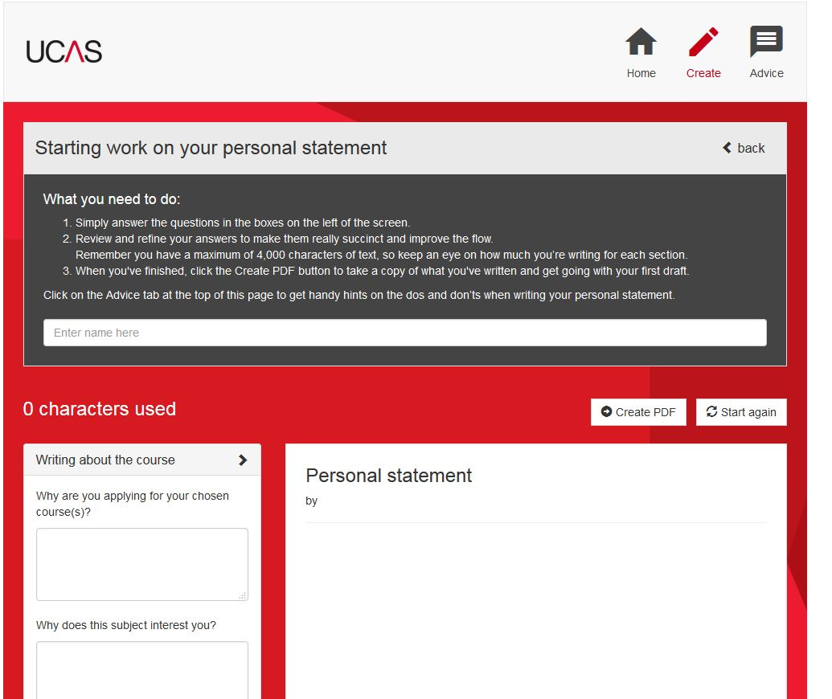
Our personal statement tool

Slide 13
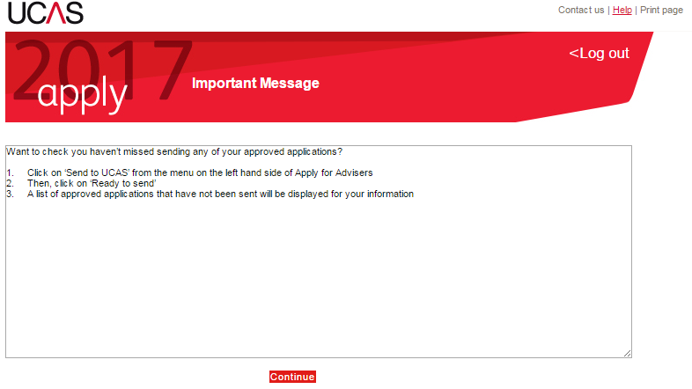
Lessons learned – key deadlines
Ignoring messages on the Apply for advisers home screen.
Approving applications but not sending to UCAS.
Forgetting an application has been returned to an applicant.
Waiting too long to complete the reference.
Applicants being held in the ‘default group’

Slide 14

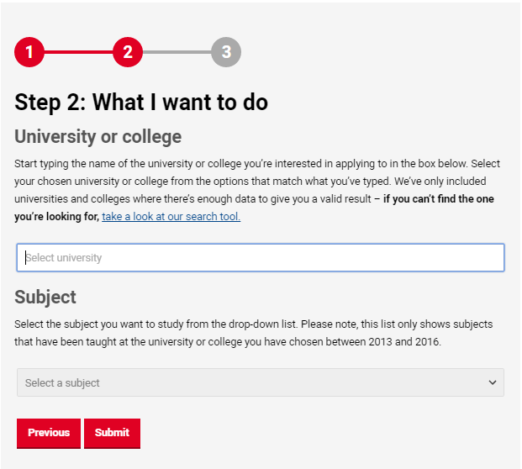
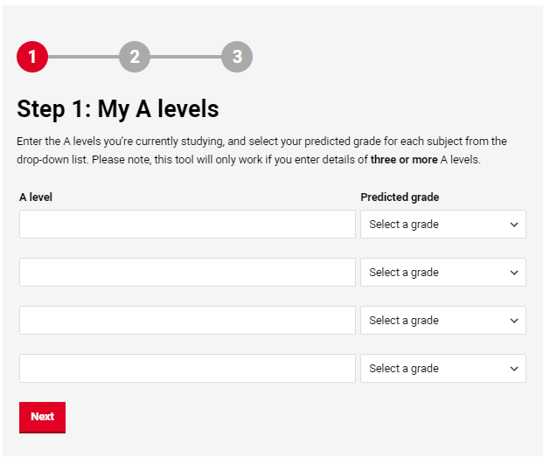
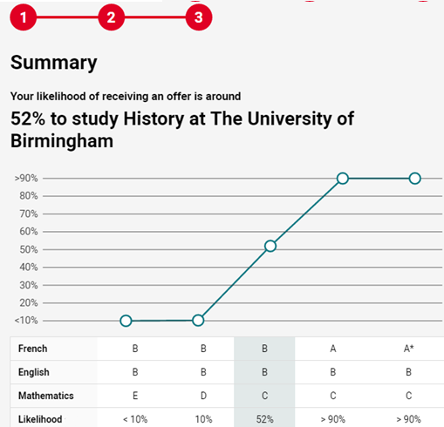
Offer rate calculator

Slide 15
Remember…
This tool has been designed for use with students in a 1-2-1 context with a teacher or adviser.
The calculator provides an estimate based on past applications.
Universities and colleges take much more than just grades into consideration.

Slide 16
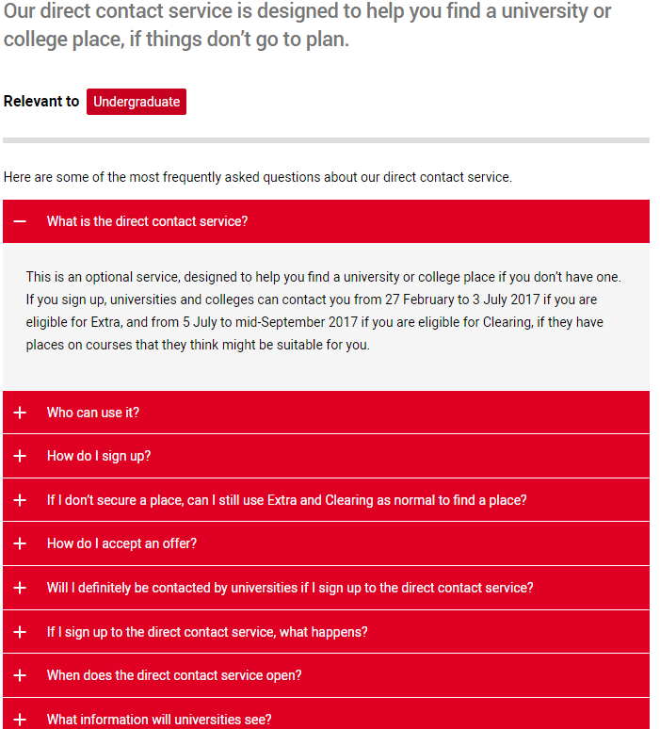
Direct contact service
An optional sign up service for learners
to find a place if they aren’t holding any
live choices.
Universities and colleges can
contact learners from
27 February to 3 July 2017 - if
they are eligible for Extra.
And again from 5 July to
mid-September 2017 if they
are eligible for Clearing.

Slide 17
Preparing for Confirmation and Clearing
Ensure personal details are correct.
Remind students to keep Track up to date.
C&C information now in one place on our website.
Clearing choice can be added from 15.00 on results day.
Emails about mismatched and unplaced applicants.
Ensure students are informed about their options.
Notes:
Learners are overwhelmingly happy with the support they get with their application from their school (93% felt supported)
But during Clearing it would seem less support is available. Only 52% of those placed in Clearing agreed they got the support needed from their school.
We plan to email advisers on SQA and A level results days with a list of students who have not had their place confirmed at their chosen university or college. It is envisaged we will only be able to offer this to centres where applicants are taking qualifications with which UCAS has a formal Awarding Body Linkage (see www.ucas.com/ advisers/exam-results). Testing is currently taking place on exact details, so please look out for more information on the website and in our newsletters.

Slide 18
Awarding Body Linkage
          To prevent mismatches through ABL there are some things you can do to help:
          Work with your exams officer to ensure that qualifications entered match those that the applicant is actually taking e.g. has dropped a subject, wrong BTEC etc.
          Check date of birth is entered correctly and that month and year on exam records match UCAS application.
          Check that names match e.g. correct order, shortened first names.
          This will help to prevent delays at Confirmation post-results.
          For further information see Exams results.
Notes:
UCAS receives exam results from many awarding bodies. We then match the results to your students’ applications and send them to the universities and colleges that are holding offers for them.
If your students are taking an examination not listed in our exam results webpage, they need to send their results/certificates to their firm and insurance choice universities as soon as they receive them.
Once you have submitted the application remember that if there are changes to exam details that applicants have entered in Apply
Let us know at qualsupport@ucas.ac.uk straight away if any of your students’ exam details change, and let the universities/colleges know too. that's anything from exam subjects, modules or units, to awarding/examining bodies and centre numbers. The email is also listed in our exam results webpage.
It's important to tell us, as it could delay the processing of the exam results if we are not updated. If results can’t be confirmed, your student might not get their place.

Slide 19
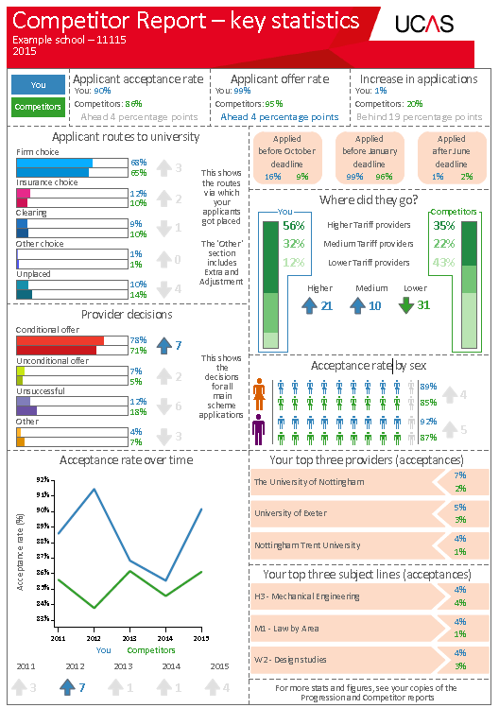
Improved reports for advisers
New style Competitor Report dashboard
Headline stats at-a-glance
Applicant Status Reports (ASRs)
New Macro tool to help sort and filter your ASRs
Institutional codes and campus
codes listed on the UCAS website
Notes:
Macro tool link - https://www.ucas.com/advisers/managing-applications/adviser-track-and-reporting
ASR codes -https://www.ucas.com/advisers/managing-applications/adviser-track-and-reporting

Slide 20

Professional Development Portal
Our new professional development portal for advisers gives you access to a series of short digital training modules.
Designed to expand your understanding of the UCAS admissions service.

Slide 21
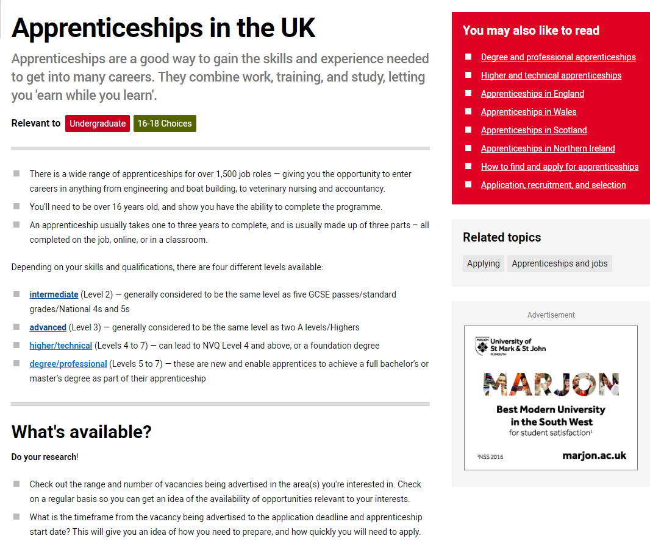
Apprenticeships I&A

Slide 22
Changes at UCAS
New Application Management System (AMS) for 2019 cycle.
Apprenticeship information and advice.
Ability to search for apprenticeships, graduate jobs, and internships.
Direct contact service for Extra as well as Clearing.
Qualification reform information, advice, and resources.
Information on contextualised admissions and widening participation.
Adviser timeline … coming soon!

Slide 23
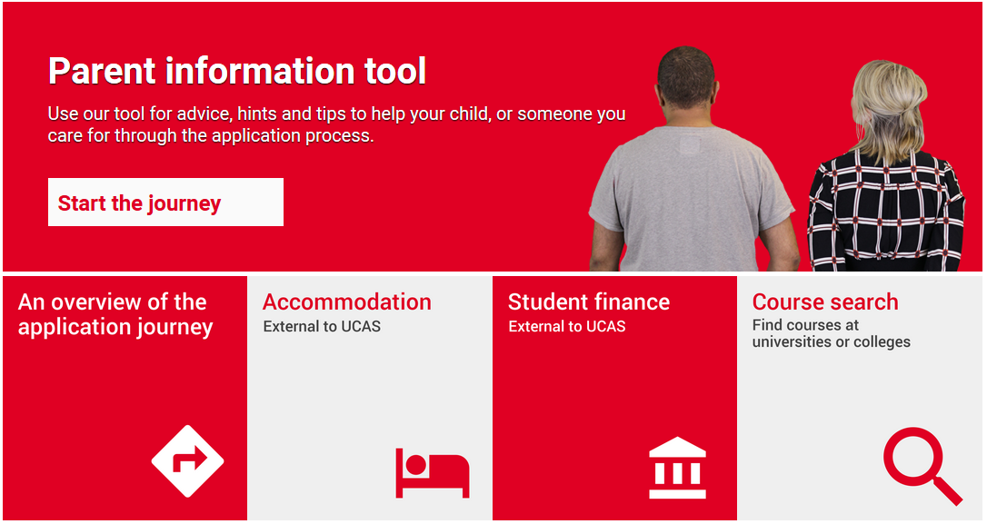
Parents’ information tool
A handy guide for parents through the entire application process.
Notes:
Available at - https://www.ucasdigital.com/widgets/parents_tool/index.html#/home

Slide 24
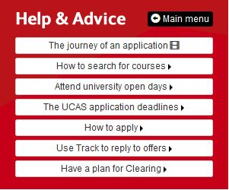
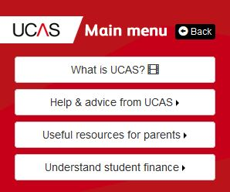

The UCAS widget
Hosted on your school or college’s website.
Link your students and their parents to important information about UCAS.
Simple and intuitive navigation.
Content reviewed regularly by UCAS.

Slide 25
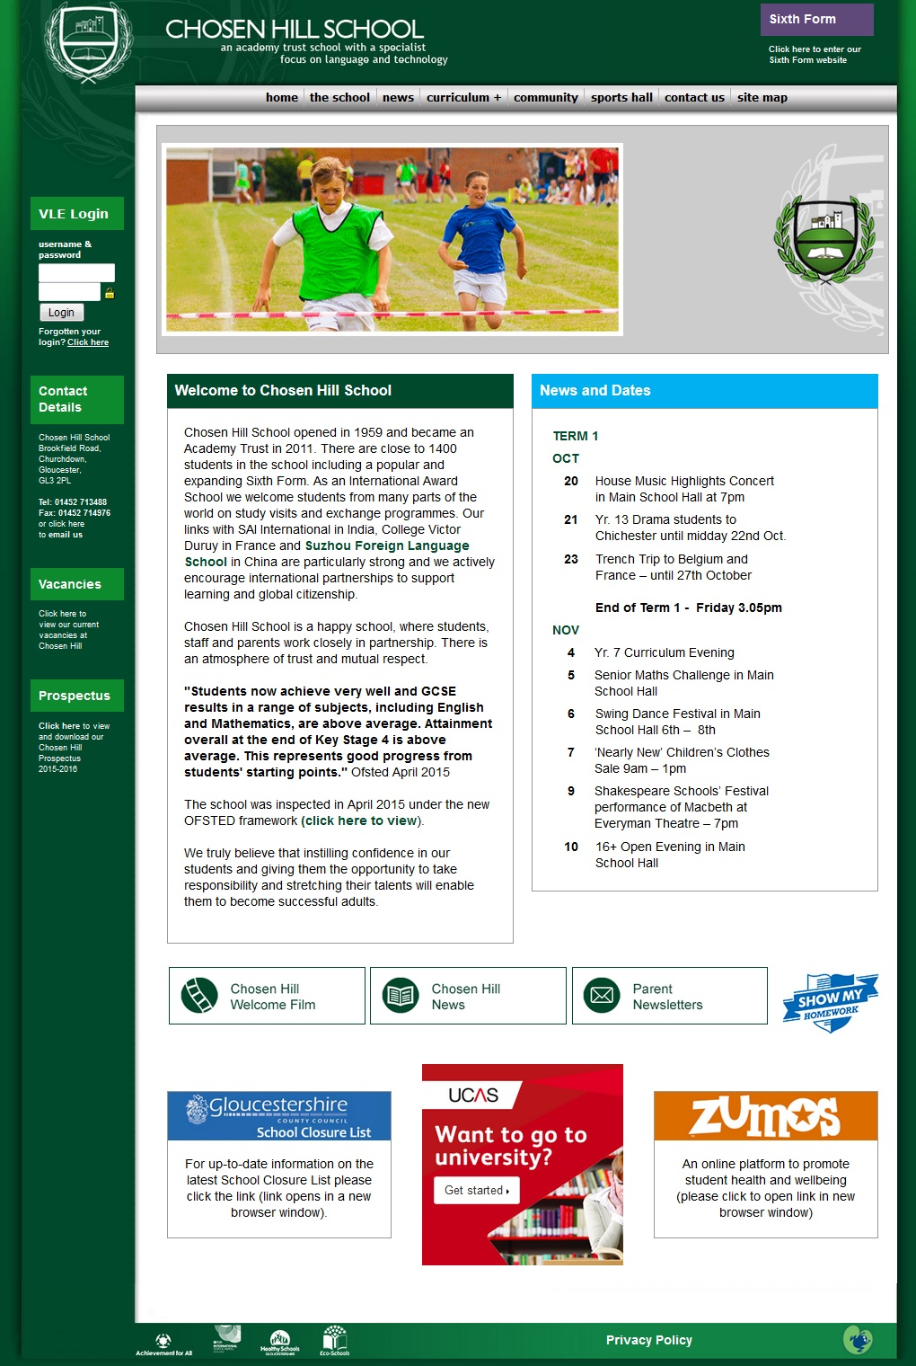

Slide 26
More support and guidance
Contact the UCAS Schools Team:
UK advisers: 0345 123 8001
Email: adviserhelp@ucas.ac.uk
Visit www.ucas.com/advisers to:
understand more about the application process
access Apply for advisers
download guides and resources
Access information on training and conferences
Adviser Track and reports guidance
latest news updates on the education sector

Slide 27
UCAS Schools Team
0345 123 8001
adviserhelp@ucas.ac.uk
Thank you
j.durant@ucas.ac.uk

