Slide 1

Pivotal area: Modelling and Guided Practice in Mathematics
Key Question: How do I model and guide the pupils to ensure they are successful in their independent practice?
Intensive Training and Practice (ITaP)
Mentor Training

Slide 2


Modelling and Guided Practice
INTRODUCE
ITaP Outcomes
Classroom Practice (Standard 4 – Plan and teach well-structured lessons)
Learn that
3. Modelling helps pupils understand new processes and ideas; good models make abstract ideas concrete and accessible.
5. Explicitly teaching pupils metacognitive strategies linked to subject knowledge, including how to plan, monitor and evaluate, supports independence and academic success.
Learn how to:
Plan effective lessons, by:
a) Using modelling explanations and scaffolds, acknowledging that novices need more structure early in a domain.
Model effectively, by:
i) Narrating thought processes when modelling to make explicit how experts think
j) Making the steps in a process memorable and ensuring pupils can recall them
k) Exposing potential pitfalls and explaining how to avoid them

Slide 3
Modelling and Guided Practice
INTRODUCE
Practicable Skills
Modelling motivation
Live modelling / worked examples (I do)
Normal speed / slowed down
Silent modelling
Narrating the process
Misconceptions
Part complete examples
Metacognitive talk
Guided practice (we do)
Set tasks similar to worked examples
Invite children to contribute
Check for success / errors
Provide further models
Independent (you do)
Set tasks similar to worked examples

Slide 4
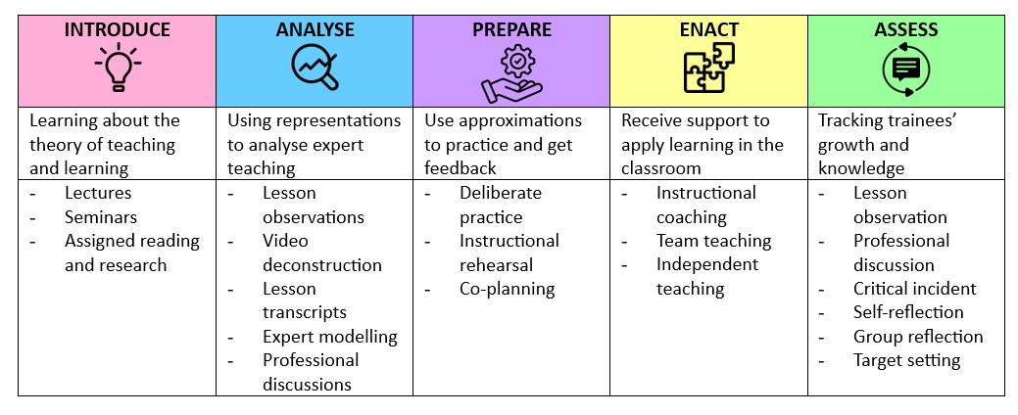
Adapted five-stage framework
The adaptation of five-stage framework, drawn from research by Grossman (2018) on teaching core practices to trainees supported the design of our ITaP models and the creation of a tightly co-ordinated set of activities that bridge pedagogical theory and teaching practice. The activities chosen to address each of the five elements of the framework are a guide and may vary between ITaPs.

Slide 5


Modelling and Guided Practice
INTRODUCE
ANALYSE
PREPARE
Day 1 - University
Notes:
We introduce the students to a range of research

Slide 6

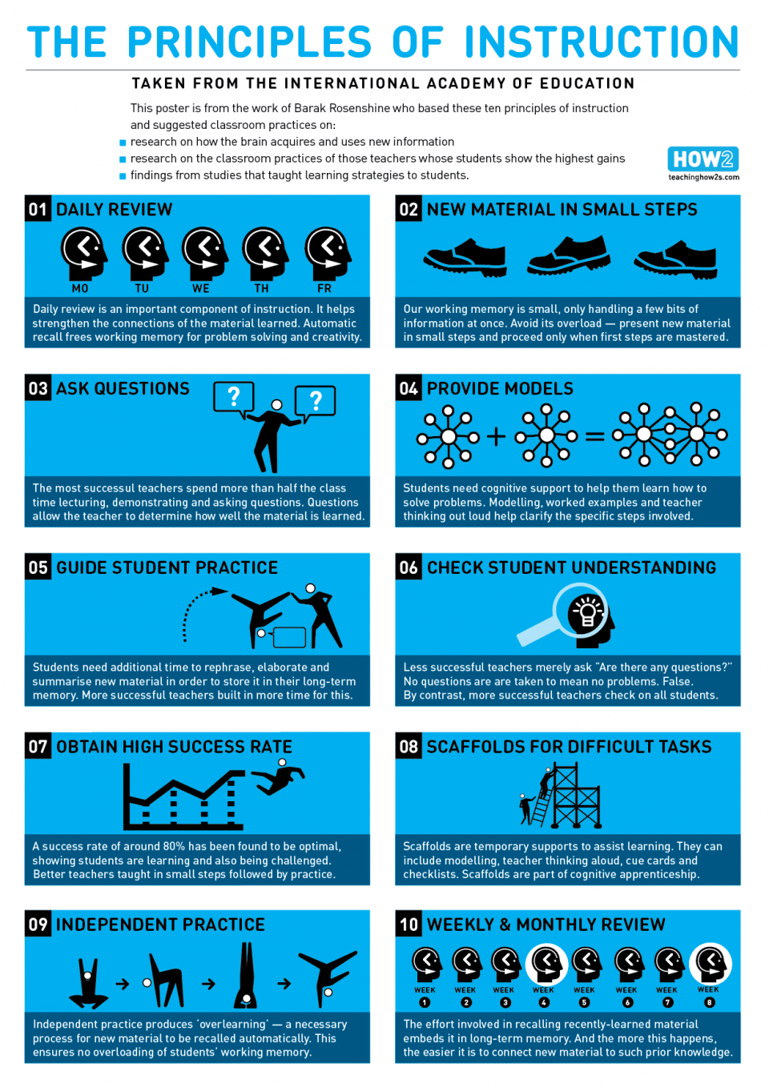
Modelling and Guided Practice
INTRODUCE
https://teachinghow2s.com/blog/principles-of-instruction
Rosenshine (2012) presented 10 ‘researched –based’ principles of instruction and suggestions for classroom practice
Rosenshine B (2012) Principles of Instruction: Research-Based Strategies That All Teachers Should Know, by Barak Rosenshine; American Educator Vol. 36, No. 1, Spring 2012, AFT

Slide 7



Modelling and Guided Practice
INTRODUCE
EEF blog: MODEL: promoting mathematical motivation and… | EEF (educationendowmentfoundation.org.uk)
Metacognition and Self-regulated Learning | EEF (educationendowmentfoundation.org.uk)
Improving Mathematics in Key Stages 2 and 3 | EEF
Notes:
Recommendation five of ‘Improving Mathematics in Key Stages 2 and 3’ guidance report highlights the importance of adults modelling strategies and behaviours to encourage pupils to develop their independence and motivation towards learning maths.

Slide 8
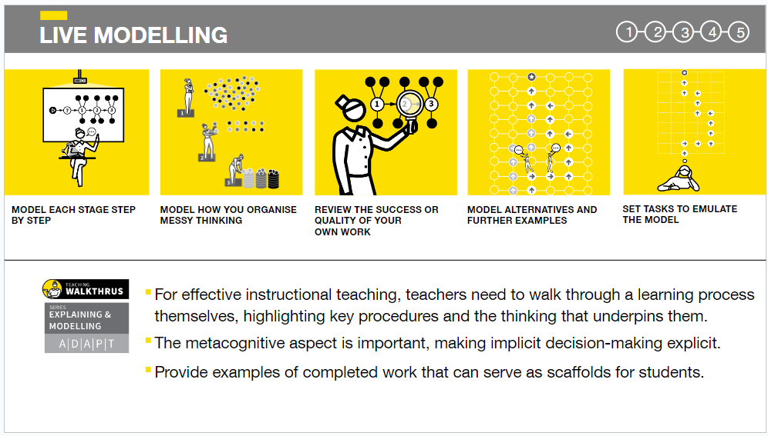
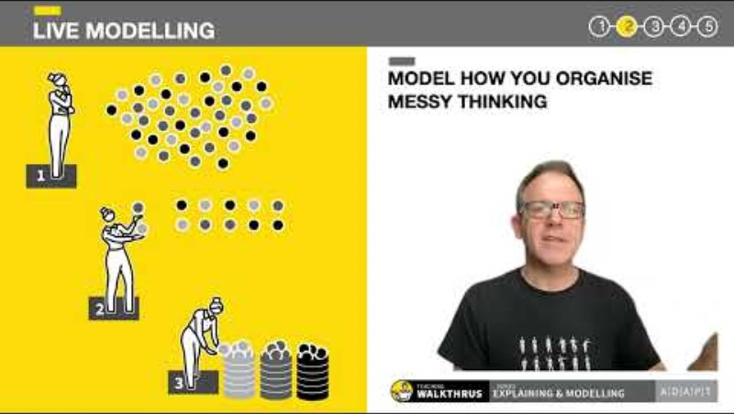
Modelling and Guided Practice
INTRODUCE
STUDENT V2 update (youtube.com)

Slide 9
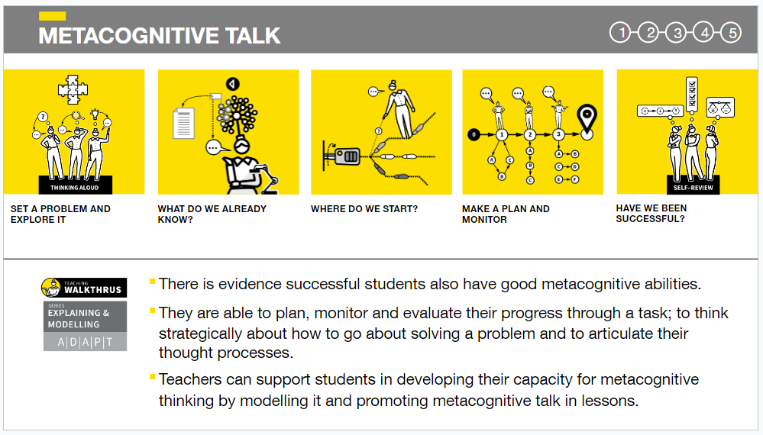
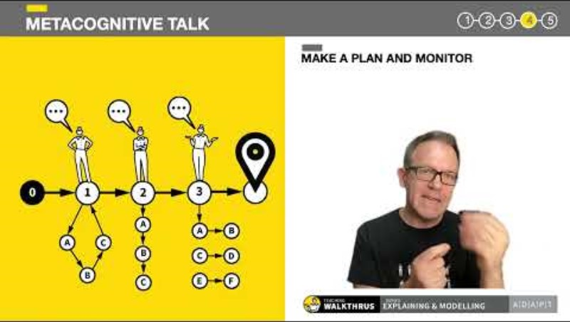
Modelling and Guided Practice
INTRODUCE
Metacognitive Talk (youtube.com)

Slide 10
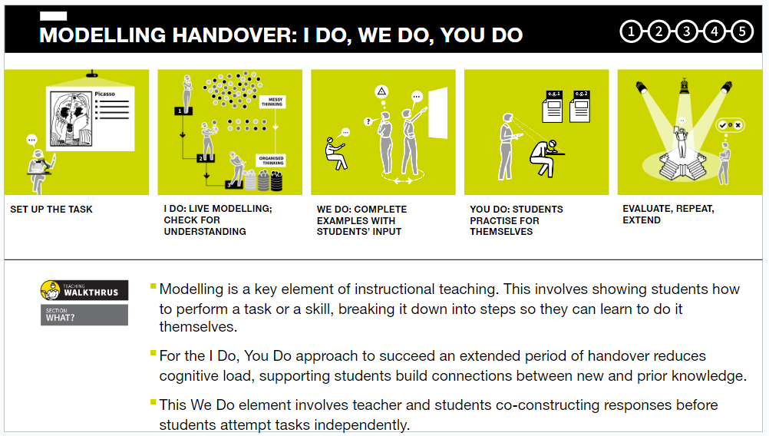

Modelling and Guided Practice
INTRODUCE
Modelling Handover I Do, We Do, You Do (youtube.com)

Slide 11
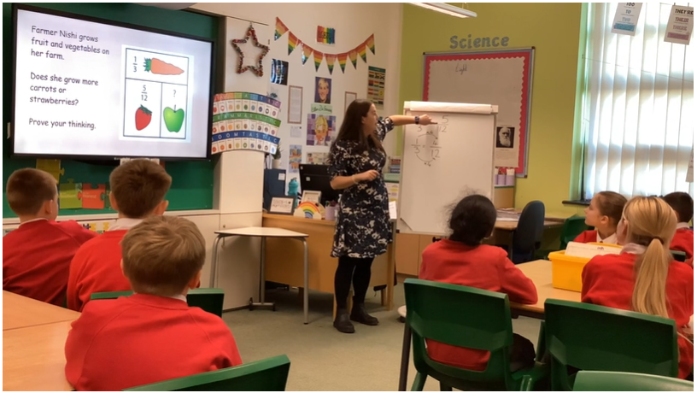
Modelling and Guided Practice
ANALYSE
Analysis and deconstruction of maths lesson - video
Analysis and deconstruction of modelling by Lead Mentor
Modelling Motivation - confidence, enjoyment and a positive attitude
Forms of live modelling using worked examples
  Normal speed / slowed down
  Silent modelling
  Narrating the process
  Misconceptions
  Part complete examples
Metacognitive talk
Where to start
  Talk through the information
  Consider previous learning that might be relevant
Steps to take to complete the task
  Model each step
  Narrate each step - being explicit about each decision
Self-review
  Check back over it to see if it is correct, complete, accurate, finished to a high standard.
  Explore ways of knowing if it is correct

Slide 12
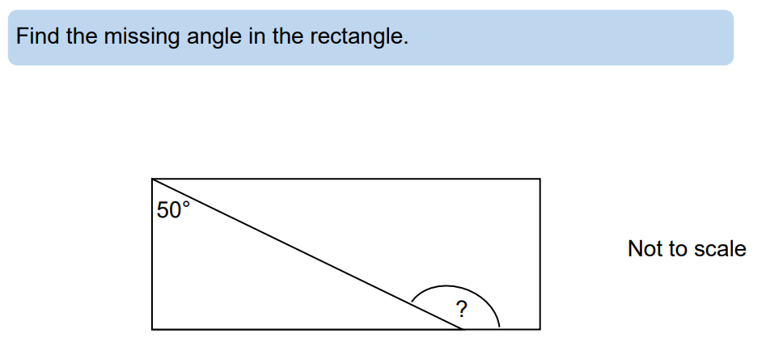
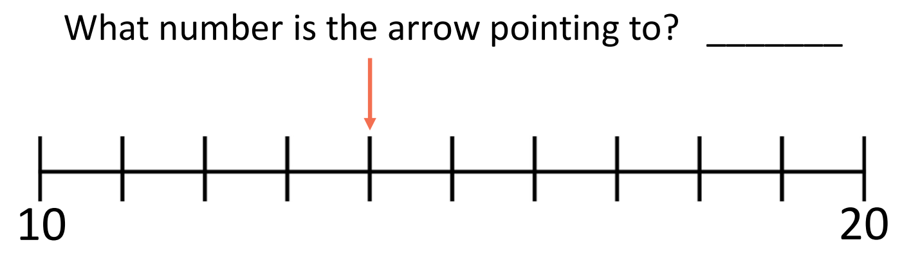
Modelling and Guided Practice
PREPARE
Create a micro script
Deliberate Practice
Peer feedback
Lead Mentor feedback
Self-reflection

Slide 13





Modelling and Guided Practice
ANALYSE
PREPARE
ENACT
Observe a maths lesson (1 hour)
  Complete the Associate Teacher Learning Observation form
  Professional discussion with placement mentor
Plan and prepare (1 hour)
  Which children need additional modelling and guided practice?
  Plan and prepare small group or 1:1 intervention based on the observed lesson
Enact – modelling and guided practice with small group (1 hour)
  Reflect on practice and the impact of this intervention
Professional discussion (1 hour)
  What information do you need to be able to plan the maths lesson in university on for teaching in school?
Day 2

Slide 14
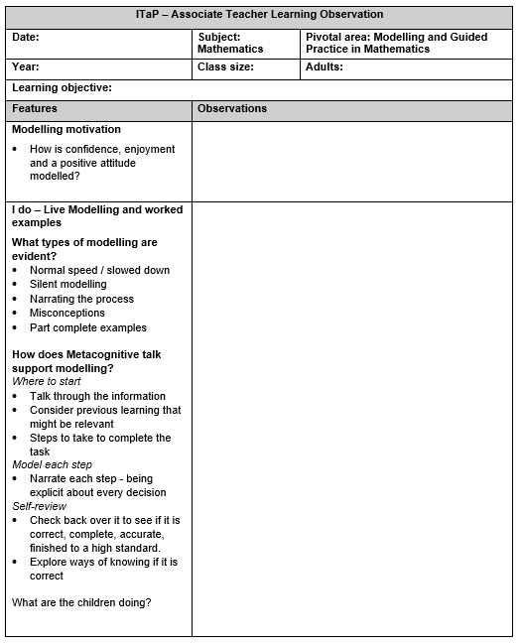
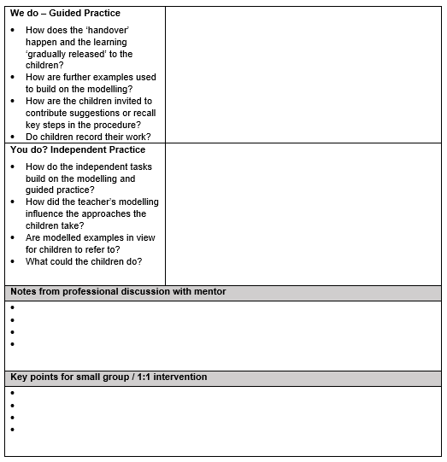

Modelling and Guided Practice
ANALYSE
Associate Teacher to observe the Placement Mentor and complete Learning Observation form

Slide 15
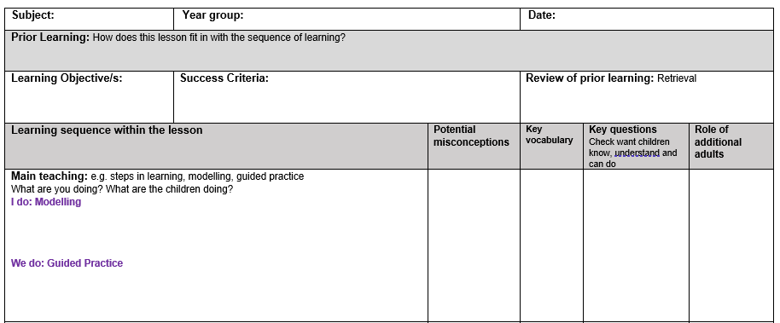
Modelling and Guided Practice
PREPARE

Slide 16



Modelling and Guided Practice
PREPARE
Day 3 - University
Live Modelling
  Plan tasks
  Consider types of live modelling to be used
  Plan the micro script
Guided Practice
  Plan tasks that build on the live modelling
  Plan how the children will contribute
Independent Practice
  Plan tasks
Own SBT class
Co-planning
Deliberate practice
Peer feedback
Lead Mentor feedback
Self-reflection

Slide 17

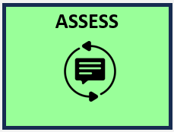
Modelling and Guided Practice
PREPARE
ENACT
ASSESS
Independent teaching of maths - Live Modelling (I do) Guided Practice (we do) - whole class
  Placement Mentor to observe and complete feedback form
Professional discussion of lesson observation
  Targeted feedback and target setting - Self-reflection
Plan and prepare - based on feedback
  Which children need additional modelling and guided practice?
  Plan and prepare small group intervention
Independent teaching of maths - Live Modelling (I do) Guided Practice (we do) - group
  Placement Mentor to observe and complete feedback form
Professional discussion of lesson observation
  Targeted feedback and target setting – Self-reflection
Day 4

Slide 18
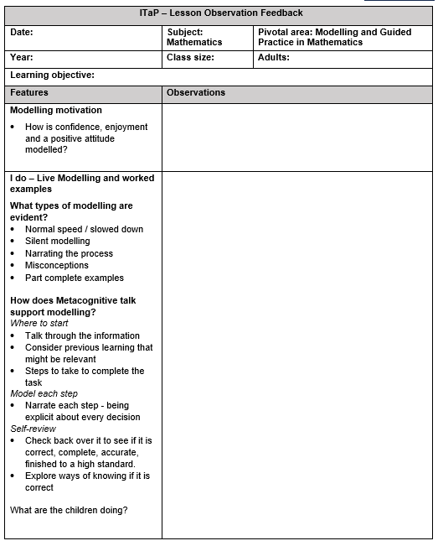
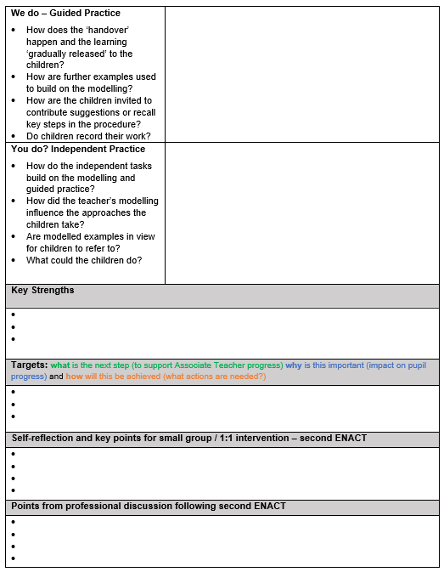
Modelling and Guided Practice
ASSESS
Placement Mentor to observe the Associate Teacher and complete Lesson Observation Feedback form

Slide 19

Modelling and Guided Practice
INTRODUCE
ANALYSE
Day 5 - University
Modelling and Guided Practice across the Primary Curriculum
Application of learning in other contexts
Consider another area of the curriculum
How could live modelling – ‘I do’ – and metacognitive talk be used?
How could guided practice – ‘we do’ – be used as part of the learning ‘handover’?

Slide 20
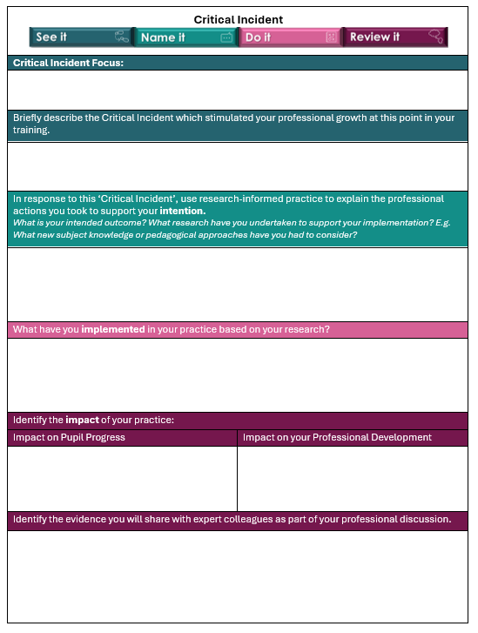
Modelling and Guided Practice
ASSESS
Critical Incident
A critical incident is an event or situation within your teaching practice that forces you to reflect on what happened and your response. McAteer et al (2010: 107) suggest that a "critical incident is one that challenges your own assumptions or makes you think differently."
This critical incident is an opportunity for reflection on learning about modelling and guided practice and the application of this learning to a different subject.
The opportunity to revisit the ITaP focus and enables the impact of the intense training on broader practice over a longer timeframe to be assessed.

Slide 21
Modelling and Guided Practice
INTRODUCE
ANALYSE
PREPARE
ENACT
ASSESS
Practicable Skills
Modelling motivation
Live modelling / worked examples (I do)
Normal speed / slowed down
Silent modelling
Narrating the process
Misconceptions
Part complete examples
Metacognitive talk
Guided practice (we do)
Set tasks similar to worked examples
Invite children to contribute
Check for success / errors
Provide further models
Independent (you do)
Set tasks similar to worked examples

Slide 22
References
EEF (2021) Metacognition and Self-Regulated Learning Metacognition and Self-regulated Learning | EEF (educationendowmentfoundation.org.uk)
EEF blog: Modelling mathematical motivation and independence
The role of teacher modelling in developing pupils’ independence in maths (2023) EEF blog: Modelling mathematical motivation and independence | EEF (educationendowmentfoundation.org.uk)
EEF blog: MODEL: promoting mathematical motivation and… | EEF (educationendowmentfoundation.org.uk)
Fisher, D. and Frey, N., 2010. Guided instruction: How to develop confident and successful learners. ASCD
Rosenshine B (2012) Principles of Instruction: Research-Based Strategies That All Teachers Should Know, by Barak Rosenshine; American Educator Vol. 36, No. 1, Spring 2012, AFT
Sherrington, T (2020) Teaching WalkThrus: Five-Step Guides to Instructional Coaching, John Catt
Educational, Limited, London.
Sherrington, T. & Caviglioli, O. (2021) Teaching WalkThrus 2 : five-step guides to instructional coaching. Melton, Woodbridge: John Catt Educational Ltd.
Sherrington The art of modelling… it’s all in the handover. – teacherhead

