Slide 2
Mentor update

Slide 3
National Developments
Dip HE ODP Curriculum has been withdrawn
The BSc ODP has replaced this
HCPC review of entry to register anticipated in time
BSc(Hons) ODP Curriculum is being reviewed
The new HCPC Standards of Proficiency were introduced in 2014 (in response to the evolution of the role and facilitating the more efficient use of ODPs generally).These have been incorporated into the new courses.

Slide 4
Developments at BCU
Revalidation of Dip HE (2015)
Introduction and Approval of the BSc (Pending)
New practice assessment documentation
ARC- placement management system

Slide 5
The role of a Mentor:
Facilitation and coordination of learning opportunities.
Working with the student to set realistic objectives.
Providing feedback which will allow the student to reflect and thereby improve their performance.
Assess the students clinical performance and level of professionalism.
Identify problems at the earliest possible opportunity and coach students who require support.

Slide 6
A Mentor needs to :
Act as an excellent role model.
Motivate and inspire.
Facilitate reflection.
Provide support where appropriate.

Slide 7
What do you need to become a Mentor ?
Possess a recognised Mentorship qualification.
Be a Registered Practitioner
(6 months experience as a minimum.)
Practice needs to be evidence based.
CPD must be up to date and supported by appropriate evidence.

Slide 8
What about Associate Mentors ?
…provide student support
… have a minimum of six months post-qualification experience.
…has relevant evidence of CPD.
Associate Mentors can use this experience in order to develop knowledge and skills that will ultimately result in them becoming a Mentor.

Slide 9
What is ARC?
ARC is a placement allocation system
The ARC system facilitates full management of the placement and allocation life cycle
The system offers benefits to staff, students and practice providers through a variety of databases and online resources and portals
Coming on-line over 2015-16

Slide 10
The new documentation…
The new assessment documentation is less complicated and more user-friendly than previous versions.
Expectations are clarified at every stage.
Both clinical practice and professionalism are assessed.

Slide 11
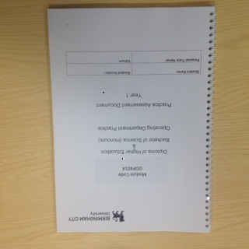
The process…….

Slide 12
During first week
Student to discuss SCOT analysis with Mentor and develop personal action plan
Complete initial Interpersonal and Professional Development review and assessment using performance criteria and document any comments
Student to complete SCOT analysis
Halfway through
Interpersonal and Professional Development review and assessment using performance criteria
Identification of any further action points and document comments
Skills and Practice Assessment
(Ongoing over the whole year)
During last two weeks
Complete final Interpersonal and Professional Development Assessment and document comments
IF LAST PLACEMENT OF THE YEAR
Review & complete final Skills & Practice Assessment
Complete final grading and future action plan
2013-2014

Slide 13
SCOT analysis
Strengths
What we do well?
Challenges
What can we improve?
Opportunities
What will help us achieve the goal?
Threats
What might stop us from achieving the goal?

Slide 14
Skills and Practice Assessment… Pass or Fail Elements
This can be undertaken at any point during the year as long as mentors are convinced that the required standard is being consistently met.
There is no need to reassess elements which have been ‘passed’,
A ‘Fail’ should not be given until the last placement is almost complete.

Slide 15
Interpersonal and Professional Development Assessment….
Summative assessment as competent can be undertaken at any stage of a placement once formative work indicates the Student is ready.
That element does not then have to reassessed again in future placements however students are expected to maintain competent performance
Performance must be competent and consistent.
Awarding a Fail is only appropriate when their final placement is coming to an end.

Slide 16
Providing feedback to learners
Quality feedback is essential as it aids student progression, and to ensure the standard of professionalism and practice meets the requirements to keep the patient safe in their care as well as an on-going record for future placements and will:
Enable a future mentors judgment to be made regarding the learners’ overall performance whilst on the placement
Track those elements of the learners professionalism relating to approach, behaviour and attitude
Summarise a learners development of applied knowledge
To feed forward to future mentors any concerns or challenges
Identify any particular strengths the learner has and to build upon these
Ensure learners receive constructive feedback and to offer suggestions on how to make further improvements to promote progress
Provide an audit trail and monitor the learners practice development

Slide 17
Supportive commentary- examples
These are just some ideas which can be used to create an overall written account of the learners’ development and progression.
Professional behaviour and attitude e.g. communication skills, attitude to other team members, conscientious, patient-centred approach
How do they manage issues such as managing their shift work? e.g. child care, time keeping, conforming to the regular shift patterns of the placement area
Professional development e.g. self-confidence, motivation, ability to reflect, use of theory to underpin problem-solving, self-awareness
Interpersonal Skills e.g. consideration of others, relationships developed appropriate to the situation.

Slide 18
Supportive commentary- examples
Self-Management e.g. how have they demonstrated their ability to take responsibility for their own development?
Situational Leadership e.g. have they had the opportunity to demonstrate leadership during placement? If so, have they used these to develop or demonstrate any leadership skills?
Interprofessional Learning e.g. have they demonstrated an ability to work with other students/professionals? How did they perform?
Change Management e.g. how do they adapt or repsond to change? This could be organisational, procedural, staff and or patient focused.

Slide 19
Practice boundaries.
It is essential that students have a full understanding of the limits within which they must work.
Clarification of these boundaries can be found in the practice documentation which will ensure that a student will not perform any actions which lie beyond their remit.

Slide 20
The practice documentation includes additional information regarding:
absence procedures
clinical incidents
accidents
shift patterns
timesheet protocol
Cause for Concern

Slide 21
Concerns…what to do…
It is much better to report any cause for concern earlier rather than later, as this ensures that issues
are addressed and interventions put in place.
Areas of concern may be related to:
Lack of clinical progress
Lack of Professionalism
Concern about the student’s well being
ANY concerns about patient safety
“Failure to fail” impacts on patients, colleagues and the profession as a whole.

Slide 22
Students may find this helpful…...

Slide 23
Mentor Updates
All Mentors must have an annual update.
Support is also available from your Trust Professional Development Department, the University Placement Facilitator as well as the Link Tutors.
All relevant Contact information is available in the Competency Documents and via ARC.

Slide 24
It clarifies issues such as:
Protected time
Accountability
Supporting the underperforming student
CPD and how you can use this experience for re-registration

Slide 25
In addition to this App an extensive range of useful resources are available on our Website.
http://www.bcu.ac.uk/allied-and-public-health-professions/about-us/mentors-and-assessors/odp

Slide 26
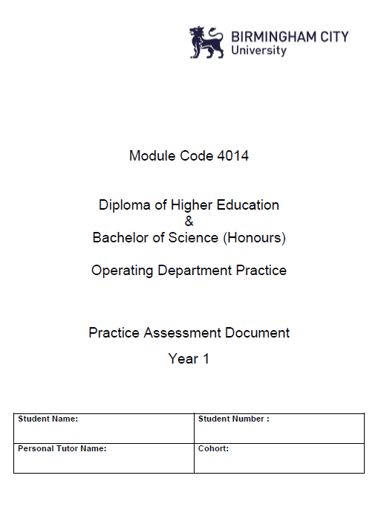
I am embedded to open me. End slide show & double click image
BACK

Slide 27
SCOT Analysis performed prior to commencing Clinical Placement
Strengths Good team worker Open-minded Good listener Interested and enthusiastic Patient Really keen to learn more about………… | Opportunities Using the theory from university to underpin my practice Working with a mentor will allow me to develop and trusting relationship so I can ask questions without feeling stupid Team members who I can for support
Challenges Can be shy I have not been in theatres before apart from a couple of days experience Disorganised at times Sometimes when under pressure I rush things and don’t perform to the best of my ability | Threats NO healthcare experience Not confident with being assertive unless I know people Feel that I don’t know enough Trying to get my study/practice/home life balance right
Student comments: I am a little nervous, but I am really looking forward to this placement. I have found the topic lectures to be really interesting. I think I need to ask my mentor to spend some time with me at the end of the day, to reflect on my knowledge and practice, so I can make sure I know what I need to work-on to improve.
Placement Mentor initials: |  | Date:
BACK

Slide 28
How do you assess interpersonal and professional development?
The student will either be deemed:
B for Beginner, D for Developing or C for Competent.
Adapted from Glaser (1990)
The precise definitions of these categories are provided in the Competency Document.
BACK

Slide 29
Useful Resources
Surviving your placement in health and social care: a student handbook
By Healey, Joan
Book. English.
Published Maidenhead: McGraw Hill Open University Press, 2008
Assessment, supervision, and support in clinical practice: a guide for nurses, midwives, and other health professionals
By Stuart, Ci Ci
Book. English.
Published Edinburgh: Churchill Livingstone, 2003

