Slide 1

of 20

Slide 2

of 20

Slide 3
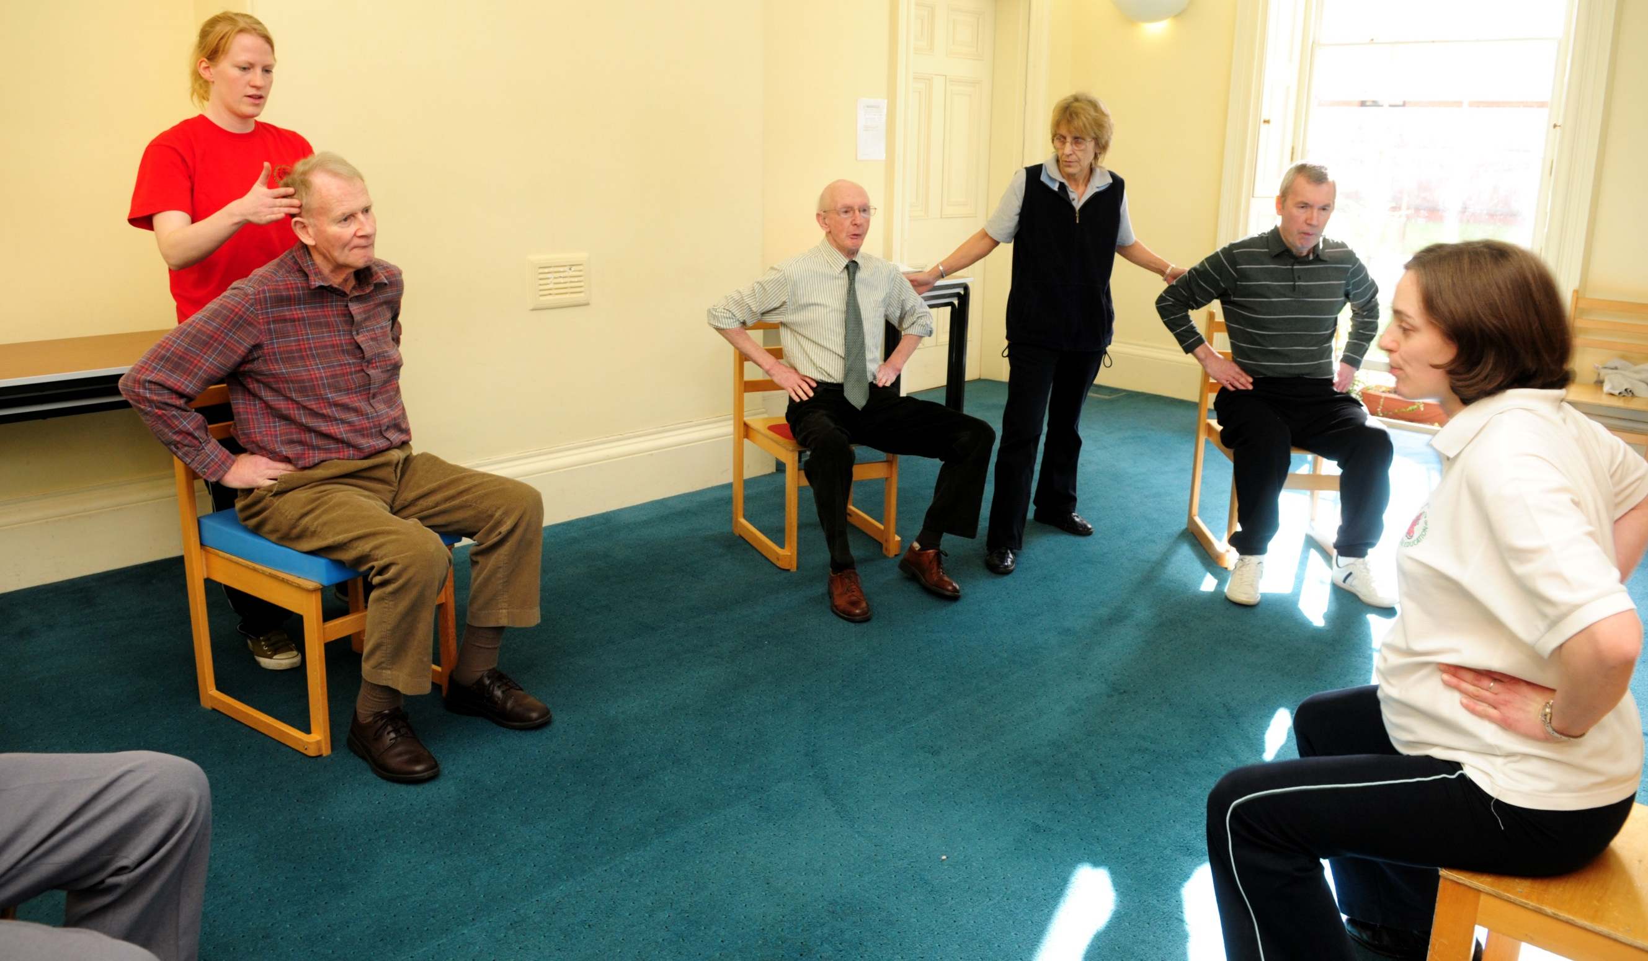
of 20

Slide 4
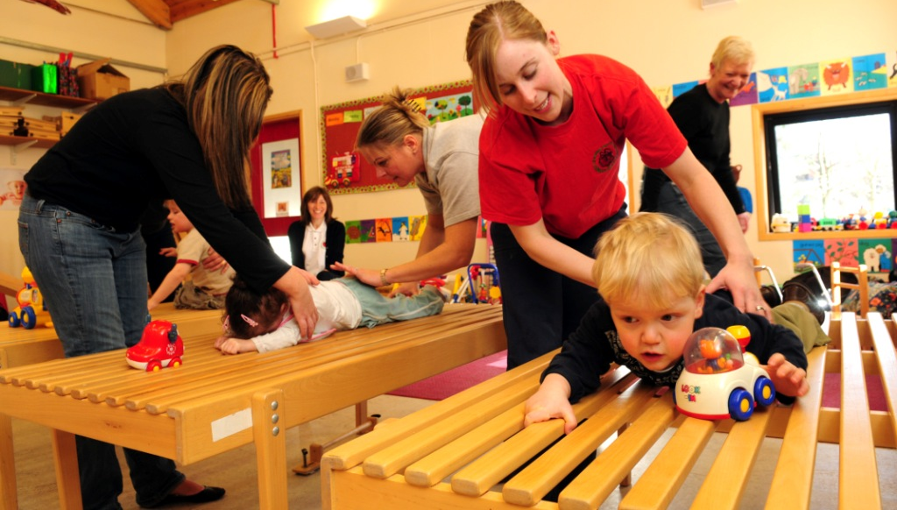
of 20

Slide 5

of 20

Slide 6

of 20

Slide 7

of 20

Slide 8

of 20

Slide 9

of 20

Slide 10
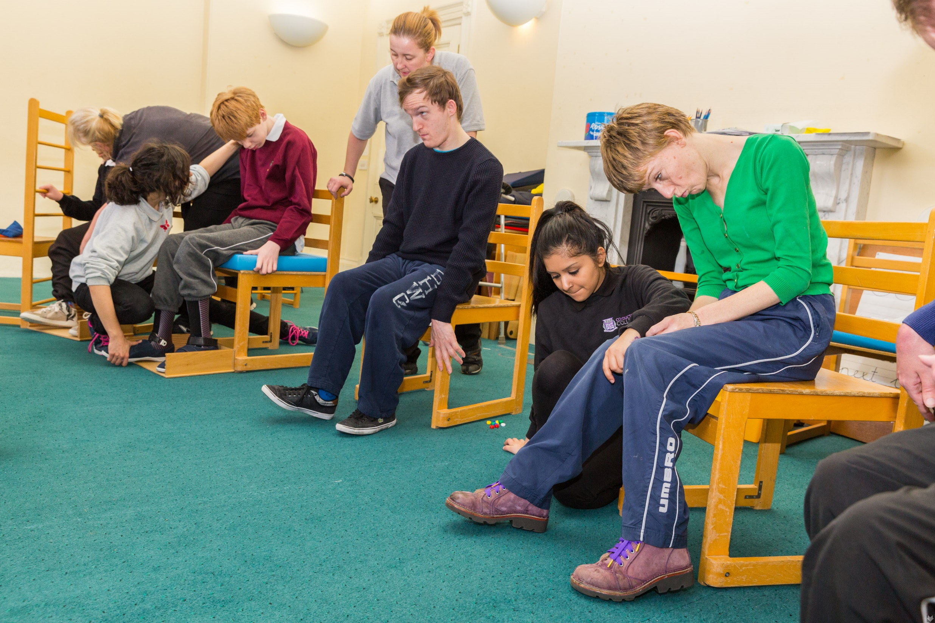
of 20

Slide 11

of 20

Slide 12
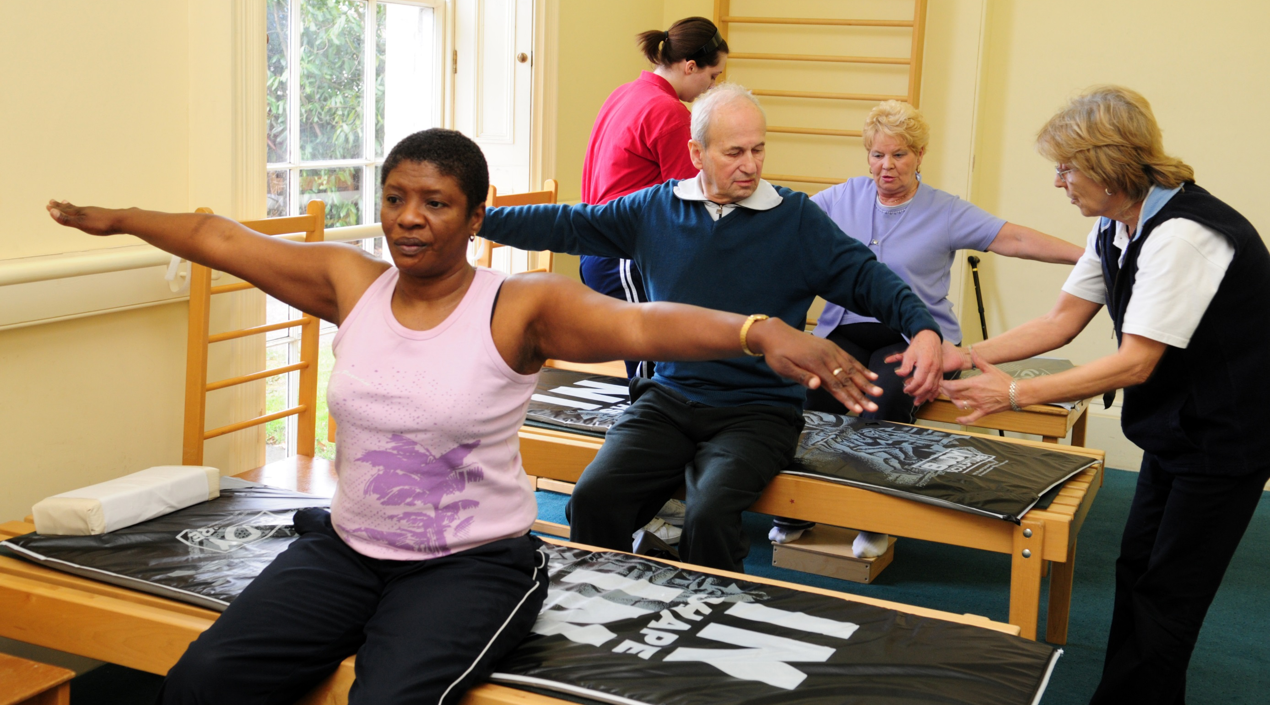
of 20

Slide 13
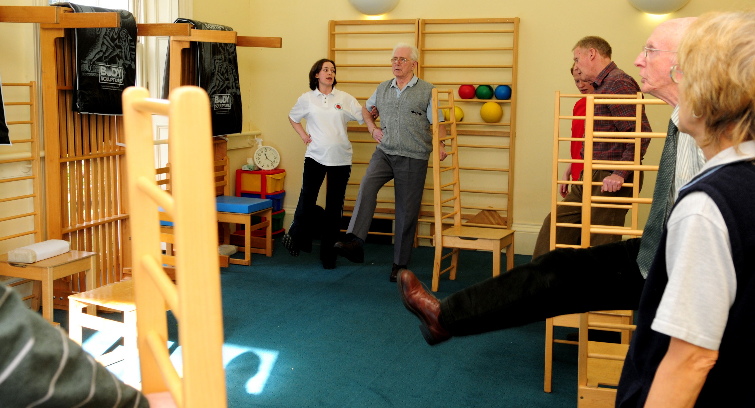
of 20

Slide 14

of 20

Slide 15

of 20

Slide 16
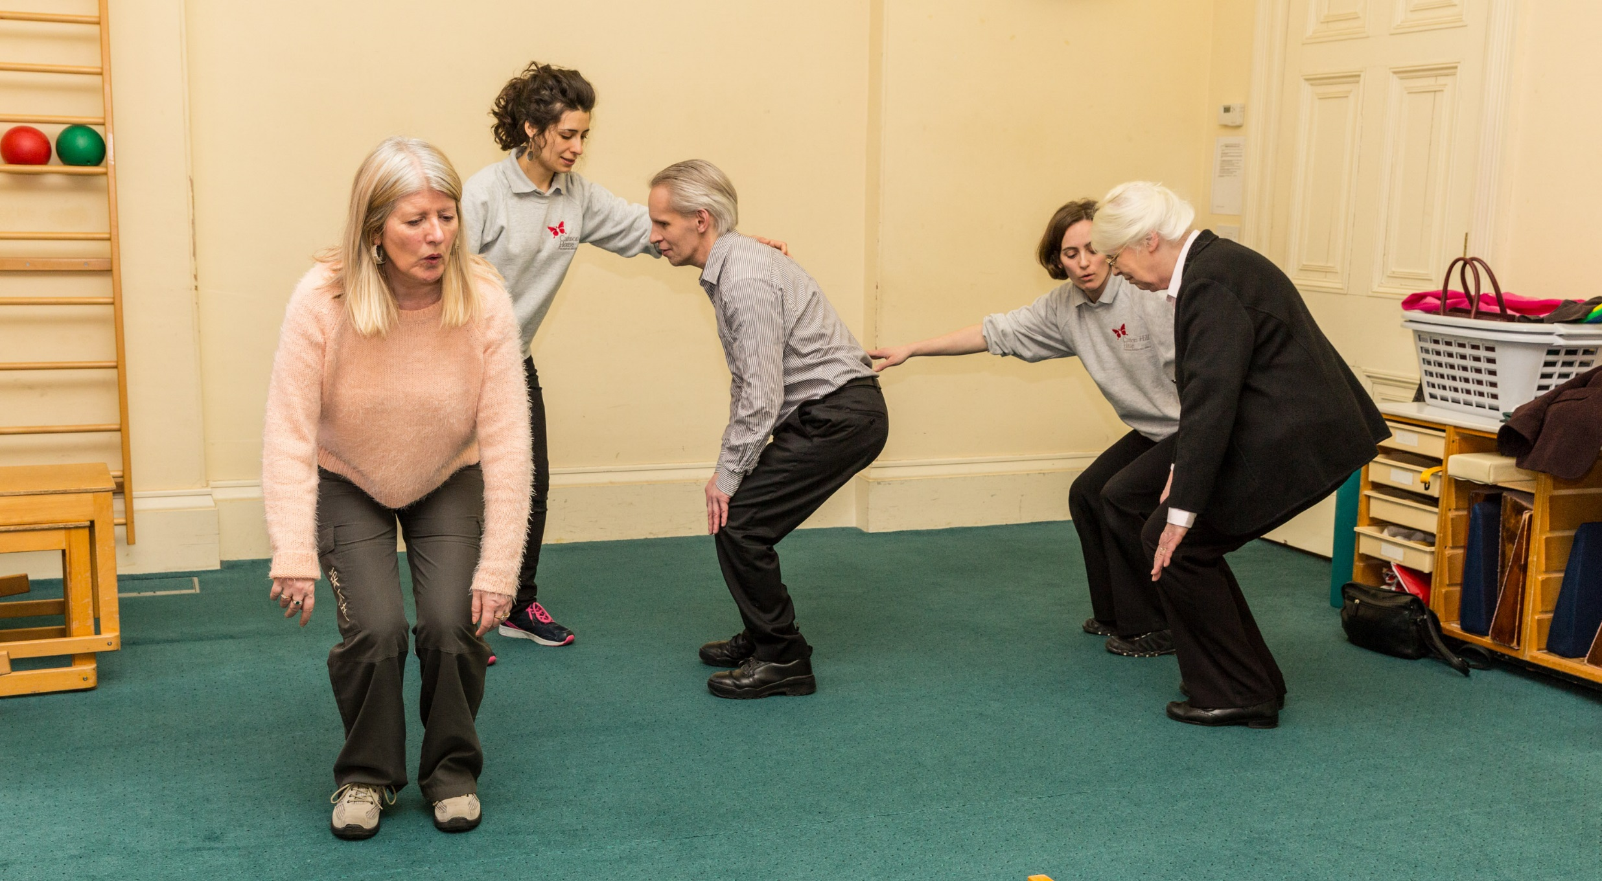
of 20

Slide 17

of 20

Slide 18
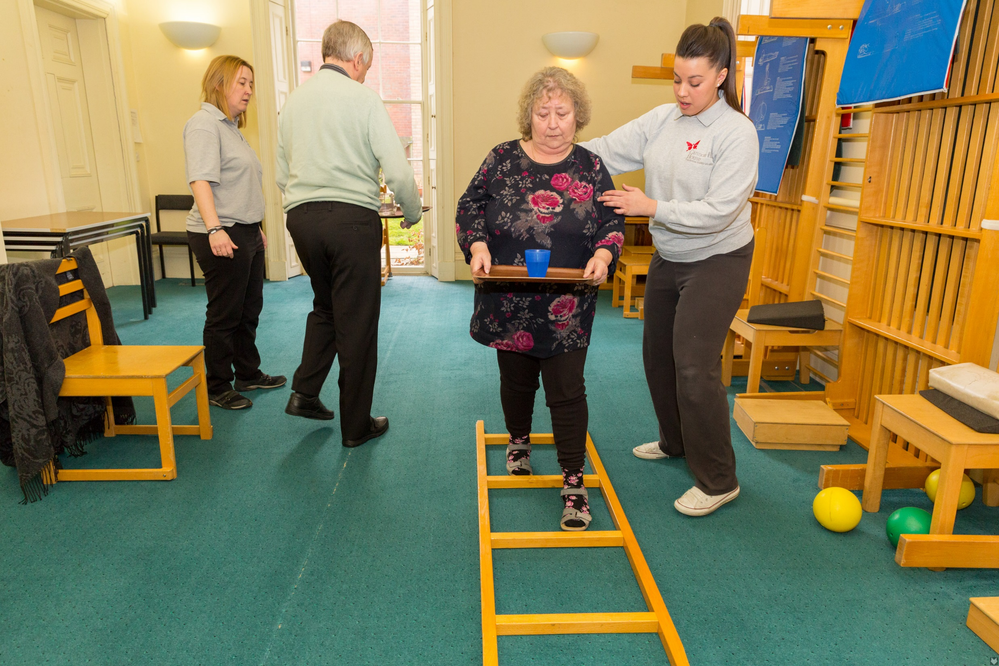
of 20

Slide 19
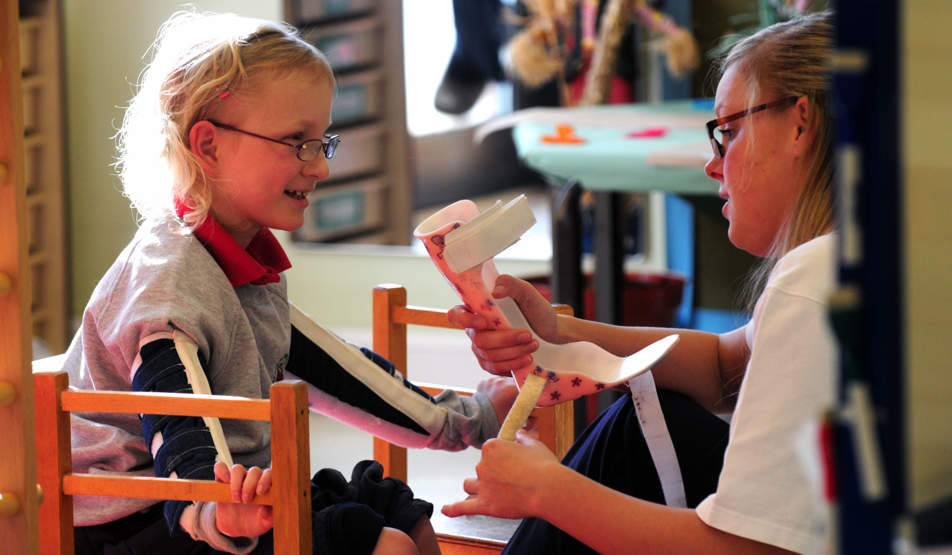
of 20

Slide 20
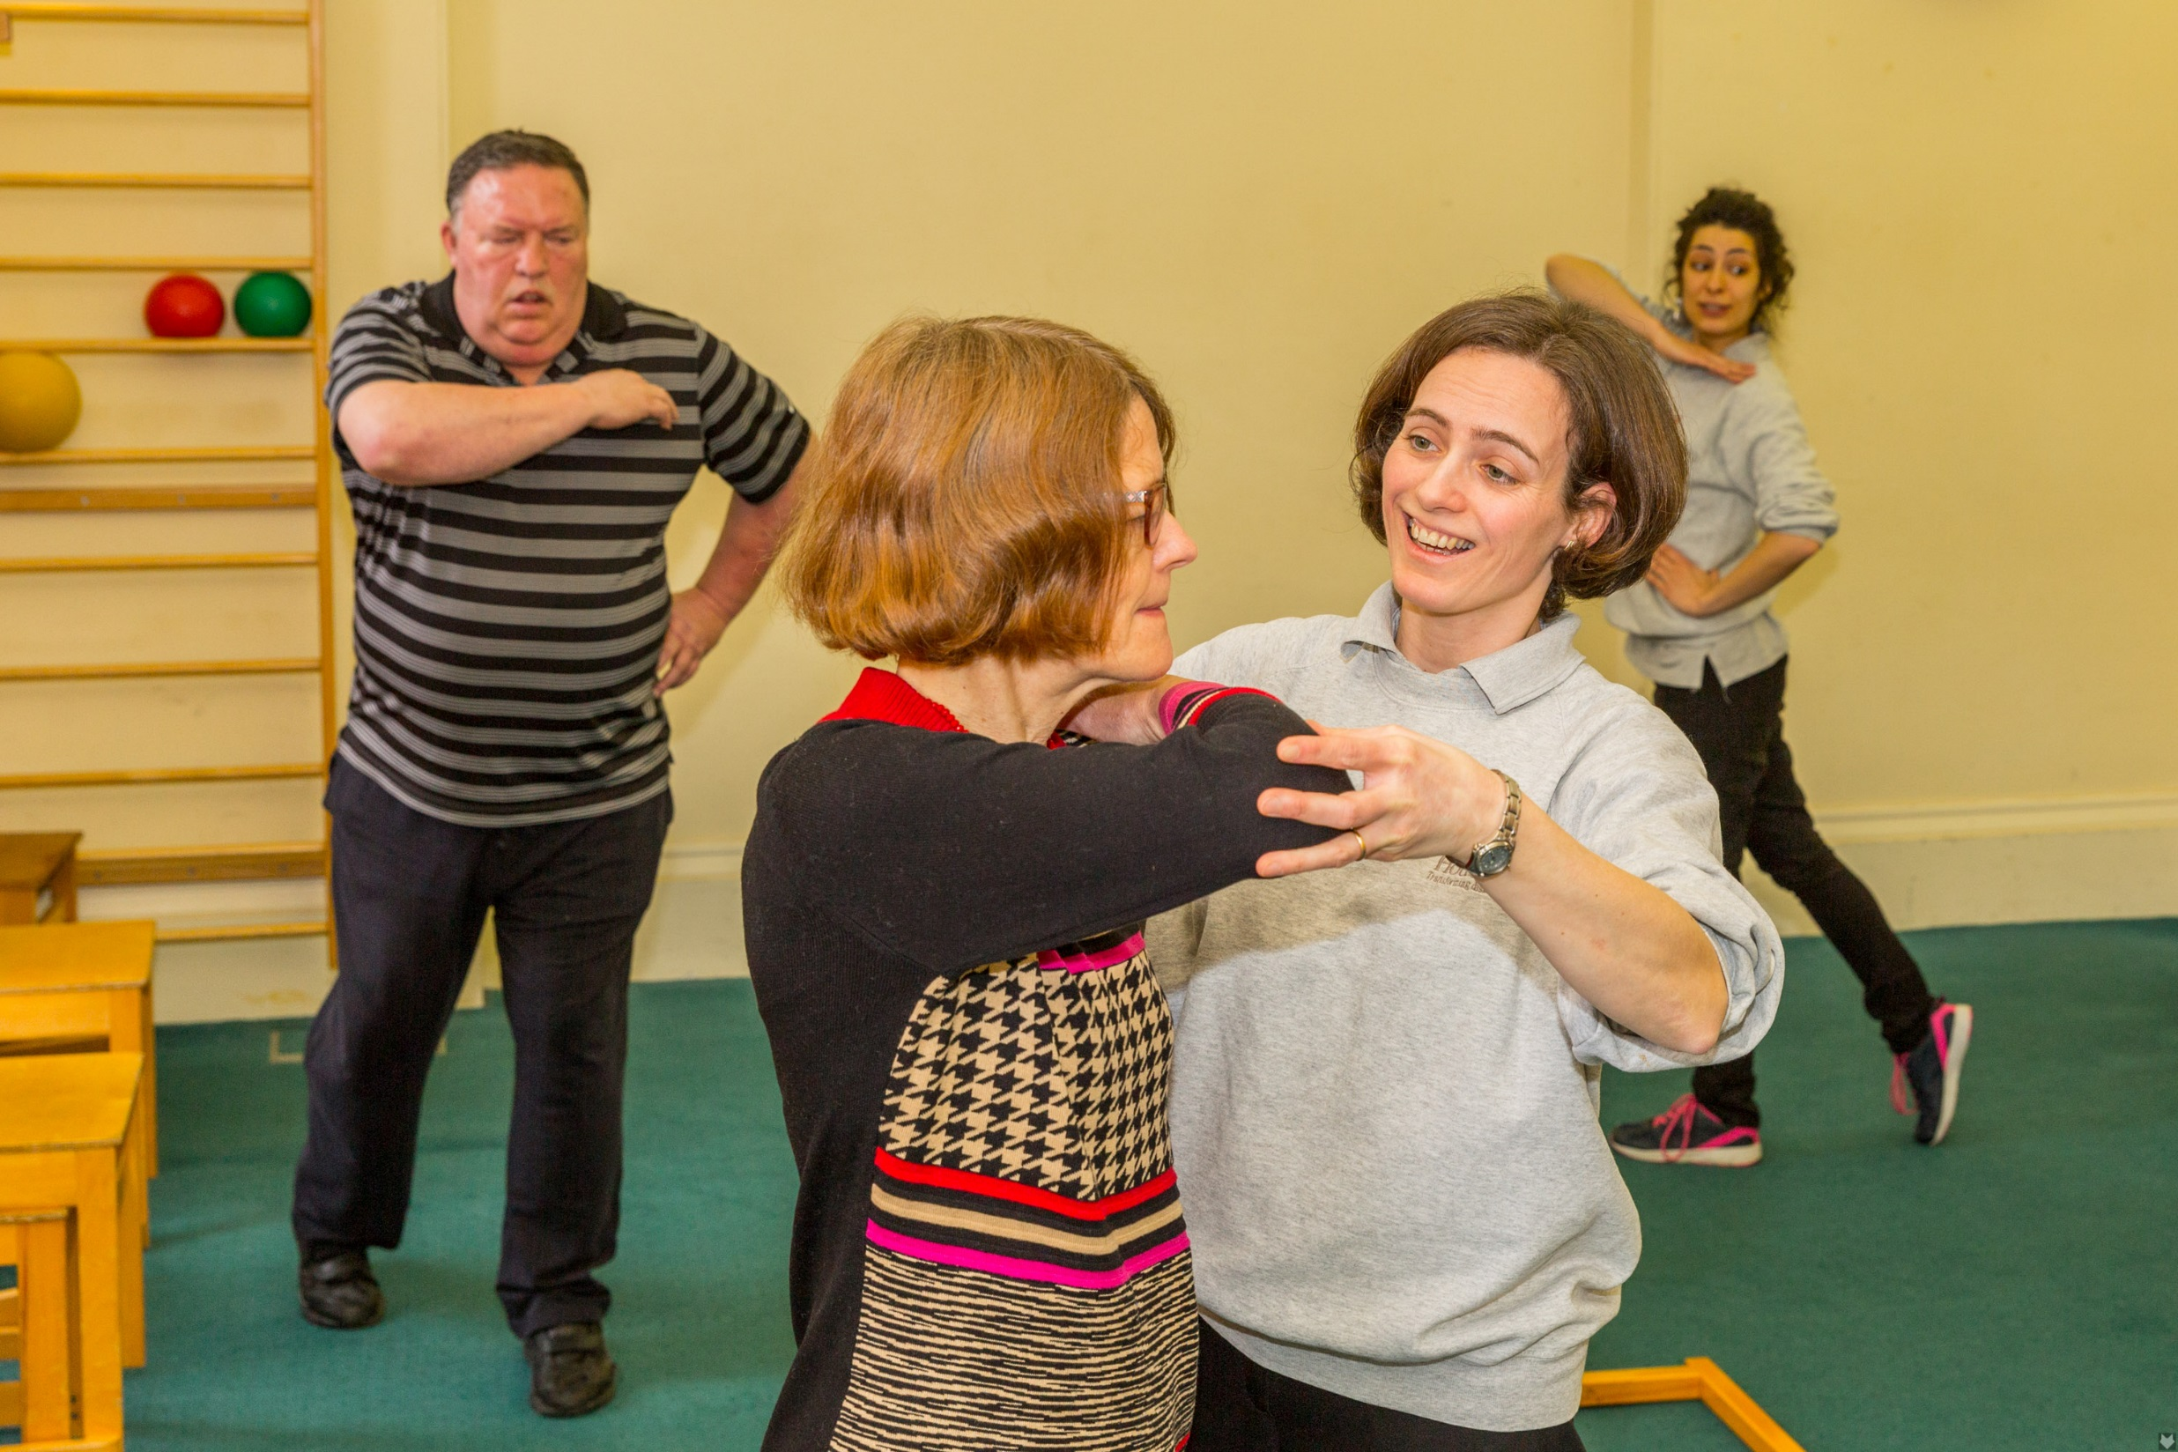
of 20

