Slide 1

of 20
Notes:
This is my first ever Pecha Kucha…wish me luck. Deep breath. Hidden Gems. The idea of these presentations this morning is to focus on some of the hidden gems among BCU courses, and I am really pleased to be asked to do that, because the course that I run is very definitely one of those.

Slide 2
BA in Applied Performance
[Community and Education]
of 20
Notes:
Applied Performance – hidden mostly because it isn’t obvious at all what it means. The subtitle helps a bit. But also hidden, because it isn’t something on the school or college curriculum. It isn’t something many people would think of doing. People don’t know of it as an option.

Slide 3

BA in Applied Performance
[Community and Education]
of 20
Notes:
If you has asked me 2 years ago I might have been a bit hazy about what it meant, which is ironic because the answer would have been ‘It’s what you’ve been doing for the last 34 years , Peter’ – I know hard to believe but I started very young.

Slide 4
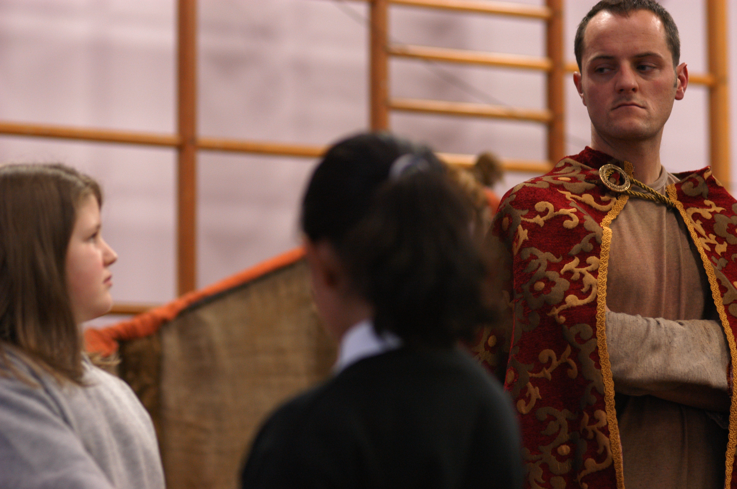
of 20
Notes:
I wouldn’t have said it was what I did – nobody says they work in Applied Performance – it is an academic umbrella term for the kind of professional theatre work that happens often in non-theatre places. I would have said “I do drama with young people”, or “I work in Theatre-in-Education”, or “I’m working with a Community Theatre Company”

Slide 5
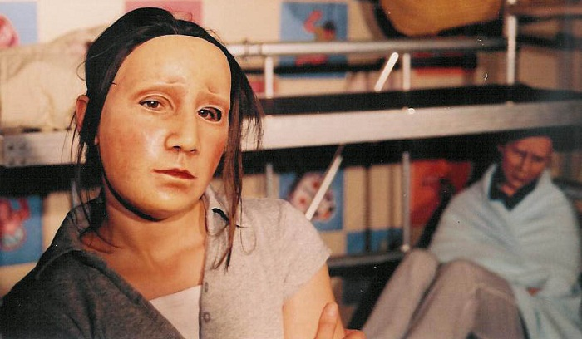
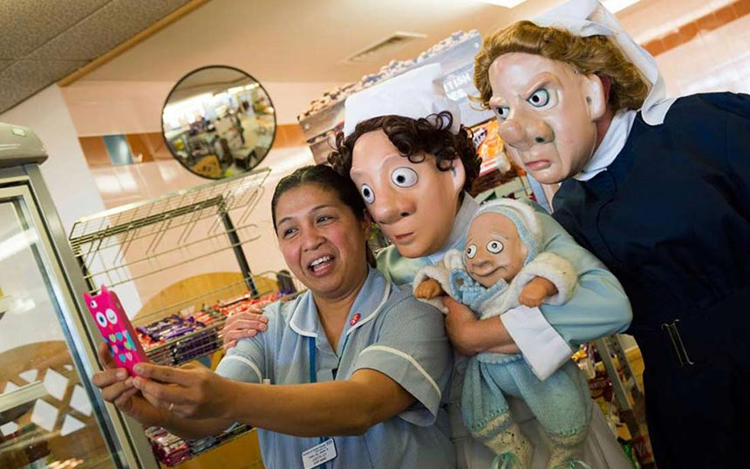
of 20
Notes:
Applied Theatre, or Applied Performance covers Theatre in health, in hospitals perhaps, in prisons, in care homes, in the street. Theatre with a specific purpose, which might be educational, social, political. Theatre that asks questions, that provokes, that challenges.

Slide 6

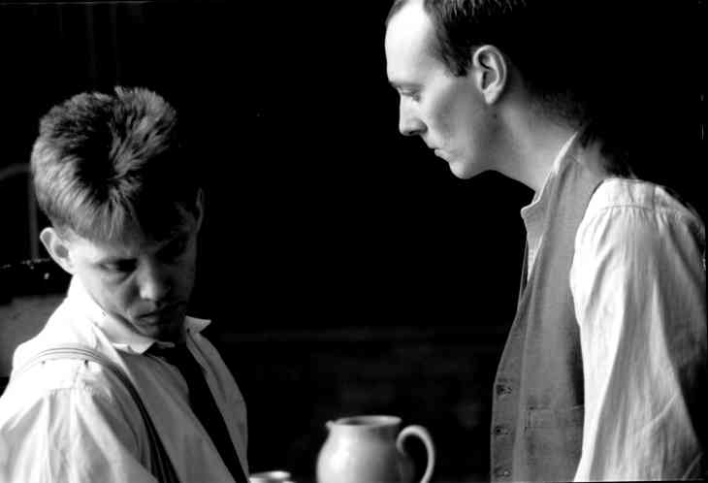
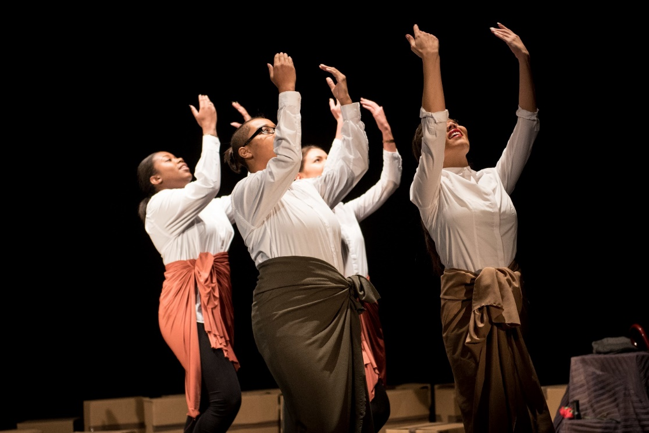
of 20
Notes:
Theatre that is aiming to educate, to challenge injustice, to spread well-being, to make political or social change.

Slide 7
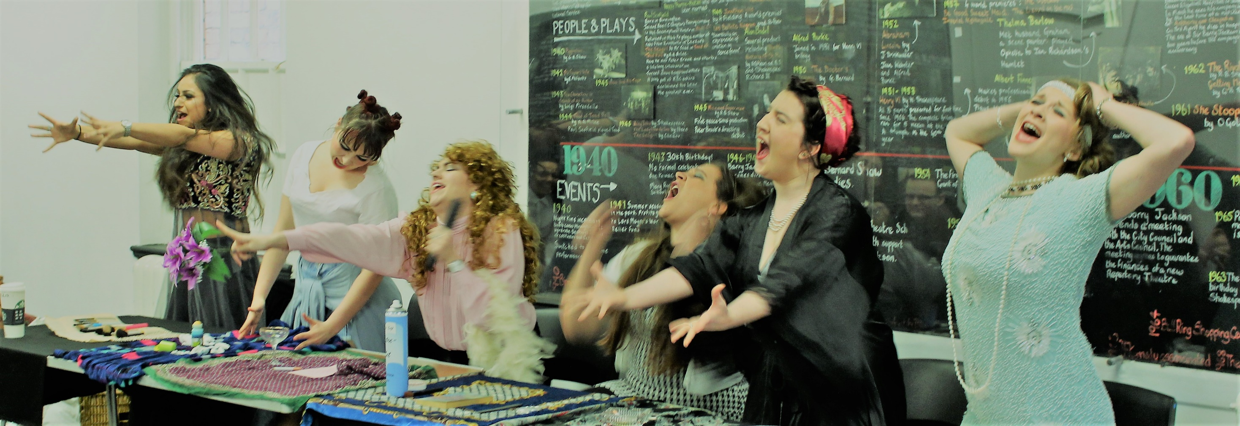
of 20
Notes:
So that is true it is what I spent 34 years doing – and our course is taught by people who are committed to the area of work, and we have a very specific mission. - to prepare the next generation of practitioners who are using all the power of new strong theatre to change the world, in big ways or small.

Slide 8
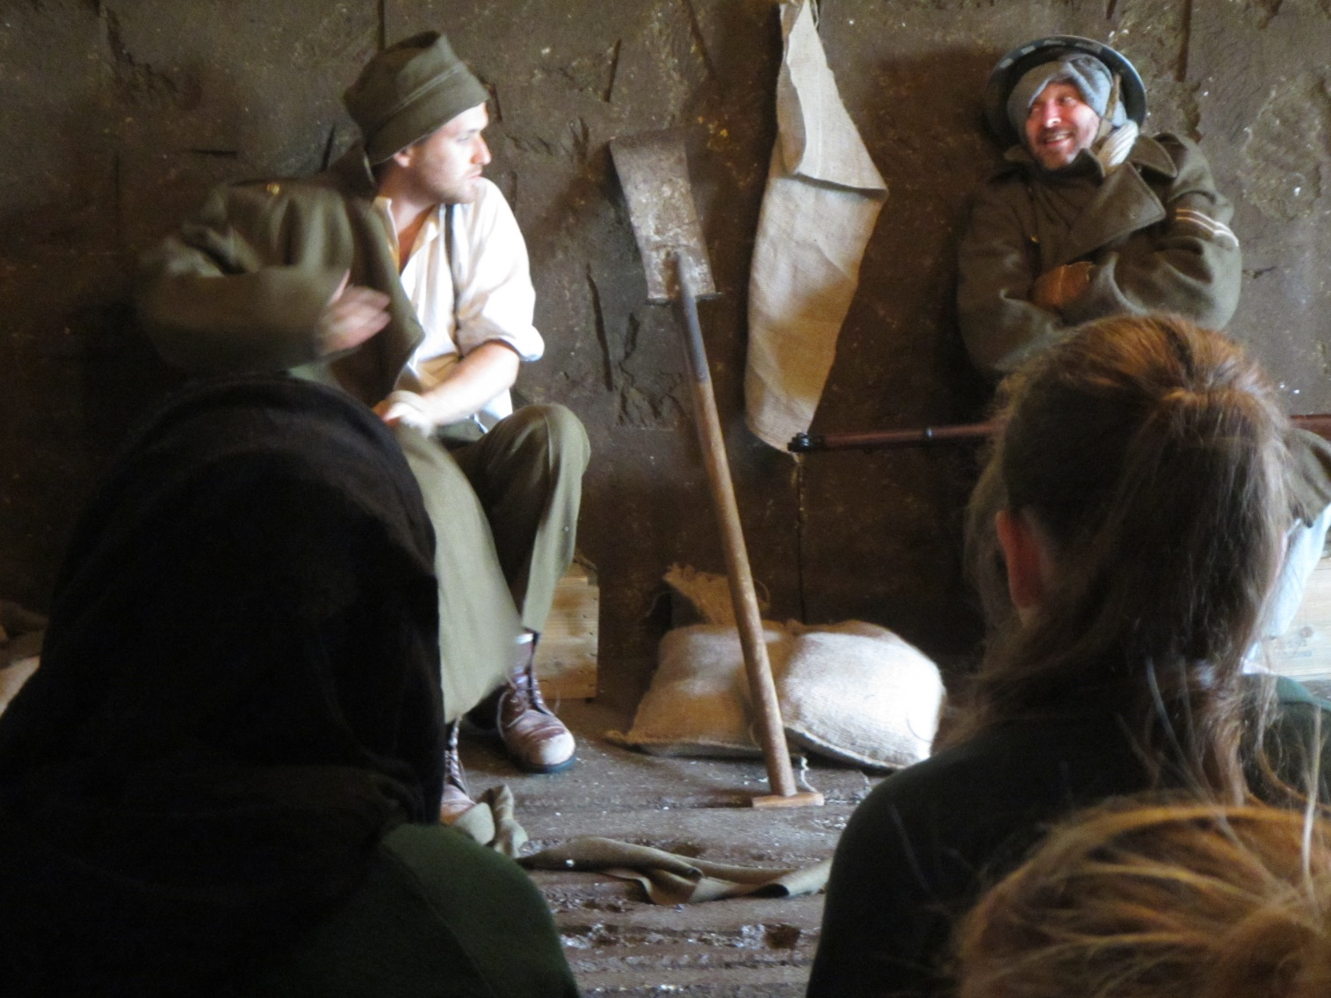
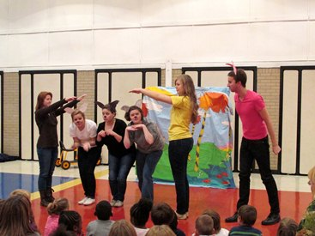
of 20
Notes:
It is an area of work that needs new young voices, and people with passion to fight for it. There is a lot of great practice and a fair amount of mediocre practice in the world of Applied Theatre – and we know very clearly which side of that fence we want our graduates to be on. So I have a really committed team that knows what it believes and believes in it deeply.

Slide 9

Yes, but what about
us
Kids?
of 20
Notes:
So what kind of young people now in schools or colleges would the course suit? I think the thing is you’ve all got them. You all know them… I think the students that fly through our course and leap out the other end into the big bad world have probably agitated their way through the education system to date.

Slide 10
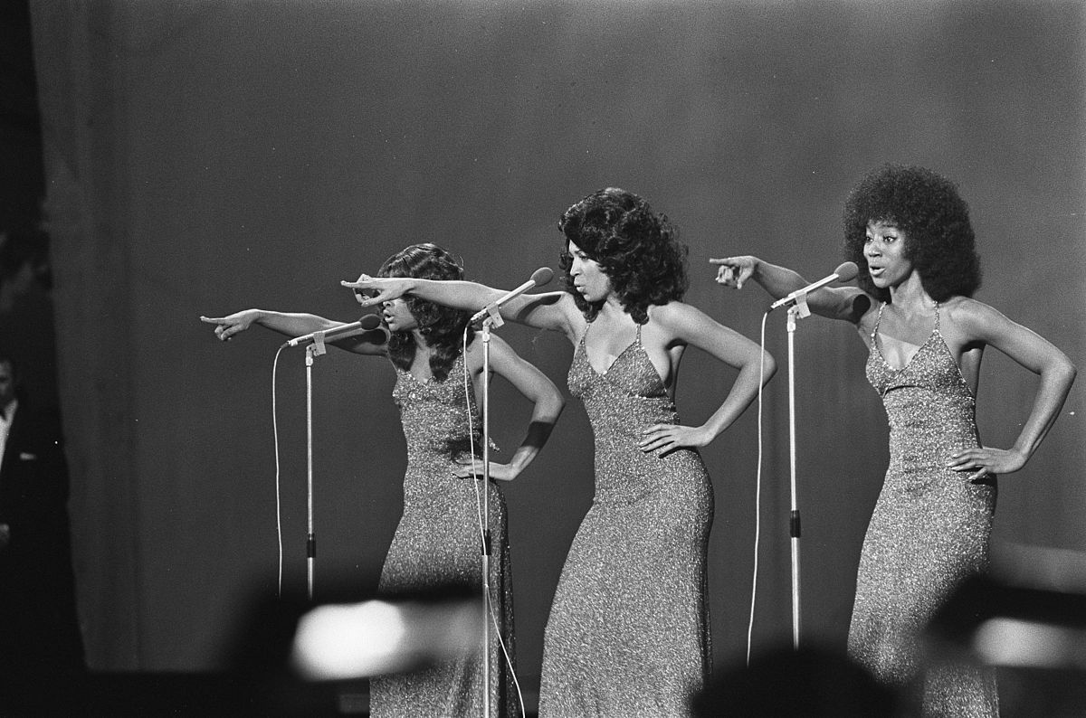
of 20
Notes:
Our course is one of three degree courses in the school of acting. [OK they said PechaKuchas are supposed to have that kind of joke… ]

Slide 11
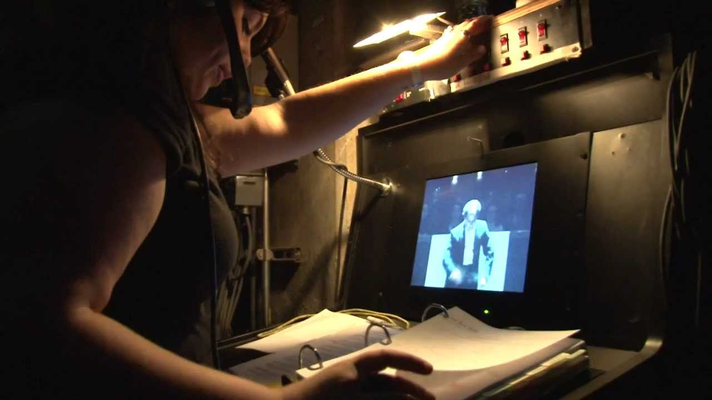
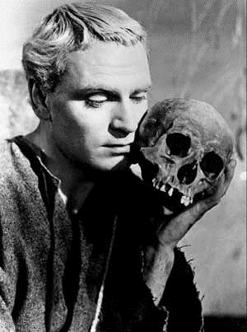
of 20
Notes:
BA in Acting – we know what that is. BA in Stage Management – you can identify young people who might suit either of those… But the ones that would really benefit from and find their home in Applied Performance – what are the signs?

Slide 12
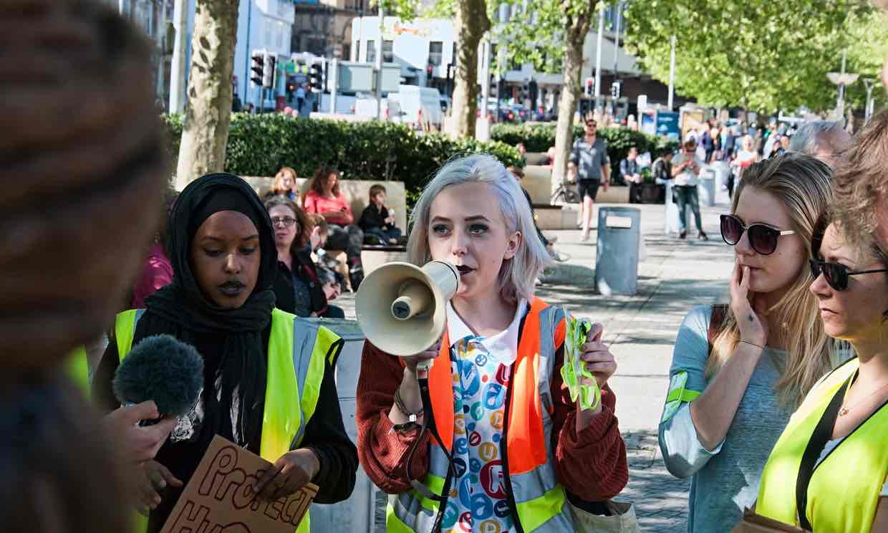
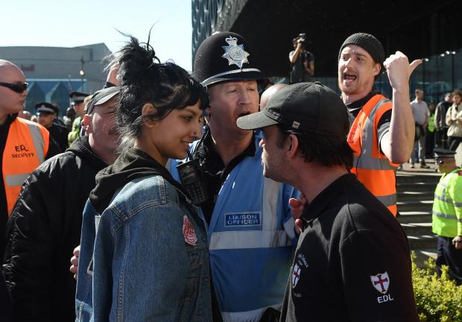
of 20
Notes:
Not the ones who love acting because they want to be rich and famous… It is the young people with something to say. If you have students that are passionate about drama but also passionate about finding their own voice

Slide 13


of 20
Notes:
If they are angry, committed, noisy – maybe those ones with their own unique look. Who created their own spoken word performance about the unfairness of the uniform policy in Year 8.

Slide 14
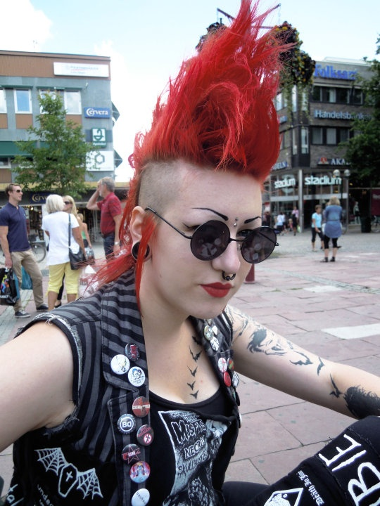
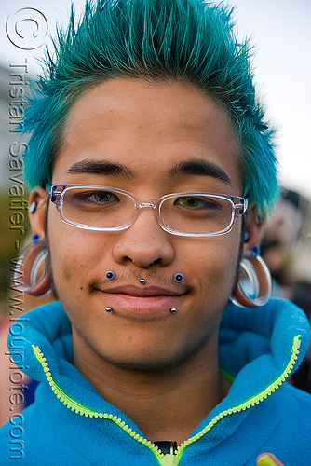
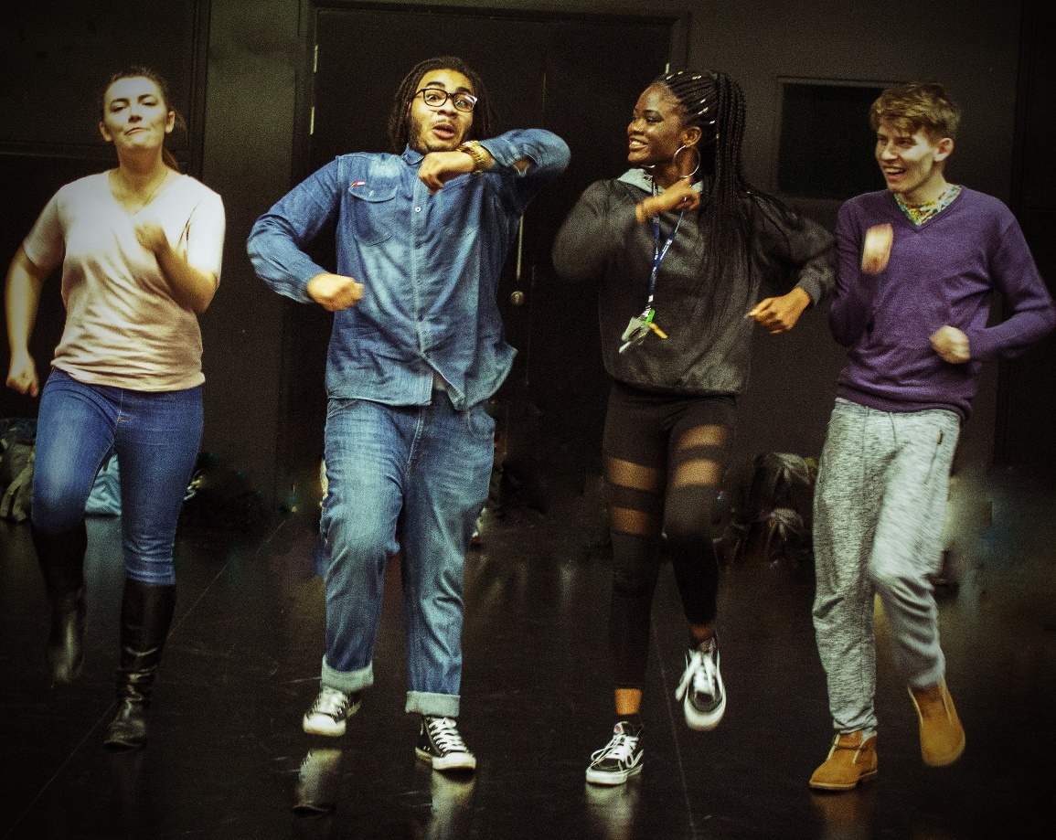
of 20
Notes:
Or got together with friends to create a dance about refugees. If you recognise any of these – suggest to them they might look at Applied Performance.

Slide 15
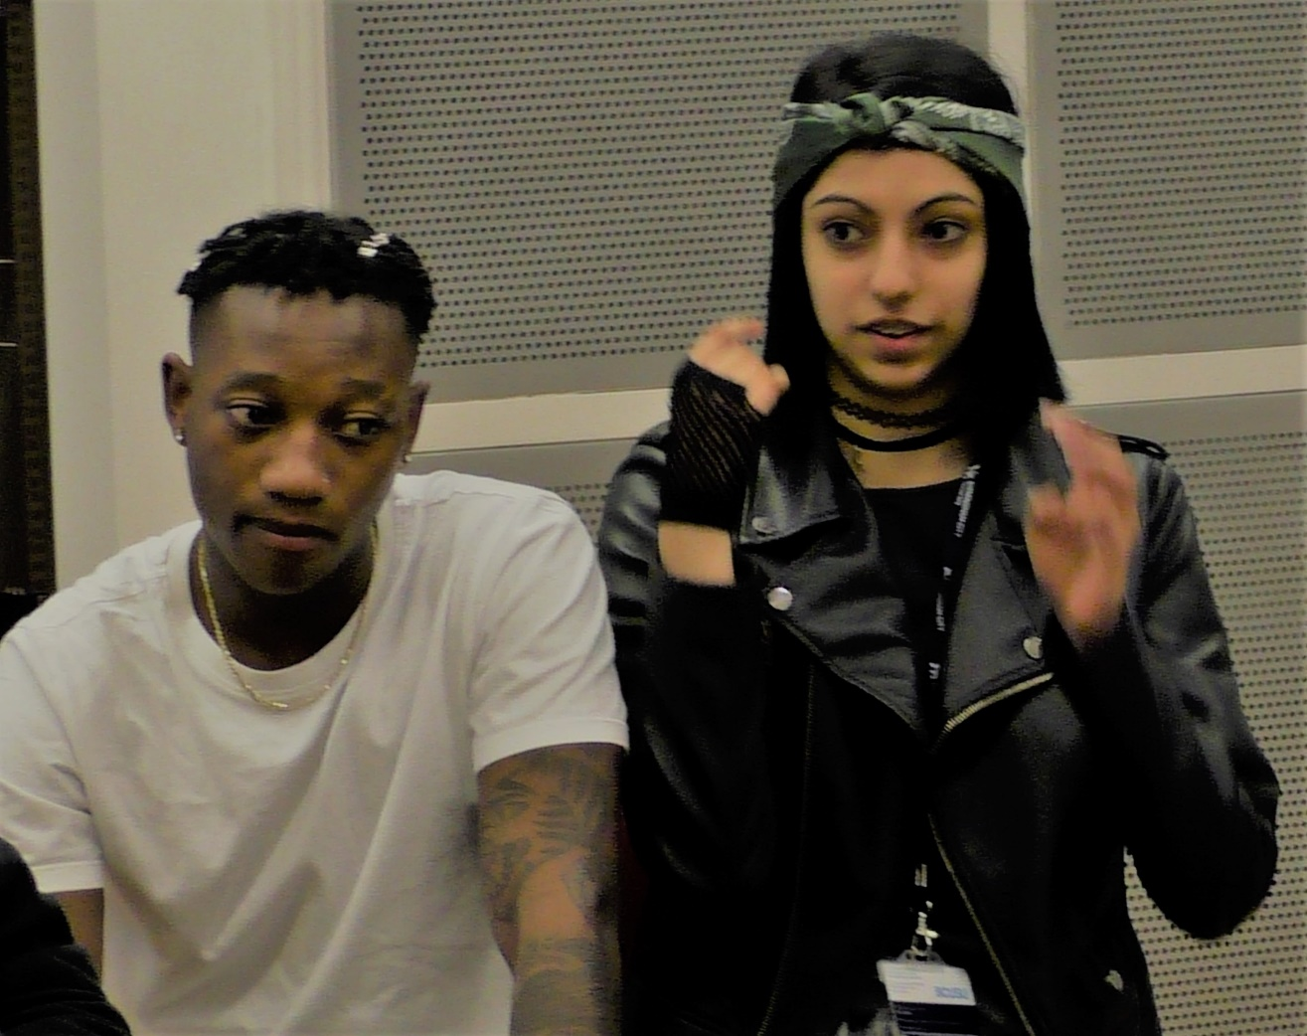
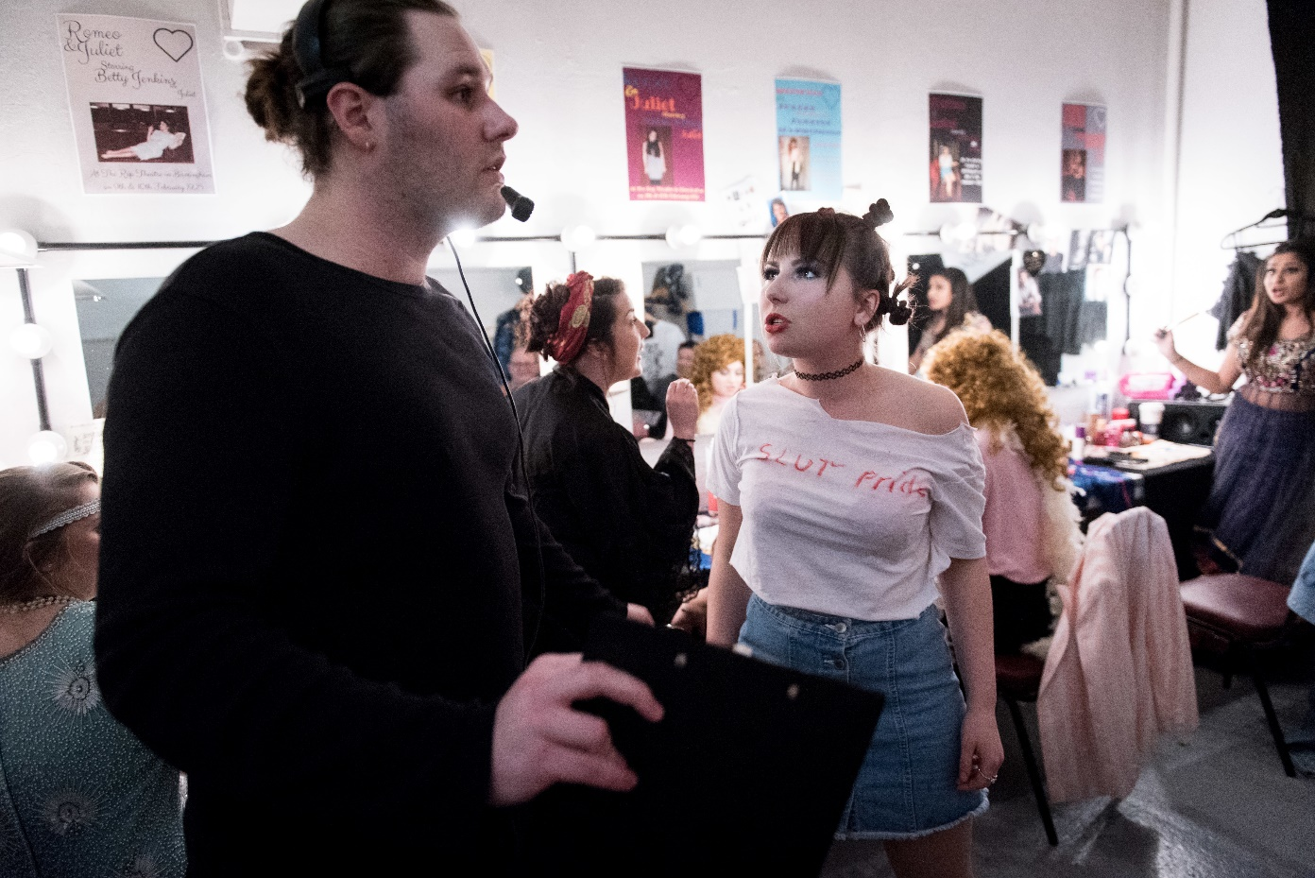
National Student Survey Score 2015 100%
National Student Survey Score 2016 100%
of 20
Notes:
In my 6 minutes and 40 seconds I cant tell you details about the course, but you can look them up

Slide 16
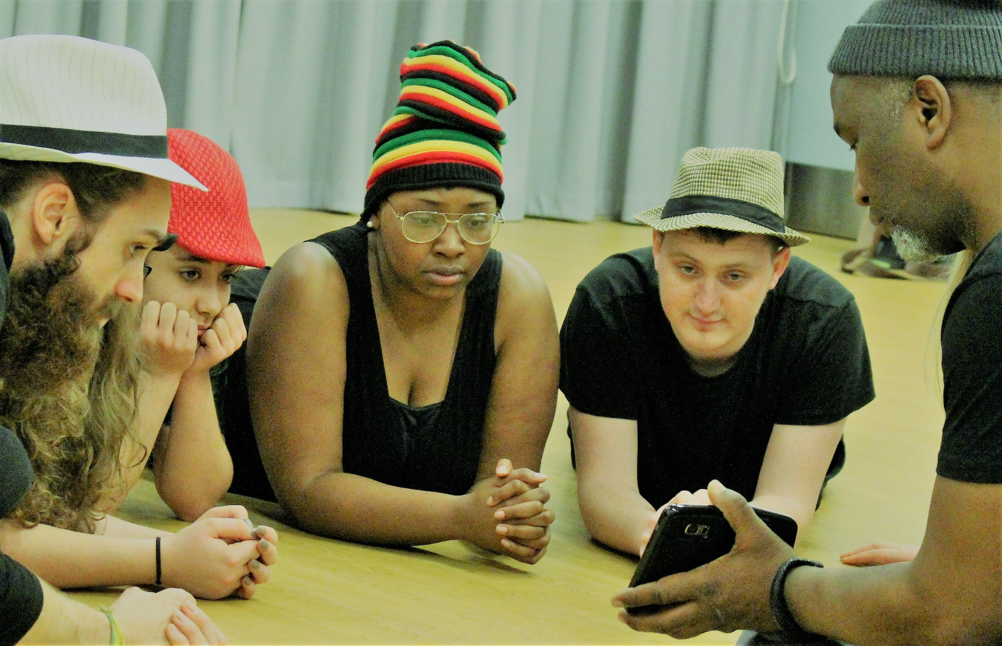
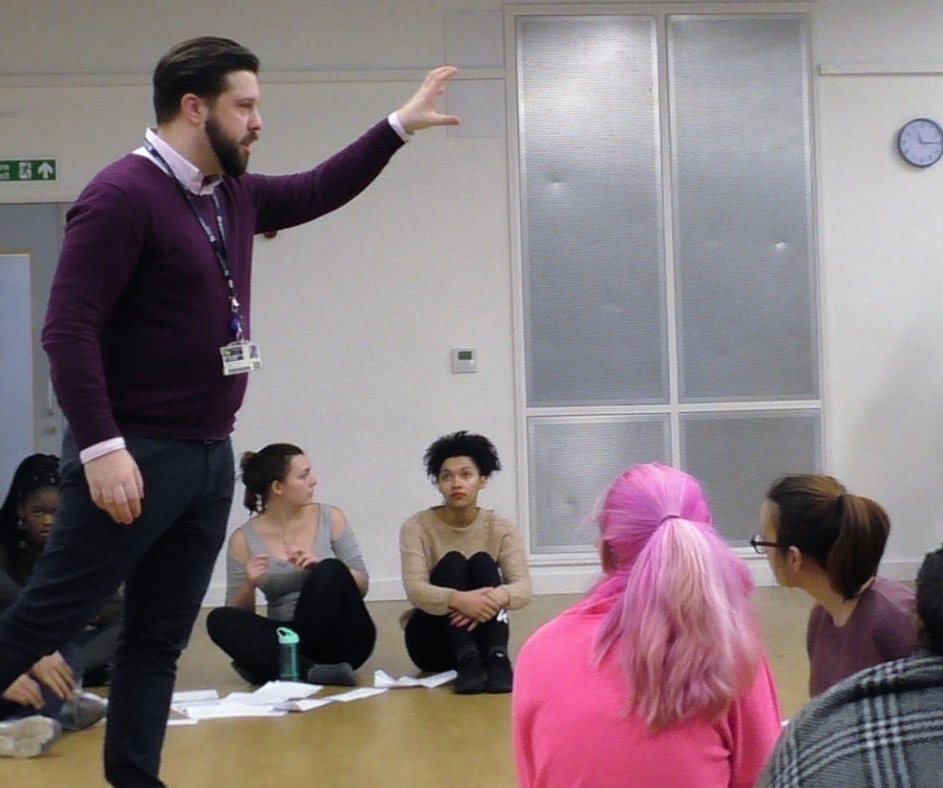
of 20
Notes:
All the teaching is done by practitioners – theatre companies come in and students go out into the community all the time. In the second year the do full-time placements for six weeks, and many of them go on to get work with the organisations that they have done placements with.

Slide 17






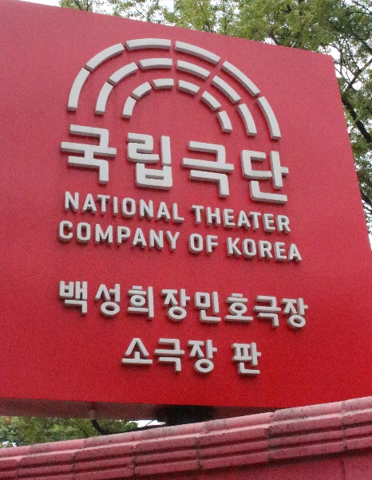







PARTNERS
of 20
Notes:
Yes, I did say they go on to get work. On my list of industry partners there are now over 60 small-scale companies working in the Birmingham Area. But our graduates go into a very wide range of work. Quite a number go into teaching [I know – what can you say?] Others into the informal education sector, running youth theatre groups, or dance clubs.

Slide 18
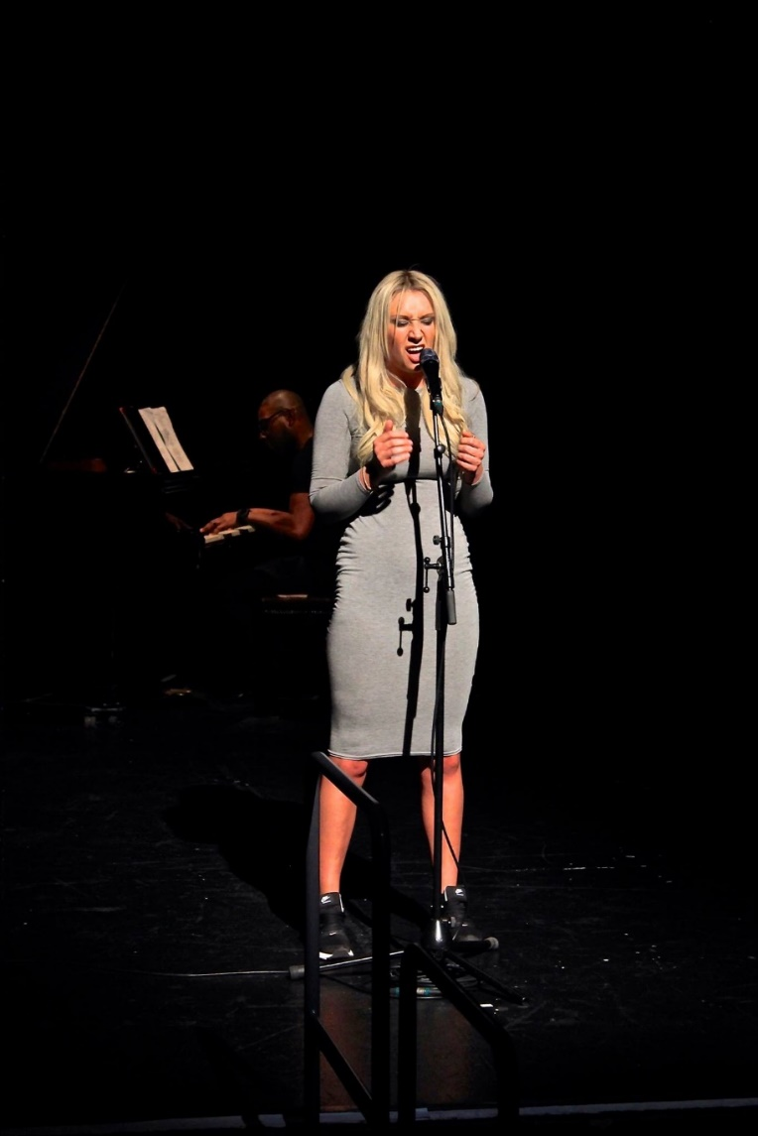


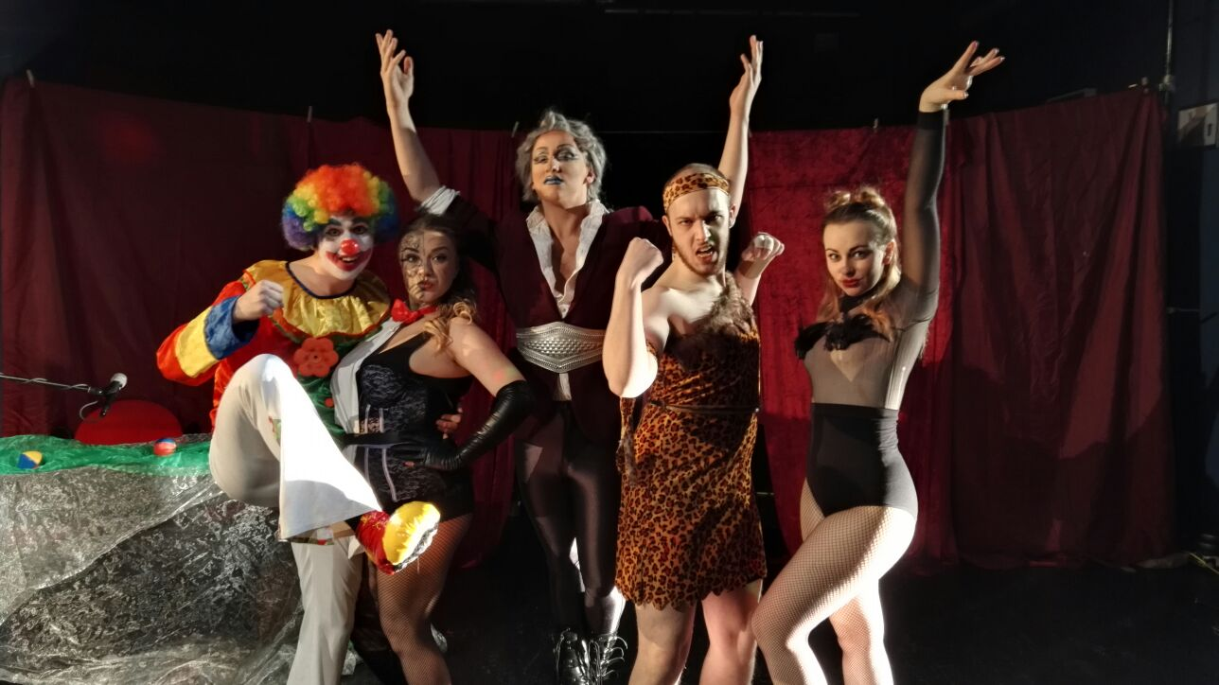
of 20
Notes:
Others set up their own companies or go freelance, they have been equipped for a very wide and enjoyable area of work.

Slide 19
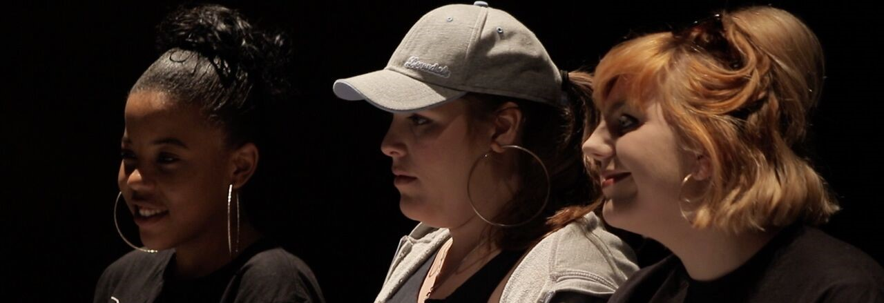
BA Applied Performance
at Birmingham Conservatoire
at Birmingham School of Acting
of 20
Notes:
So there you have it – Applied Performance. One more little twist. From September you will not find this course in the School of Acting. In fact you will not find the acting course in the school of acting, in fact you will not find the school of acting. Because in September we join forces with the world renowned Birmingham Conservatoire – still within BCU of course, but with added harmonies.

Slide 20
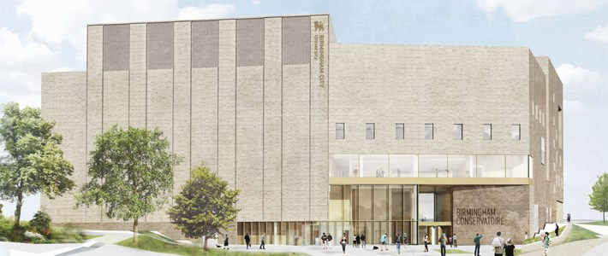
Coming Soon……..
peter.wynne-willson@bcu.ac.uk
of 20
Notes:
The beautiful new building being finished off behind us will house the music sections, and we will still be in our current base in Millennium Point. So you or your pupils will still be able to find us and when they do, they will have found a hidden gem. Pecha Kucha complete. Arigato gazeimas.

