Slide 1
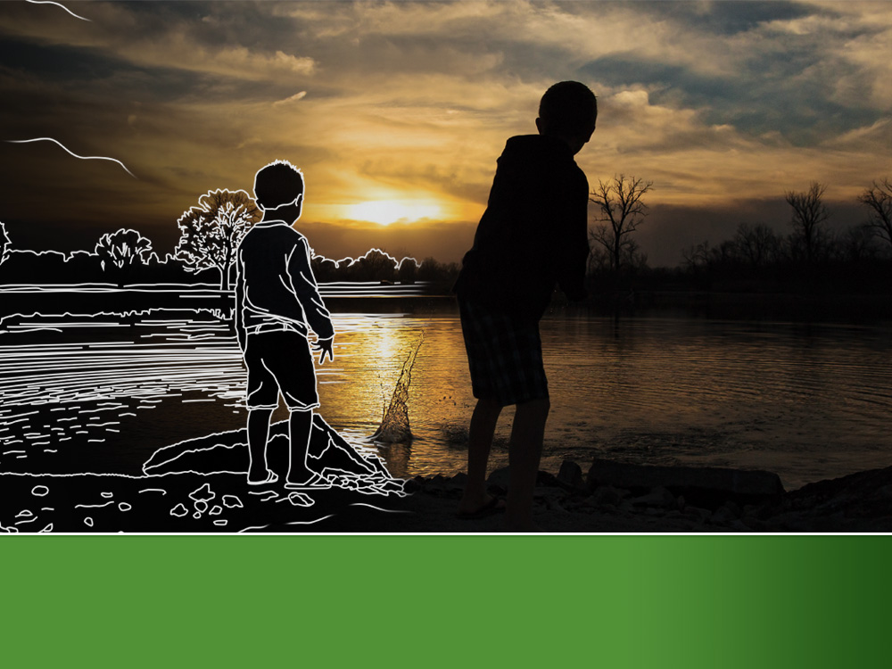
The Rural Futures Institute
Jessica A. Shoemaker
Assistant Professor, University of Nebraska College of Law

Slide 2
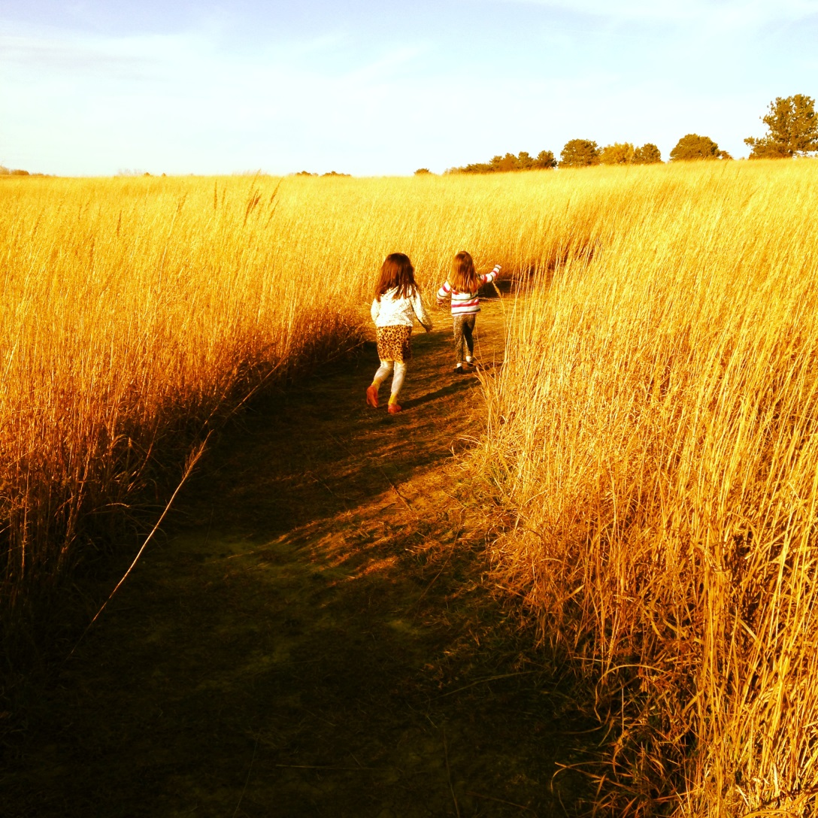
Great Plains Region of the U.S.
Both rural and urban but landscape predominantly open, agricultural
Undergoing significant demographic changes (rural depopulation, immigration, aging)
Abundant natural resources but complex water, food, energy, and other environmental challenges ahead
Multiple legal jurisdictions
Complex historical heritage

Slide 3
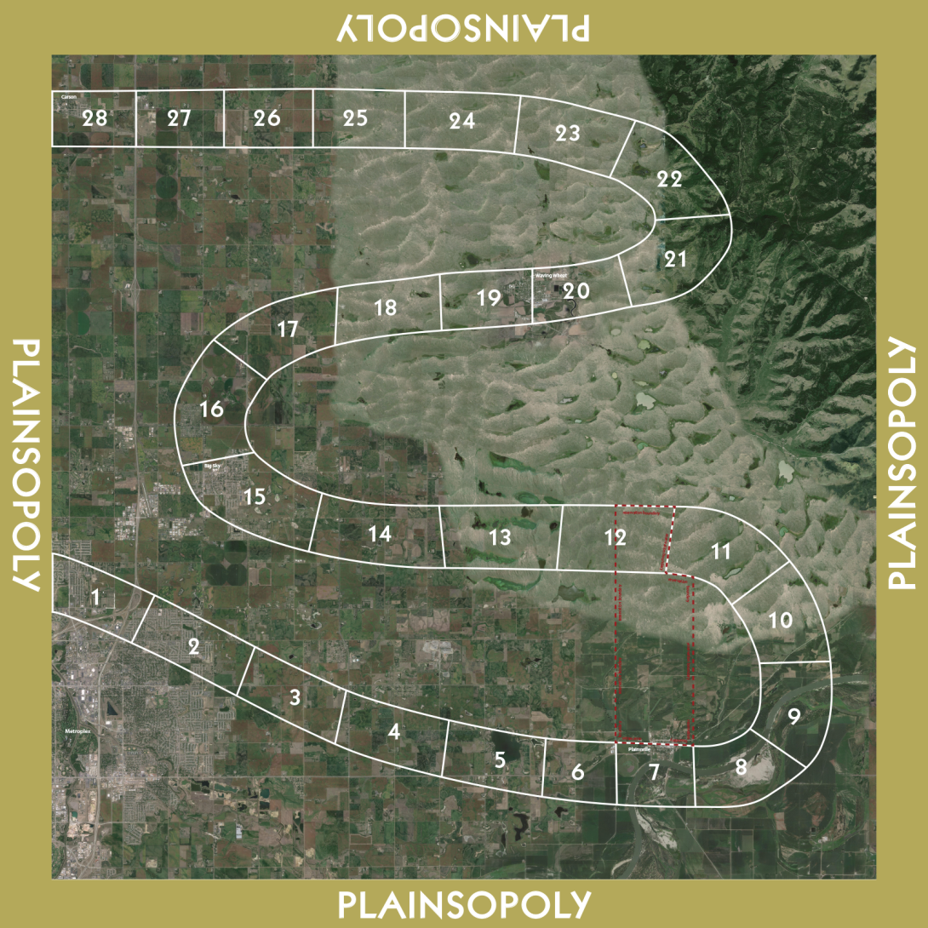
Plainsopoly Game Board

Slide 4
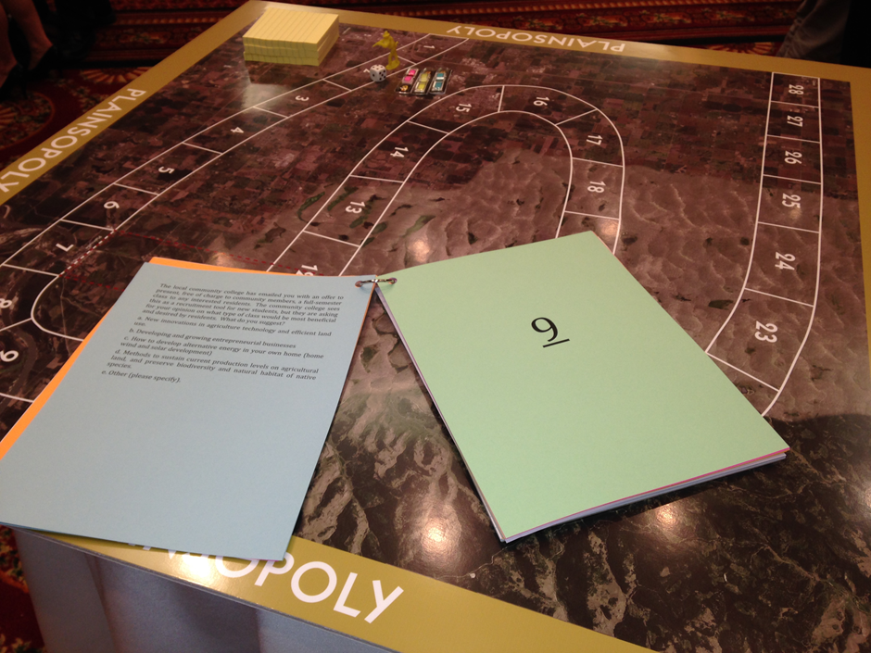

Slide 5
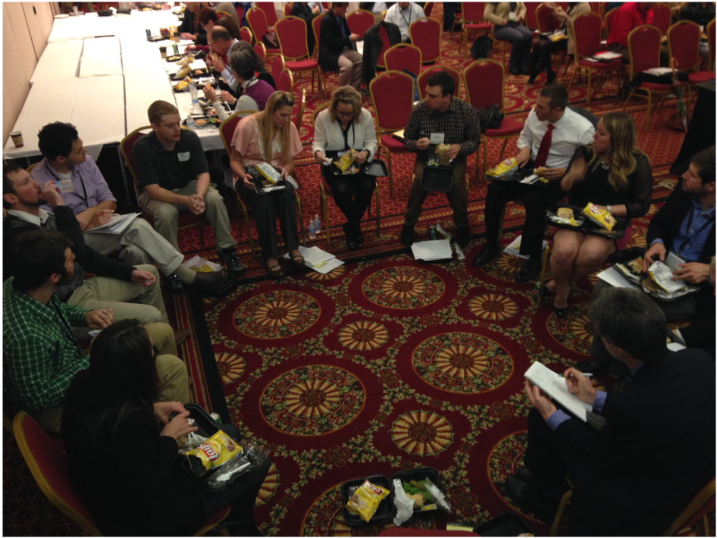
Process of Question Development: Almost as Valuable as Game Itself

Slide 6
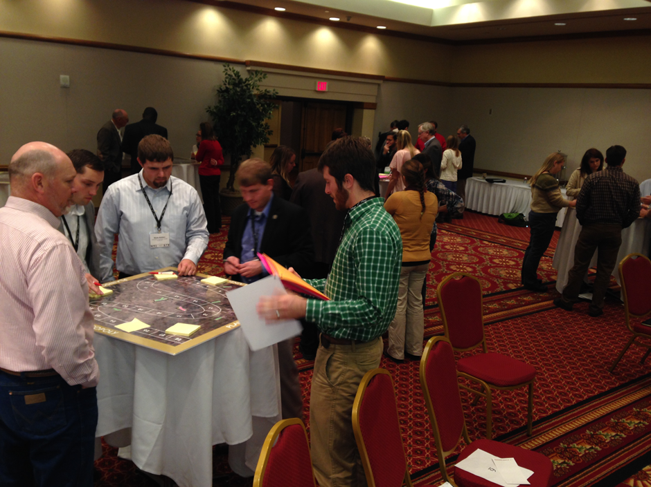
Particular Game Values
Unique capacity to spur civil dialogue on highly charged political issues
Engagement on an even playing field
Regional scale awareness for planning and systems understanding
Introduces a more relative understanding of property rights – how one's land use decision impacts neighbors
Builds rapport and understanding within groups

Slide 7
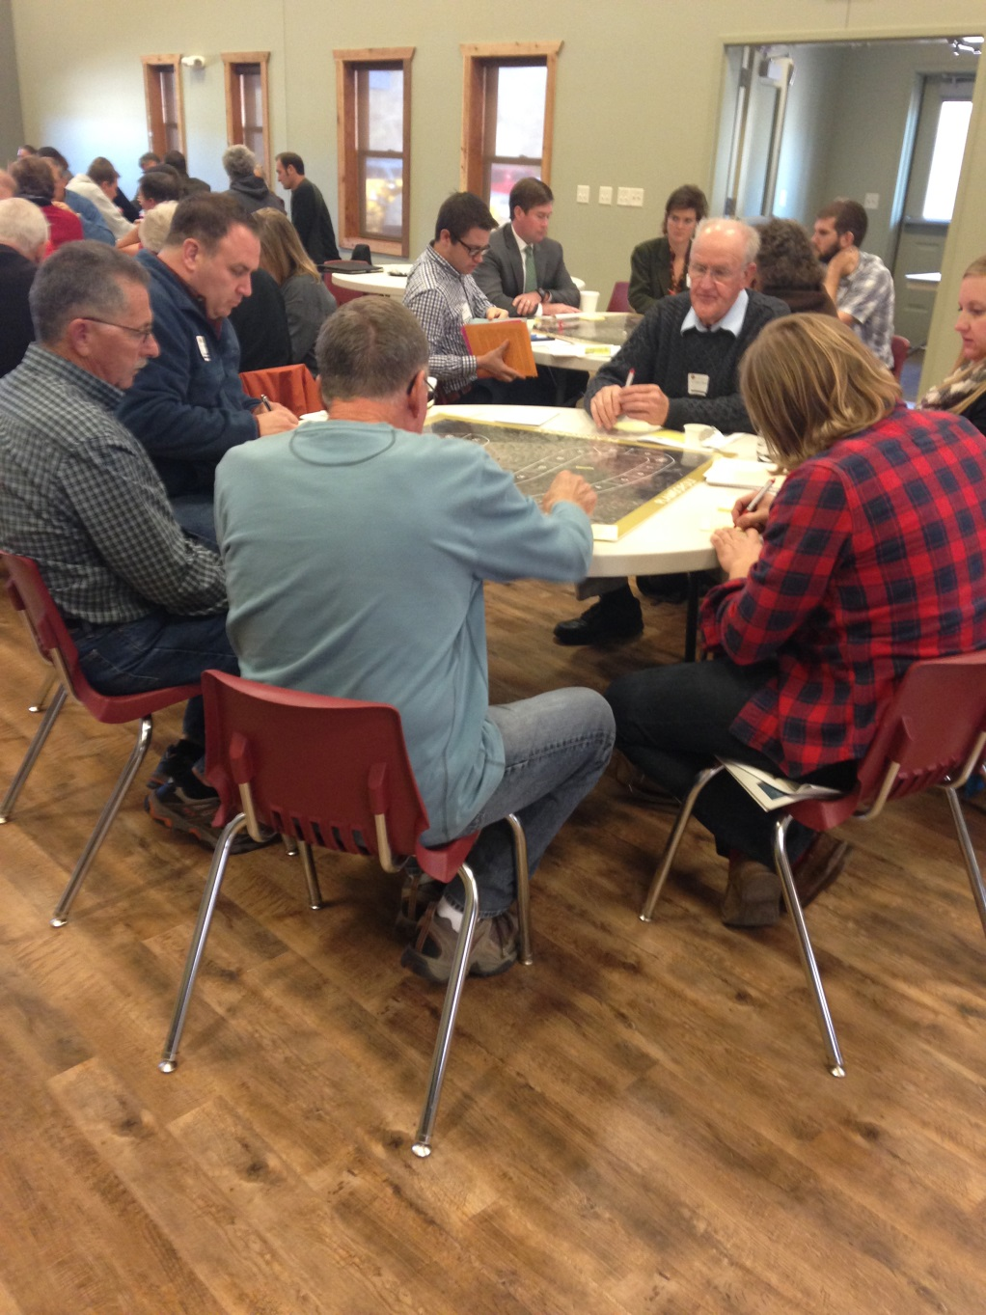
Current Limitations
Basic insight of interconnectedness less impactful to more sophisticated audience
Ultimate visions produced often very abstract or general
Unclear how (if) discussions of vision, opportunities, and barriers get translated to real world
Single fixed landscape
Facilitator dependent or possible facilitator bias
Costs of individual decisions, and their consequences later in the game, could be more explicit

Slide 8
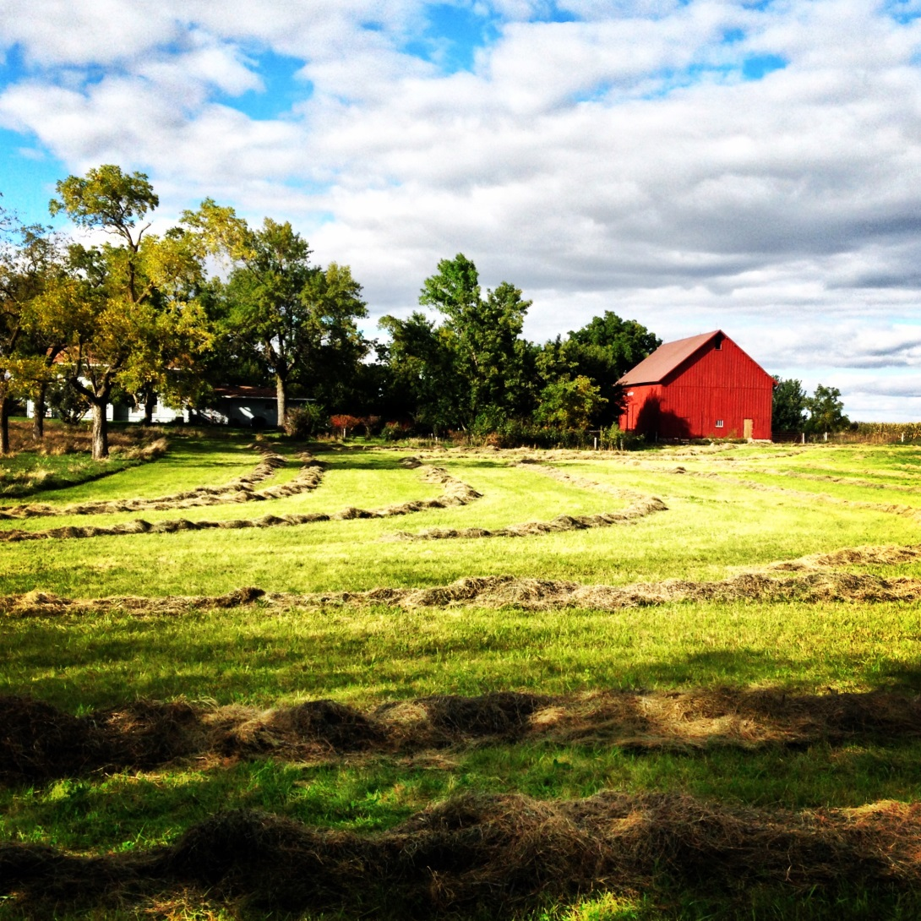
Future Demands for Plainsopoly
Lots of educational interest (high school, community college, and university)
Extension requests for team building type efforts in individual communities or groups (e.g., facilitate communication, indirect conflict resolution, etc.)
Actual planning (including river sheds and community rebuilding)
Public trust and governance research

