Slide 1
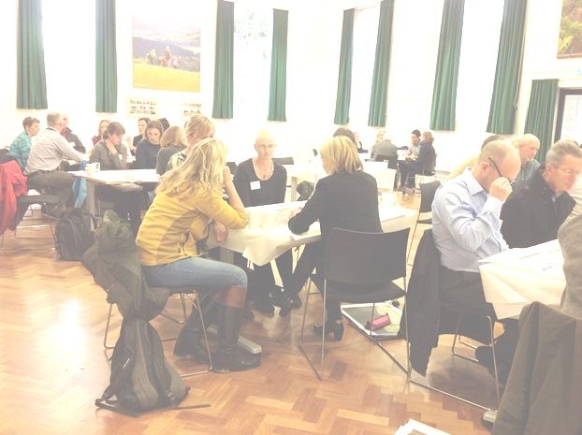
SDNP Rufopoly
Insights from the South Downs National Park (SDNP) Adaptation of Rufopoly

Slide 2
Event
“Planning to Deliver Multi-functional Benefits for the South Downs National Park and Beyond”
13 October 2014
Lead: Ray Drabble, SDNPA
Participants: Environmental agencies, eNGOs, Local Authorities, SDNPA members

Slide 3
Purpose
Purpose: Discuss spatial scenarios as part of SDNP workshop to develop a Green Infrastructure (GI) framework.
SDNP-Rufopoly game used to facilitate discussion about:
  What benefits to society should the Framework seek to deliver?
  What principles of partnership working have been identified that could deliver a better environment through a GI Framework?
  What areas of opportunity spatially and thematically should be the priorities for cross-border collaboration on GI?

Slide 4
Key Challenges
Threatened habitats and heritage
Visitor pressure
Water resources
Economic and market trends
Climate change
Changing values, behaviours, lifestyles
Development pressures
Notes:
These are the key challenges as identified having to be addressed in the forthcoming Local Plan for the SDNP.

Slide 5
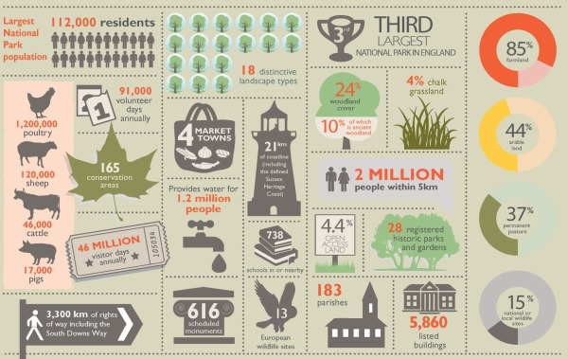
Notes:
SDNP Stats:
Towns: Lewes, Petersfield and Midhurst
over 300 other villages and hamlets
About 112,000 people live in the National Park (Census 2011), and millions of visits are made every year

Slide 6
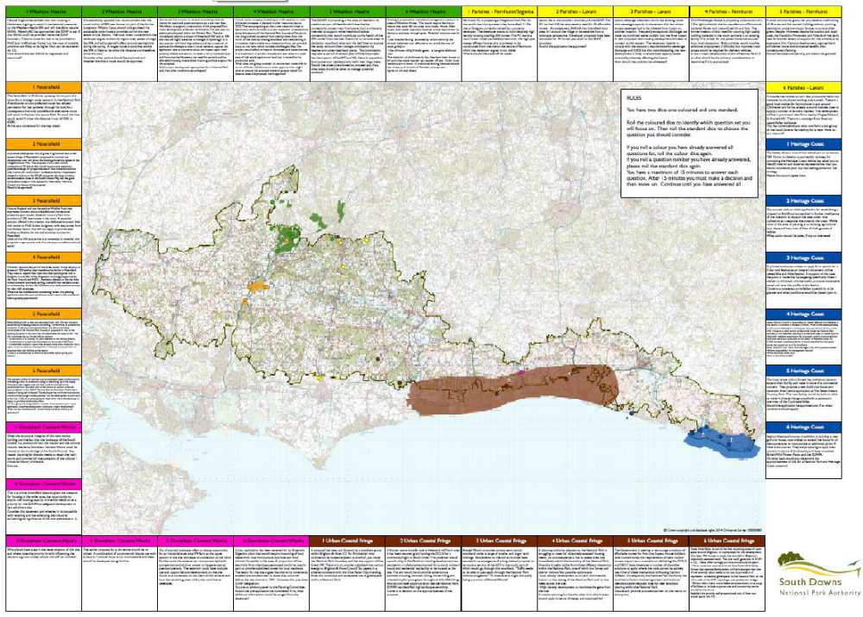
Notes:
A0 map with 6 questions / spatial scenarios for each of the 6 highlighted areas (some big some quite small / scattered

Slide 7
Landscapes / Areas
The focus in the game is on specific areas identified as of particular concern for the forthcoming Local Plan:
Petersfield (growing market town)
Parishes: Fernhurst, Lavant
Wealdon Heath SPA
Heritage coast
Urban coastal fringe
Shoreham Cement Works

Slide 8
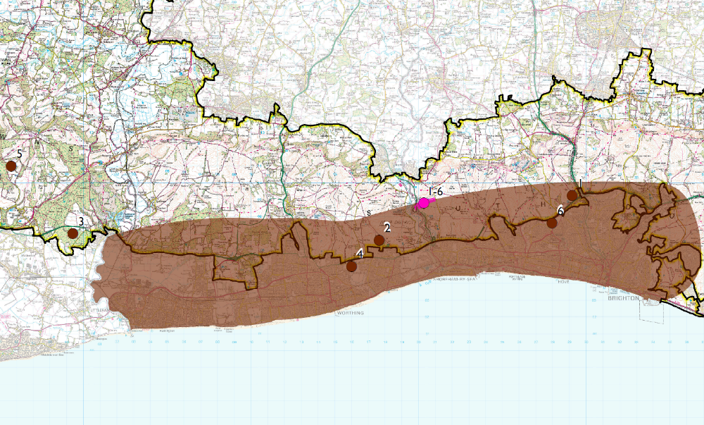
Notes:
Picked special character areas that were identified for focus in their Local Plan that is being developed (2014-2016)
See e.g. http://southdowns.gov.uk/planning/planning-policy/national-park-local-plan/

Slide 9
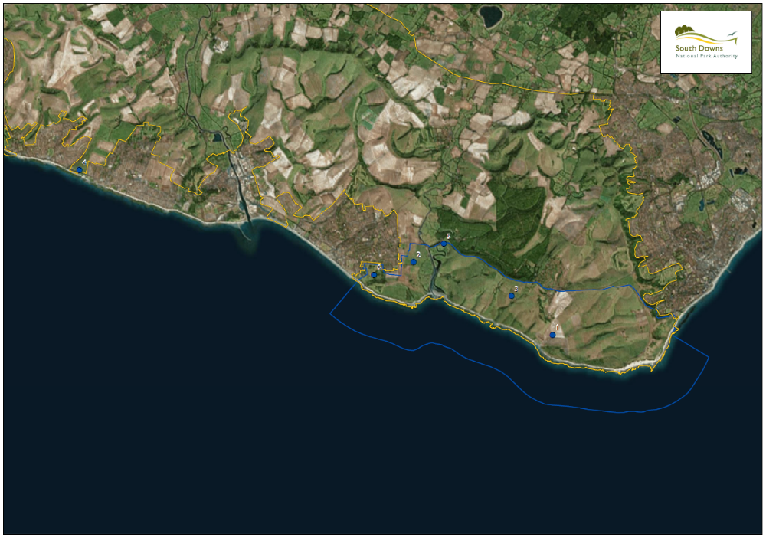
Notes:
Specific coastal area that the game focuses on

Slide 10
Practicalities
Real sites with questions based around spatial scenarios
Adaptation requires time, money, technical expertise
  a ready-made toolkit under this KE project which users can quickly and easily tailor to their needs is key
Took about 1.5–2 days for 36 questions
The spatial areas were very large (SDNP:1600 km²)
  aerial photos and additional information used
Notes:
Fictitious landscape replaced with real sites and questions based around spatial scenarios
Adaptation of Rufopoly to specific contexts, requires time, money, technical expertise (e.g. GIS skills)
a ready-made toolkit under this KE project which users can quickly and easily tailor to their needs is key
coastal area; specific industrial / post-industrial issues (e.g. Shoreham cement works)
The length of time and resources it took to develop the questions (probably 1.5 – 2 days for 36 questions)
The spatial areas were very large (SDNP covers 1600 km²)
need for (aerial) photos and additional information

Slide 11


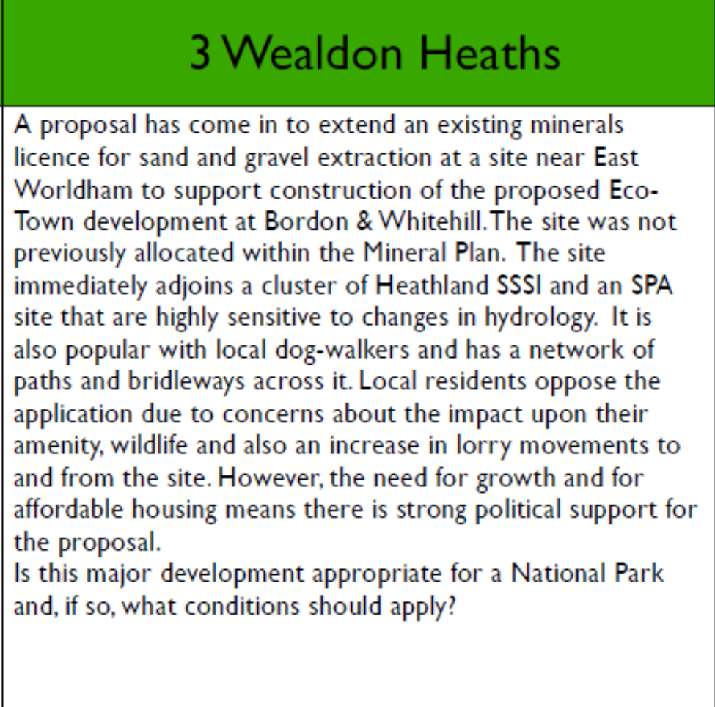
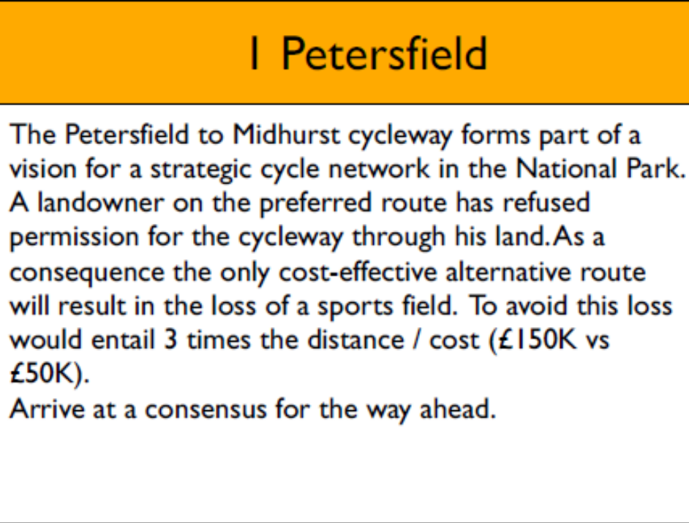
Questions Taster

Slide 12
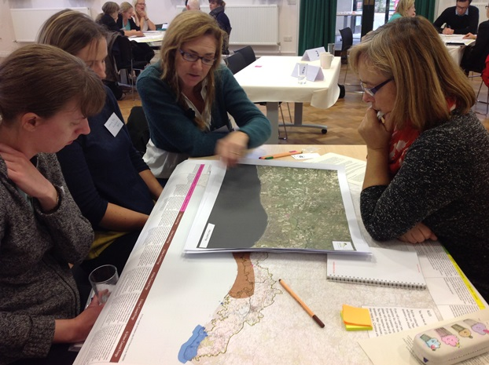

Slide 13
Lessons learnt
Questions / spatial scenarios need to be carefully written not to misrepresent the position of organisations / authorities
The success of the exercise was dependent upon the strength of the facilitator
Notes:
Questions / spatial scenarios need to be carefully written not to misrepresent the position of organisations / authorities
Feedback received indicated that the success of the exercise was dependent upon the strength of the facilitator

Slide 14
Opportunities
Use the game for range of communities-based discussions to inform the Local Plan
Adapt the game for neighbourhood planning (e.g. Lewes)
Adapt the game to specifically tease out Green Infrastructure issues

