Slide 1



SDNP Rufopoly
Insights from the South Downs National Park (SDNP) Adaptation of Rufopoly
Ray Drabble
23 April 2015
Notes:
Good Morning Ladies and Gentlemen, and My thanks to Alister and colleagues for inviting the South Downs National Park Authority to share our experience of adapting the Rufopoly concept for use in our Local Plan preparation.

Slide 2
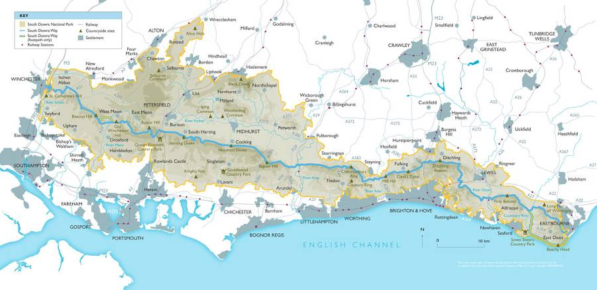
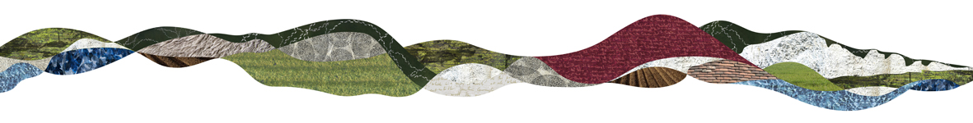
The South Downs National Park
Notes:
Let me start with a very brief introduction to the South Downs National Park which is over 1,600 sq. km and stretches 100 miles from the edge of Winchester in the west to Beachy Head, Eastbourne.
The South Downs Way which runs along the chalk spine of the South Downs is shown in blue .
All the grey shown to the south of the park is the urban coastal fringe which is intensively developed and subject to high levels of in-migration.
It nicely illustrates my counter-argument to sea-level rise in the south east which is that the region is sinking under an every increasing number of people purchased along the south coast of England!

Slide 3
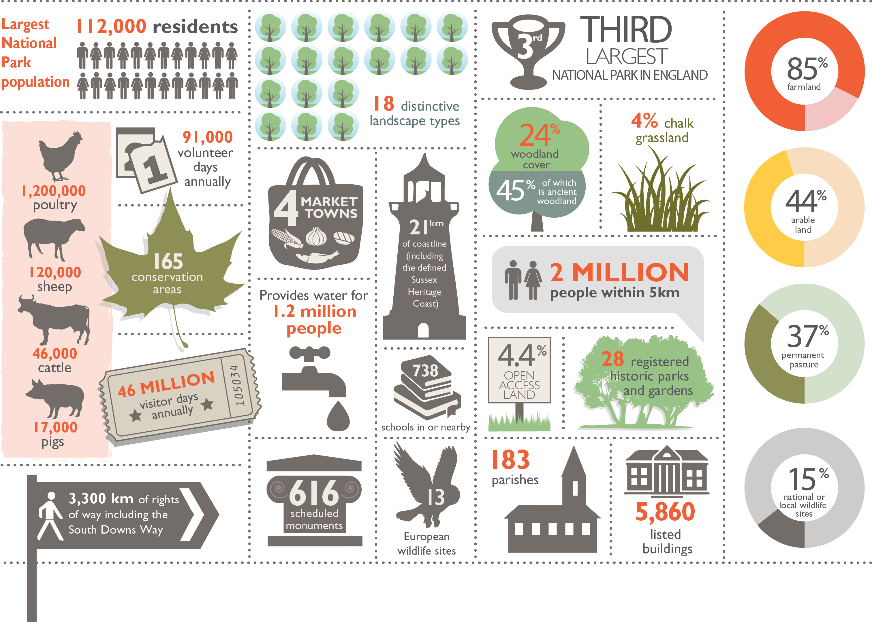
England’s Newest National Park in a Nutshell
Notes:
We are England’s newest National Park! Having been designated on 1 April 2010, we have just had our fifth birthday.
Key points to pick out:
112,000 residents; this is about 7 times the population of each of your two national parks
46 million visitor days annually considerably more than either of the Scottish NPs.
2 million people within 5km
85% farmland; It is not a wilderness area like many of the upland NPs.
In terms of national park planning we are on largely uncharted territory because we are so different from the other national parks in England or elsewhere in the UK.

Slide 4
Event
“Planning to Deliver Multi-functional Benefits for the South Downs National Park and Beyond” 13 October 2014
Purpose: Secure agreement from delegates on the principles and priorities for a South Downs National Park Green Infrastructure Framework.
Participants: Environmental agencies, eNGOs, Local Authorities, SDNPA members.
Notes:
We first used the Rufopoly concept at a workshop last October entitled Planning to Deliver Multi-functional Benefits for the South Downs National Park and Beyond
The purpose of the workshop was to get agreement from delegates on the principles and priorities for a South Downs National Park Green Infrastructure Framework that the authorities and other organisations represented would in due course buy into.

Slide 5
Rufopoly Session
Aim: To explore the implications for green infrastructure from planning issues using a range of scenarios at different spatial scales. The SDNP-Rufopoly game used to facilitate discussion about:
  What benefits to society should the Framework seek to deliver?
  What principles of partnership working have been identified that could deliver a better environment through a GI Framework?
  What areas of opportunity spatially and thematically should be the priorities for cross-border collaboration on GI?
  It was the principles and opportunities for partnership working on GI that the groups were asked to focus on.
Notes:
In a moment of weakness, I was persuaded by a colleague, Chris Fairbrother, who is leading on our ecosystems services work to develop our own version of Rufopoly for use at a Workshop Event on 13 October that I was organising. What I had failed to appreciate was the time and thought necessary to develop credible planning scenarios that would cover the range of issues and spatial scales needed to inform the development of the Green Infrastructure Framework!
Aim: To explore the implications for green infrastructure from planning issues using a range of scenarios at different spatial scales. The SDNP-Rufopoly game used to facilitate discussion about:
What benefits to society should the Framework seek to deliver?
What principles of partnership working have been identified that could deliver a better environment through a GI Framework?
What areas of opportunity spatially and thematically should be the priorities for cross-border collaboration on GI?
It was the principles and opportunities for partnership working on GI that the groups were asked to focus on

Slide 6
Key Issues for Planners
Development pressures – neighbouring authorities;
Visitor pressure – e.g. disturbance to ground nesting birds;
Threatened heritage – KE VII;
Water resources – Rivers / GW in areas fail WFD objectives;
Economic & market trends – the new Champagne region!
Climate change – coastal inundation and surface water flooding;
Changing values, behaviours, lifestyles – SDNP as a resource for health and recreation.
Notes:
Key Issues for Planners
Development pressures – neighbouring authorities;
Visitor Pressure – particularly affecting nature conservation considerations e.g. disturbance to ground nesting birds.
Threatened heritage; requires pragmatic solutions to fund conservation / enhancement e.g. KEVII. Also mention barn conversions.
Water resources; Rivers / GW in areas are fail to meet Water Framework Directive WFD objectives for goo ecological status and chemical status.
Economic and market trends – S Downs in the new Champagne region.
Climate change; changing climate has clearly benefited the growing wine industry in the area but it is causing other issues in relation to coastal inundation and surface water flooding.
Changing values, behaviours, lifestyles – Health and well-being high on the agenda of the heavily populated urban coastal fringe. The SDNP is viewed as a resource for improving health and well-being of sectors of the population through schemes like walking for life linked to GP treatment trains.
King Edward VII Estate comprises a unique mix of Grade II and II* Listed buildings which are being restored and converted into 162 exceptional apartments, duplexes and houses which will combine all the original character features of the existing buildings with modern specifications. 247 new apartments and houses will be built in the surrounding area.
Part of the restoration process will also see the gardens, originally planted by the acclaimed horticulturalist Gertrude Jekyll, meticulously restored for all residents to enjoy

Slide 7
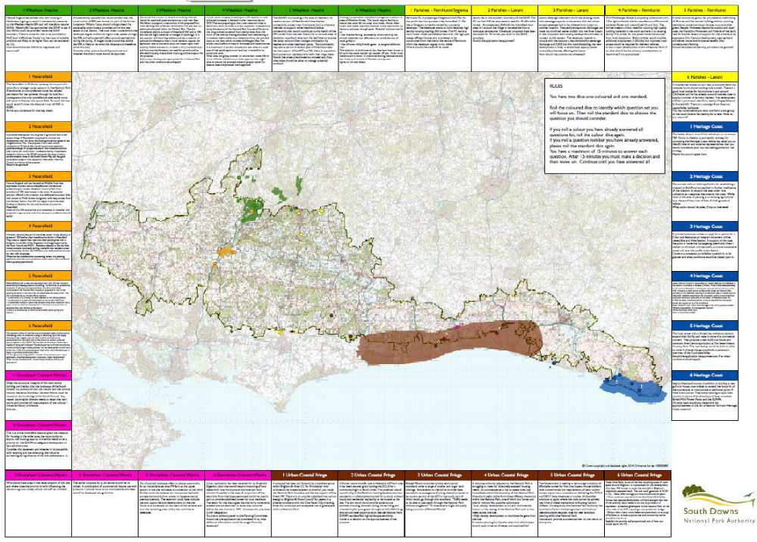
Notes:
A0 map with 6 questions / spatial scenarios for each of the 6 highlighted areas (some big some quite small / scattered. While the colours of the areas bear a close resemblance to monopoly there is no intended correspondence to the property values

Slide 8
Landscapes / Areas
The focus in the game is on specific areas identified as representative of particular concerns for the forthcoming Local Plan:
Petersfield (growing market town);
Parishes: Fernhurst, Lavant;
Wealdon Heath SPA;
Heritage coast;
Urban coastal fringe;
Shoreham Cement Works;

Slide 9
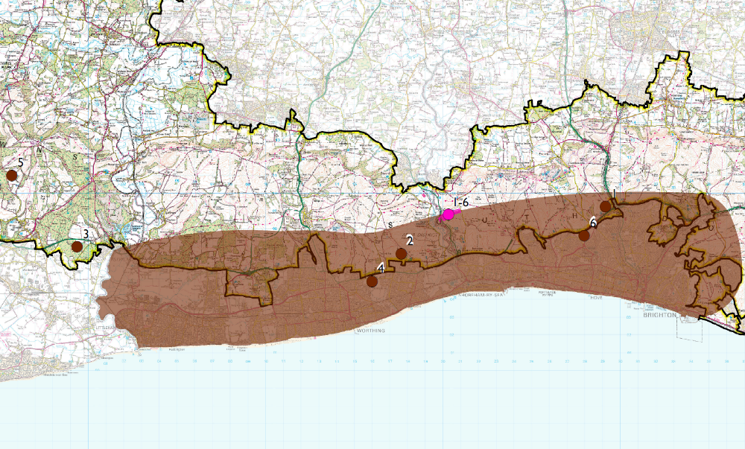
Notes:
Picked special character areas that were identified for focus in their Local Plan that is being developed (2014-2016)
See e.g. http://southdowns.gov.uk/planning/planning-policy/national-park-local-plan/

Slide 10
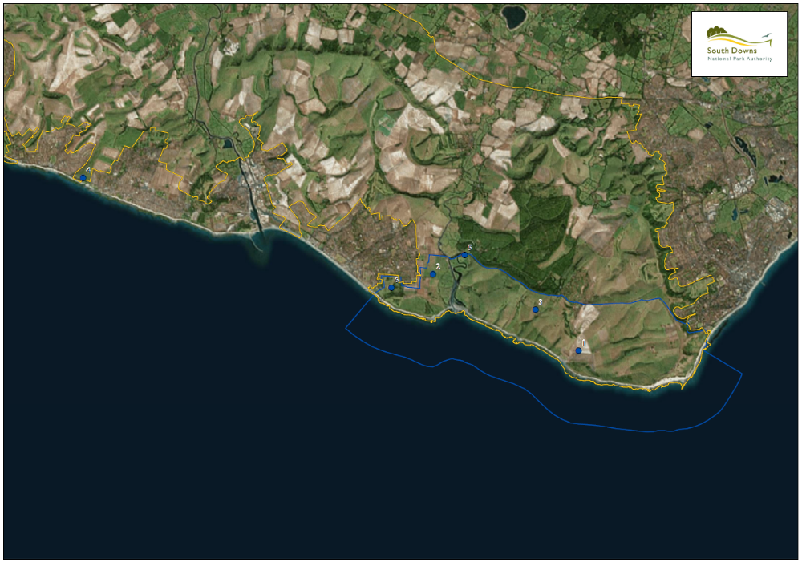
Notes:
Specific coastal area that the game focuses on

Slide 11
Practicalities
Real sites with questions based around spatial scenarios;
Adaptation of Rufopoly requires time, money, technical expertise;
  Took about 1.5–2 days for 36 questions;
Once developed, it is relatively easy to adapt and re-use with multiple audiences.
The spatial areas were very large (SDNP:1600 km²)
  aerial photos and additional information used.
Notes:
Real sites with questions based around spatial scenarios; this could be termed as ‘faction’ because to develop some of the scenarios, I used examples from elsewhere in the NP and applied them to a different location. We also had to issue a very clear health warning that while we were using real locations - and in some instances organisations - the scenarios, while plausible, were not based on actual events. We didn’t want our rufopoly scenarios to give rise to alarmist headlines in the local press!
Adaptation of the Rufopoly game requires time, money and technical expertise;
It took about 1.5–2 days for 36 questions; On this basis it is something that LPAs could undertake and once developed could adapt and re-use with multiple audiences. The SDNP Rufopoly has been used on at least 2 occasions since October.
The spatial areas were very large (SDNP:1600 km2) and because of this the areal photos for the larger sites were limited in terms of the information one could yield. We overcame this to some extent with half page descriptions of the areas.
It did raise in my mind the possibilities of what one could do with an on-line version that allowed one to zoom in and do fly throughs of area of interest!

Slide 12
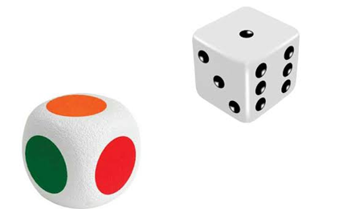
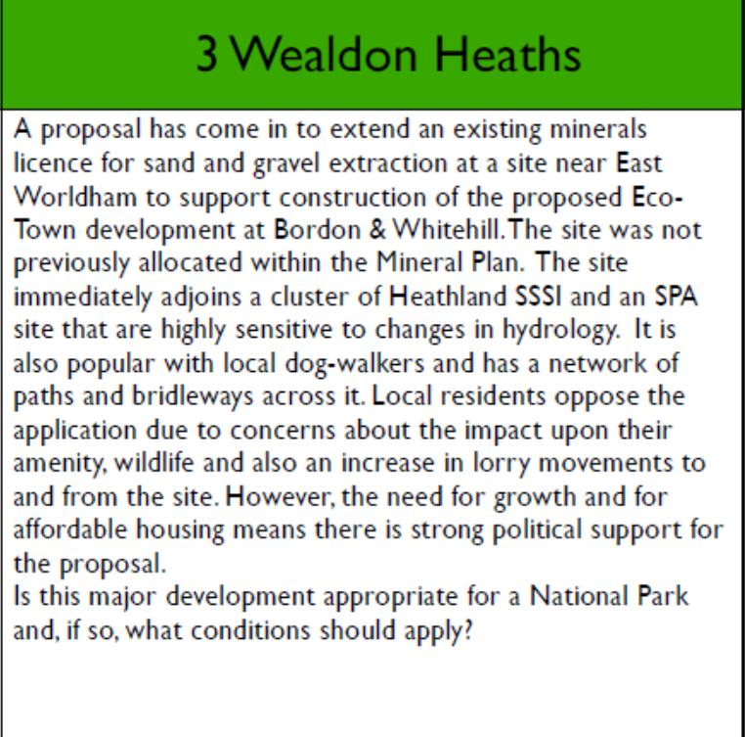
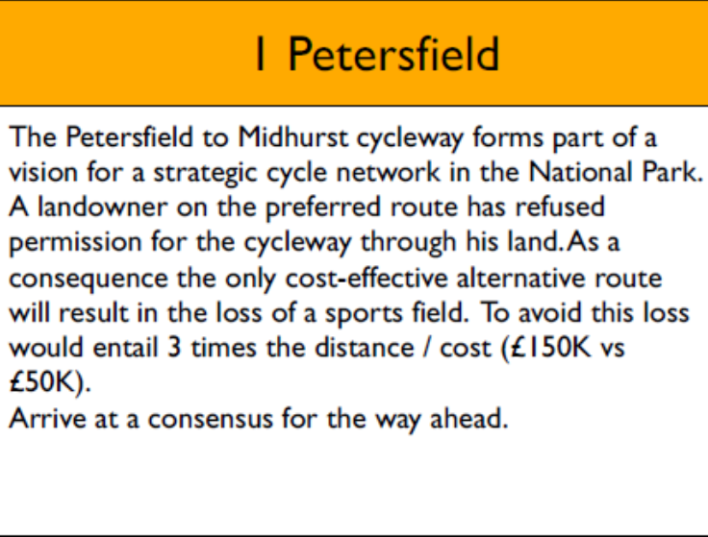
Question Taster
Notes:
Here are a couple of sample questions that Claudia picked out probably a worst and best of batch; the one on the left is probably a bit too long. I will read the one on the right: This is very much based in reality and we tried to keep a lot of the questions open ended to get delegates to think outside of their normal mind-set or organisational position to see that site specific decisions can have broad implications for more strategic GI.

Slide 13
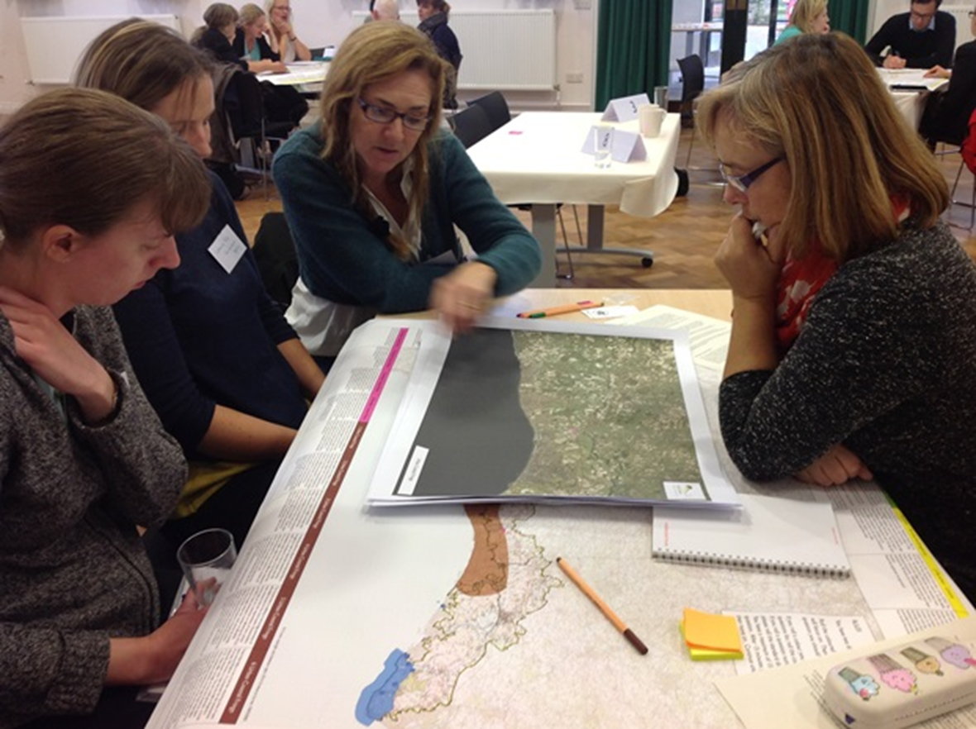
SDNP-Rufopoly in Action!
Notes:
So this picture wasn’t posed at all; the players are so engaged in debating the issues that they are oblivious to the camera. In the feedback that we received, the consensus was that more time than the one hour allotted should have been spent on the Rufopoly… but maybe that says more about the rest of the programme for the day?

Slide 14
Lessons Learnt
Questions / spatial scenarios need to be carefully written so as not to misrepresent the position of organisations / authorities;
Allow plenty of lead time to prepare the Rufopoly tool including the GIS / mapping elements;
The success of the exercise was dependent upon the strength of the facilitator;
Notes:
So the lessons that we learnt
Questions / spatial scenarios need to be carefully written so as not to misrepresent the position of organisations / authorities; we have come through unscathed thus far but there is a risk that
our audience may not always be as accommodating.
Allow plenty of lead time to prepare the Rufopoly tool including the GIS / mapping elements;
The success of the exercise was dependent upon the strength of the facilitator; he or she is likely to be far more effective if she has good local knowledge of the area and the issues.

Slide 15
Thank you for listening
Any Questions?
Ray Drabble
Sustainability policy Officer
South Downs National Park Authority
Ray.Drabble@southdowns.gov.uk

