Slide 1




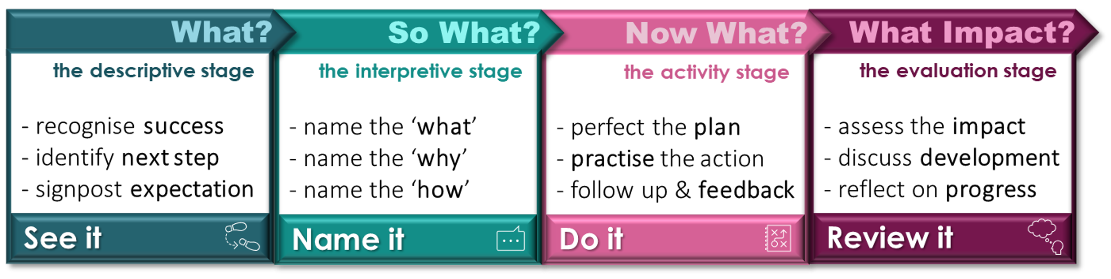

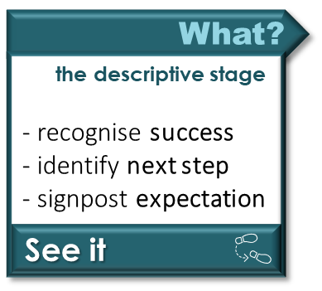
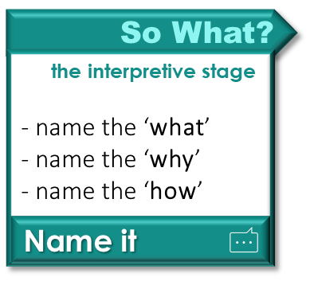
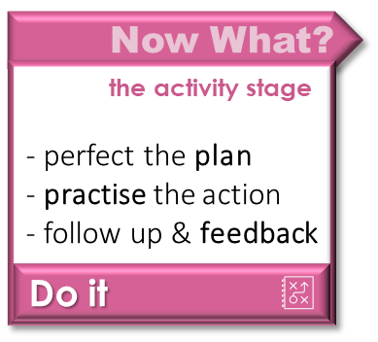



A quick guide to the
BCU ITE Mentoring Model
Offer specific praise
Ask simple follow-up questions
Identify the gap or development area
Encourage the AT to identify their next step
Show a model of the expected action
See what highly effective teaching looks like
Encourage the AT to name the target
What will they work on?
Elicit the reason behind this target
Discuss the impact it might have
Set out the approach to improve
How will the AT do this?
ATs create a plan, script the action
Compare this with their mentor’s version
Create a simulation of the targeted area
Model and practice the action
Set dates for review
Plan for ‘in-observation’ feedback
Consider the impact of the completed target
How effectively was the action step completed?
Discuss what has emerged in their teaching
How has this improved the classroom environment?
Consider what lesson has been learnt
How will they take this forward into future practice?

Slide 2




A quick guide to the
BCU ITE Mentoring Model
the ‘See it’ stage
Offer specific praise
Ask simple follow-up questions
Identify the gap or development area
Encourage the AT to identify their next step
Show a model of the expected action
See what highly effective teaching looks like
Firstly, we offer specific praise and ask simple follow-up questions. It is important for the mentee to be given opportunity to validate their own development and recognise the progress they have made so far. Then we identify the gap and identify their next step. As the mentee’s confidence and competence develops, the mentor’s role shifts to encouraging ideas from the mentee, in a more dialogical relationship. Once an area has been identified we move on to discussing the expected action, considering what highly effective practice might look like.

Slide 3




A quick guide to the
BCU ITE Mentoring Model
the ‘Name it’ stage
Encourage the AT to name the target
What will they work on?
Elicit the reason behind this target
Discuss the impact it might have
Set out the approach to improve
How will the AT do this?
Then we encourage the mentee to name the target allowing them to consider the question “what will they work on?” Once the target is isolated, it is important to explore the deeper rationale for focusing on this area, identifying the impact that such a development might have on the mentee, the classroom, and importantly upon the development of their students. Then we set out the approach to improve and discuss how this will be achieved. So, we have set out the target, we have discussed the rationale behind this, and discussed how this will be put into action.

Slide 4
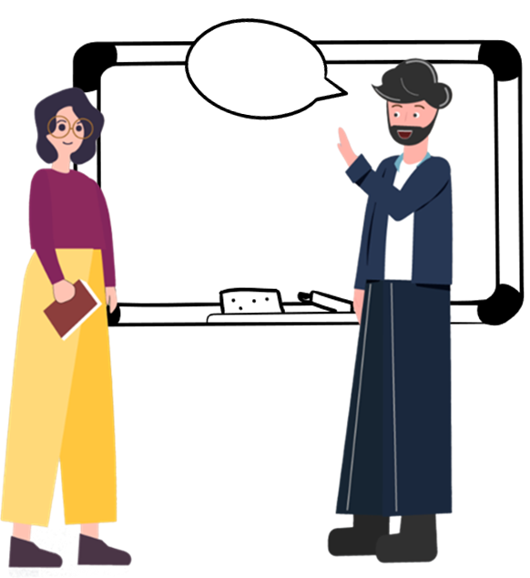


A quick guide to the
BCU ITE Mentoring Model
the ‘Do it’ stage
ATs create a plan, script the action
Compare this with their mentor’s version
Create a simulation of the targeted area
Model and practice the action
Set dates for review
Plan for ‘in-observation’ feedback
Ensure that you map out the action, behaviour or language that is required, as explicitly as required. In many cases this would literally involving creating a script, or a series of stages to direct their action. This might include cues for each stage of the practice, or the specific questions and instructions they are going to use. We create a simulation of the targeted area and model the action. It is important to offer a safe space for this be perfected. We identify a timeframe for this development, setting a date for review in action, and feedback to be made available.

Slide 5



A quick guide to the
BCU ITE Mentoring Model
the ‘Review it’ stage
Consider the impact of the completed target
How effectively was the action step completed?
Discuss what has emerged in their teaching
How has this improved the classroom environment?
Consider what lesson has been learnt
How will they take this forward into future practice?
We are now able to review the development in action, to assess the impact and reflect on the progress made. We consider the impact of the completed target and reflect upon how effectively the action step was completed, comparing the impact with the intended focus of development. We discuss what has emerged in their teaching and how this has improved the classroom environment more holistically. From this we consider what lessons have been learnt, and how they might take this forward into their future practice, recording their ongoing progress.

Slide 6
A quick guide to the
BCU ITE Mentoring Model
Key Questions
Your target and focus of the observation today was ____, how well do you think these were achieved?
What was successful in helping you to achieve ­­­­­_____?
What made ____ successful?
What impact did you see on the progress of pupils when_____?
Focusing on a specific area of the lesson (linked to observation focus), what did you want to achieve at ___ point in the lesson?
What impact do you think ­______ had on pupil progress?
What did you notice about the progress of pupils when you ­­­­____?
What challenges were there for you and the pupils when implementing _______?
What do you think the next steps are when teaching _____?
Considering what we have discussed, what do you think your target/ next steps are?
How do you think that these targets can be achieved?
I am going to write your target(s) today as_____.
Can you recall back to me what your targets are and why we have chosen these today?
Why do you think these targets are important for your current stage of development?
What are the actions you want to take to implement your target(s)?
If planning these actions/targets, what would you do first?
What would your script/ actions be if you were implementing (X)?
What prompts might your pupils need?
How might what you have just scripted/ practiced enhance your teaching in the next lesson/ learning sequence?
Did our first attempt at practice need improvement? Is there anything that was difficult that requires more attention?
What impact have these target(s)/actions had on your lesson implementation/ pupil learning?
Where would be a good place to continue to implement these target(s)/actions?
Where is the opportunity to continue to complete these target(s)/actions again?
What I would like to see you do/complete further is_____.
When we next meet/observe/ review your planning I will look for _____.

