Slide 1
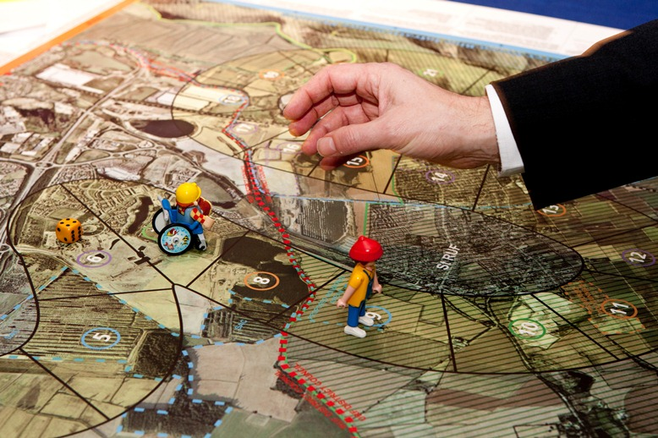
Lessons learnt and where next for Rufopoly
Blurp

Slide 2
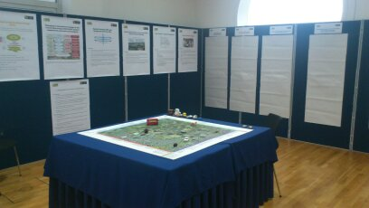
Overview
Strengths
Weaknesses
Opportunities
(and boundaries)
Possibilities for future development
(stimulus for discussion rather than set list!)

Slide 3
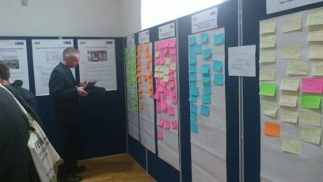
Key Strengths 1/3
Physical game, realistic range of relevant (to most) spatial planning challenges
Group aspect – forum for open discussion
Safe hypothetical space: engaging, not threatening

Slide 4
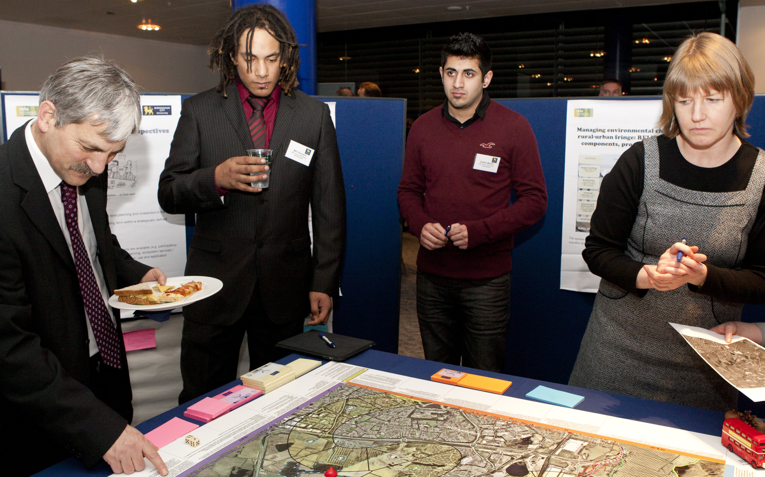
“It creates a positive atmosphere for
good discussion and dialogue.”
“The complexity of the landscape is not constructed (so people come to realize how messy the urban fringe is), and yet it is an anonymous place which opens up for a more generous debate on general principles.”
“… an exercise that requires [players] to think from an interdisciplinary and less parochial perspective.”

Slide 5
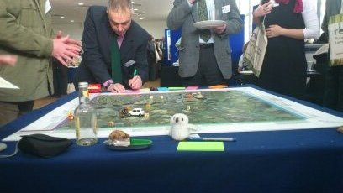
Key Strengths 2/3
Think outside usual ‘box’ - new challenges, different thoughts and new perspectives
Visioning – reflection
Easy and educational; helps develop skills e.g. discussion, conflict management, justifying opinions
“Rufopoly could definitely be used in teaching situations to highlight and discuss some problems in relation to planning and decision making. - A fun way to get an understanding of and discussing processes.”

Slide 6
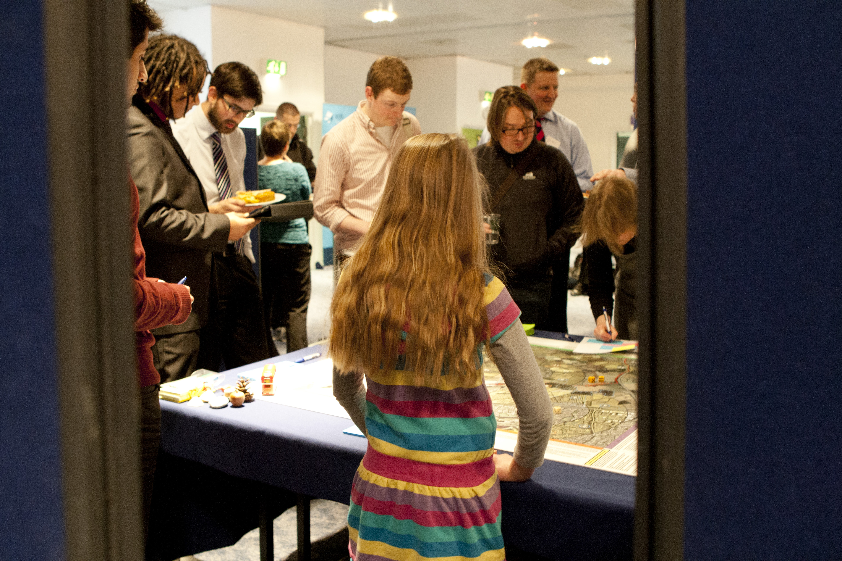
“While playing a game people are
open to trying out different ways of thinking. It gets them out of their normal working mind set and allows them safe space to experiment.”
“… it was interesting, the negotiation, different thoughts and backgrounds came to the fore there.”
“My decisions are all over the place. Pretty inconsistent for a councillor!”

Slide 7
Key Strengths 3/3
Flexible and adaptable
  The rules
  The degree of group element
  The adopted roles
  Time spend playing
  Questions and board
Different and fun
Facilitated [Also a weakness!]

Slide 8
Weaknesses 1/2
Game to what end – purpose?!
  Process (no mission, lacks knock-on effects)
  End product / outcome?
Lack of accountability. What about equity?
Lack of strategic planning questions
Limited visual horizon and context
Lack of political context – power relations

Slide 9
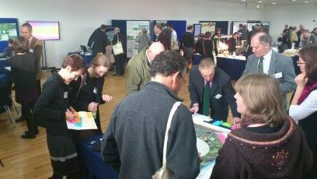
“It was not too clear if the game was played in order to come up with new strategies or just highlighting and discussing different questions in a group.”
“It lacks elements of surprise, change, excitement and maybe competing.”
“Questions weren’t often relevant to the ones we have to deal with.”

Slide 10
Weaknesses 2/2
Cross-cutting themes currently weak
Long and complicated questions; limited
Lack of capturing player’s view at outset
Facilitation and notation
“Writing down opinions and answers took time and slowed down the dynamic of the game.”

Slide 11
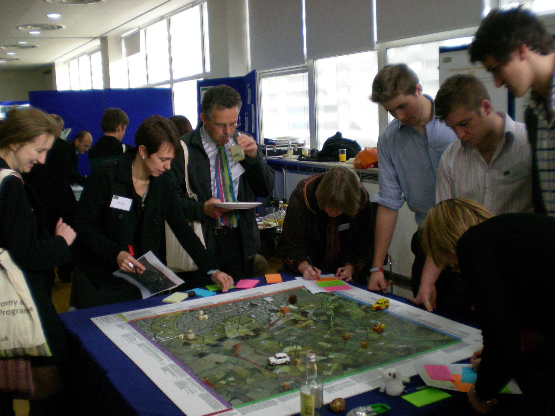
“… in the Swedish version, we have reduced
the information to a minimum. Also, we have removed the four themes (long-termism etc.) in order to make the game easier to grasp.”
“The questions were in some cases complicated and related to complicated situations that were sometimes unknown to the players.”
“The only limitation is that it needs to be facilitated by an expert and can only be done in a physical form, which limits the extent to which it can be played.”

Slide 12
Opportunities
Adaptable (e.g. Plainsopoly, SDNP Rufopoly, Swedish Rufopoly) - how can this be made easier?
Wider range of questions?
Chance cards and elements of surprise?
Specific role play options?
Decision-making trail – accountability?
Location, location, location? Generic templates or add-your-own? Scales?

Slide 13
Bear in mind…
Limited time
Limited funding
Greatest impact / potential use
Accessibility
RELEVANT FOR YOU and colleagues…

Slide 14
Needs identified so far
Understand the implications of a decision or viewpoint
Consider issues across a variety of scales and not just one
Facilitate effective consideration of strategic planning issues
Engage with both usual and unusual suspects
Become part of deliberative process to inform policy processes and decision making
Provide enough good information and evidence for people to be confident to become engaged
Retain safe environment feel for more sensitive discussions to help overcome trust and language deficit issues from competing parties and the media
Notes:
To enable people to better understand the implications of a decision or viewpoint in terms of the direct and indirect impacts.
To enable people to engage on issues across a variety of scales and not just one; e.g. the sub regional.
To enable more effective consideration of strategic planning issues particularly with regard to local plan making and consultation.
To engage with both usual and unusual suspects.
To use engagement as a deliberative process rather than as a one off tick box and to use the results to inform policy processes and decision making.
To provide enough good information and evidence for people to be confident to become engaged.
To provide a safe environment for more sensitive discussions to help overcome trust and language deficit issues from competing parties and the media.

Slide 15
Possible routes 1/2
Partner / end-user specific
Web portal with game resources and support
‘Wicked’ issues and involving unusual suspects (discursive exploring and testing)

Slide 16
Possible routes 2/2
Downloadable game with option to design own questions and board
Winner incentive based on expert-informed reference cards
Any new suggestion(s)?

